Slide 1
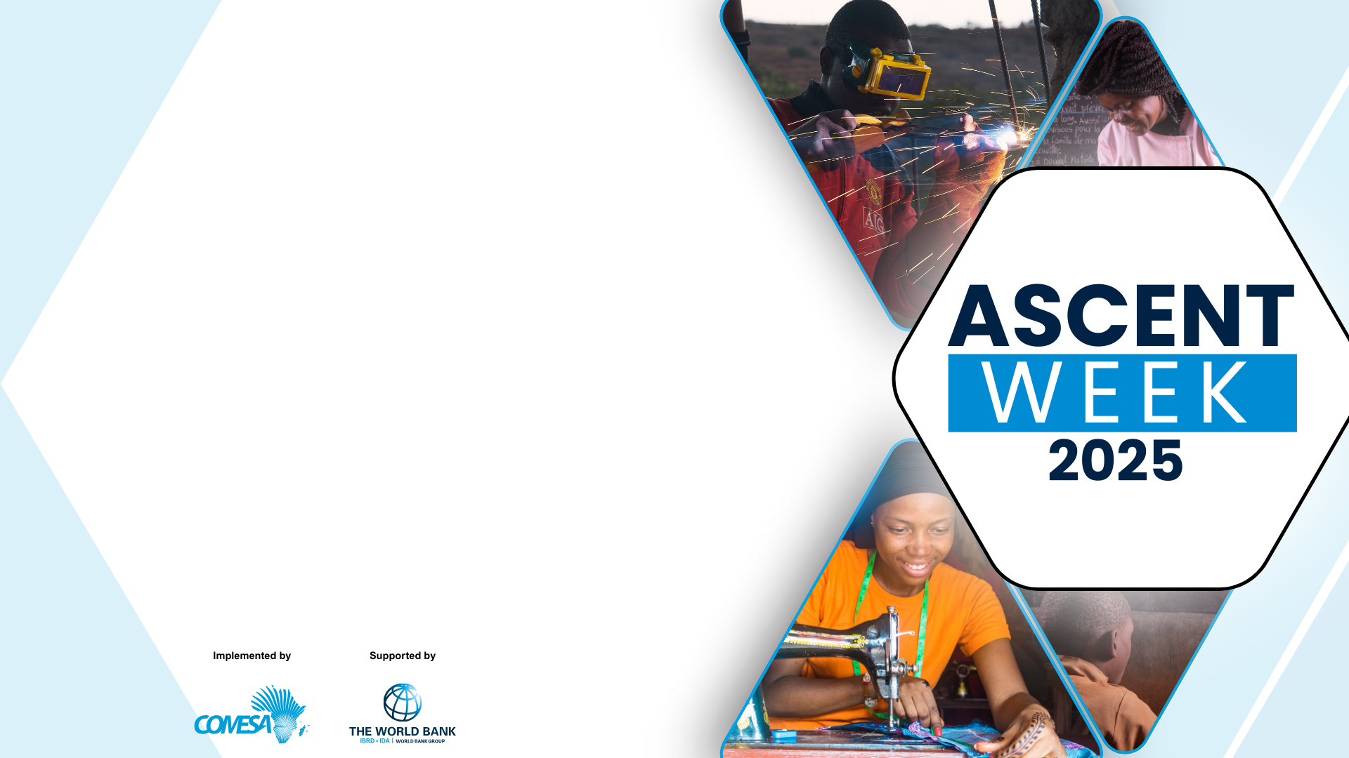



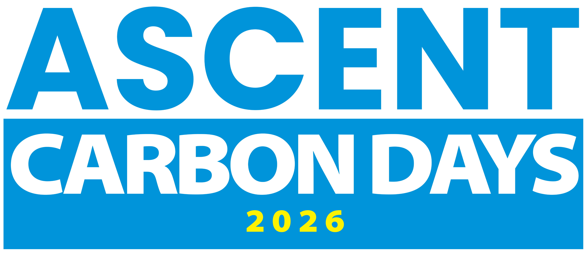
Achieving Results Faster, Together

Slide 2

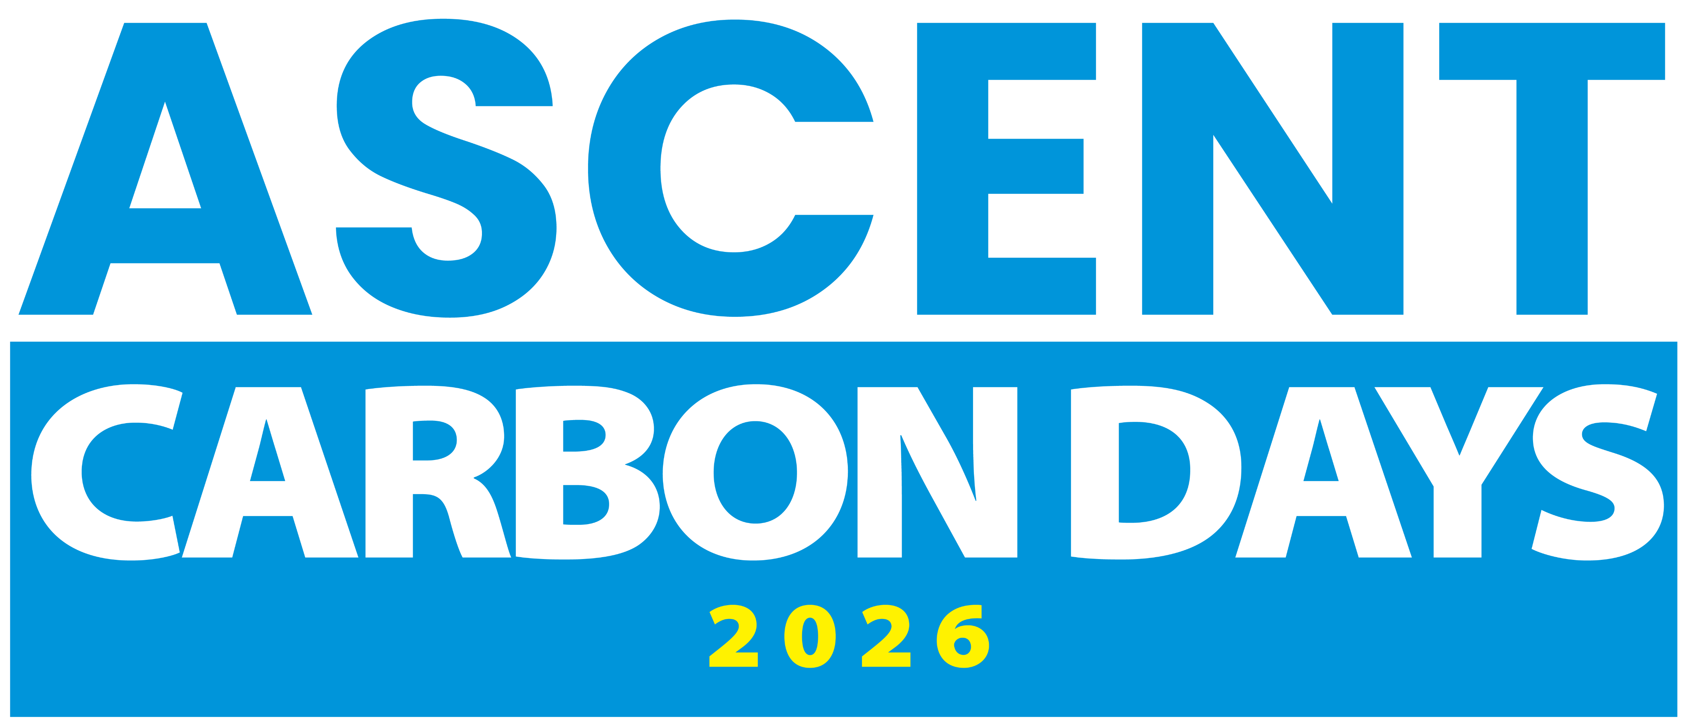
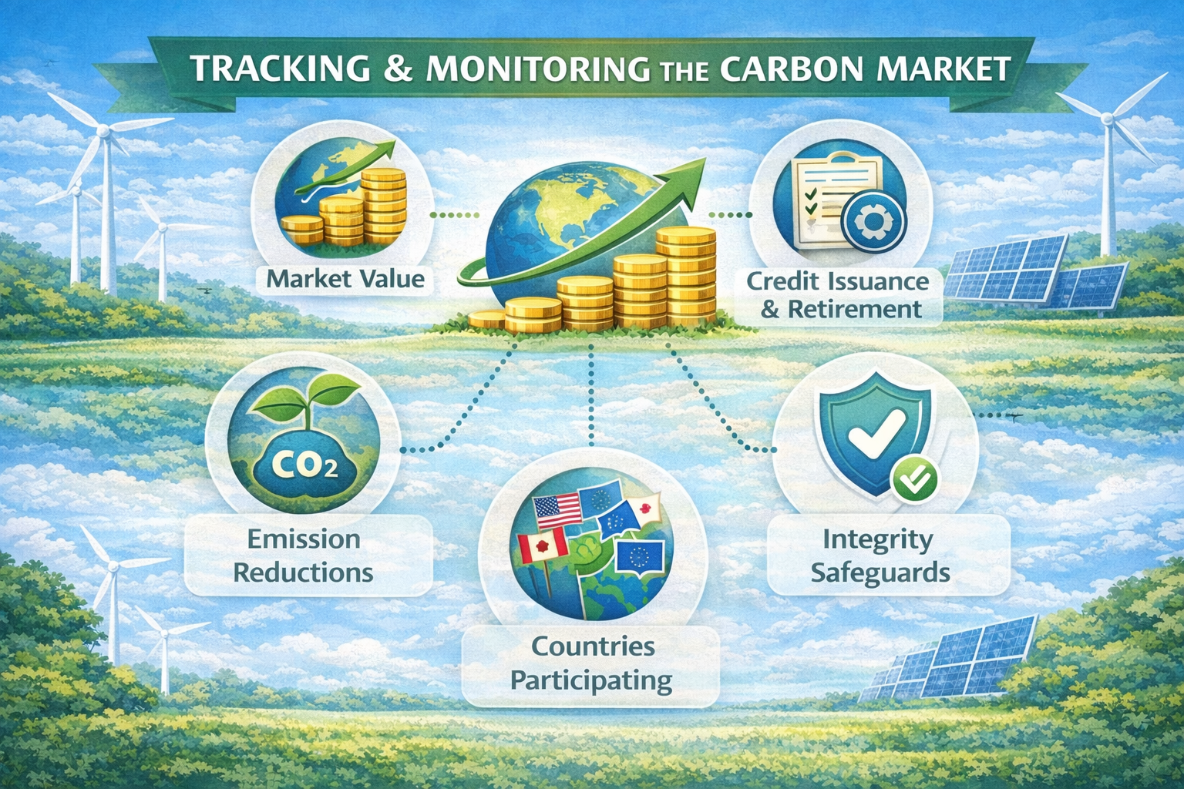
Session # E.1
State of International Carbon Markets
Achieving Results Faster, Together

Slide 3
Strengthen participants’ understanding of recent international carbon market developments and clarify the requirements and implications for effective participation in Article 6
Session Objective
Achieving Results Faster, Together

Slide 4
Has your country approved carbon projects in energy access/clean cooking sectors?
Are you familiar with the current pipeline of carbon projects and any recent or ongoing carbon credit transactions in your country (e.g., volumes, standards used, or buyers)?
Before We Start..
Achieving Results Faster, Together

Slide 5

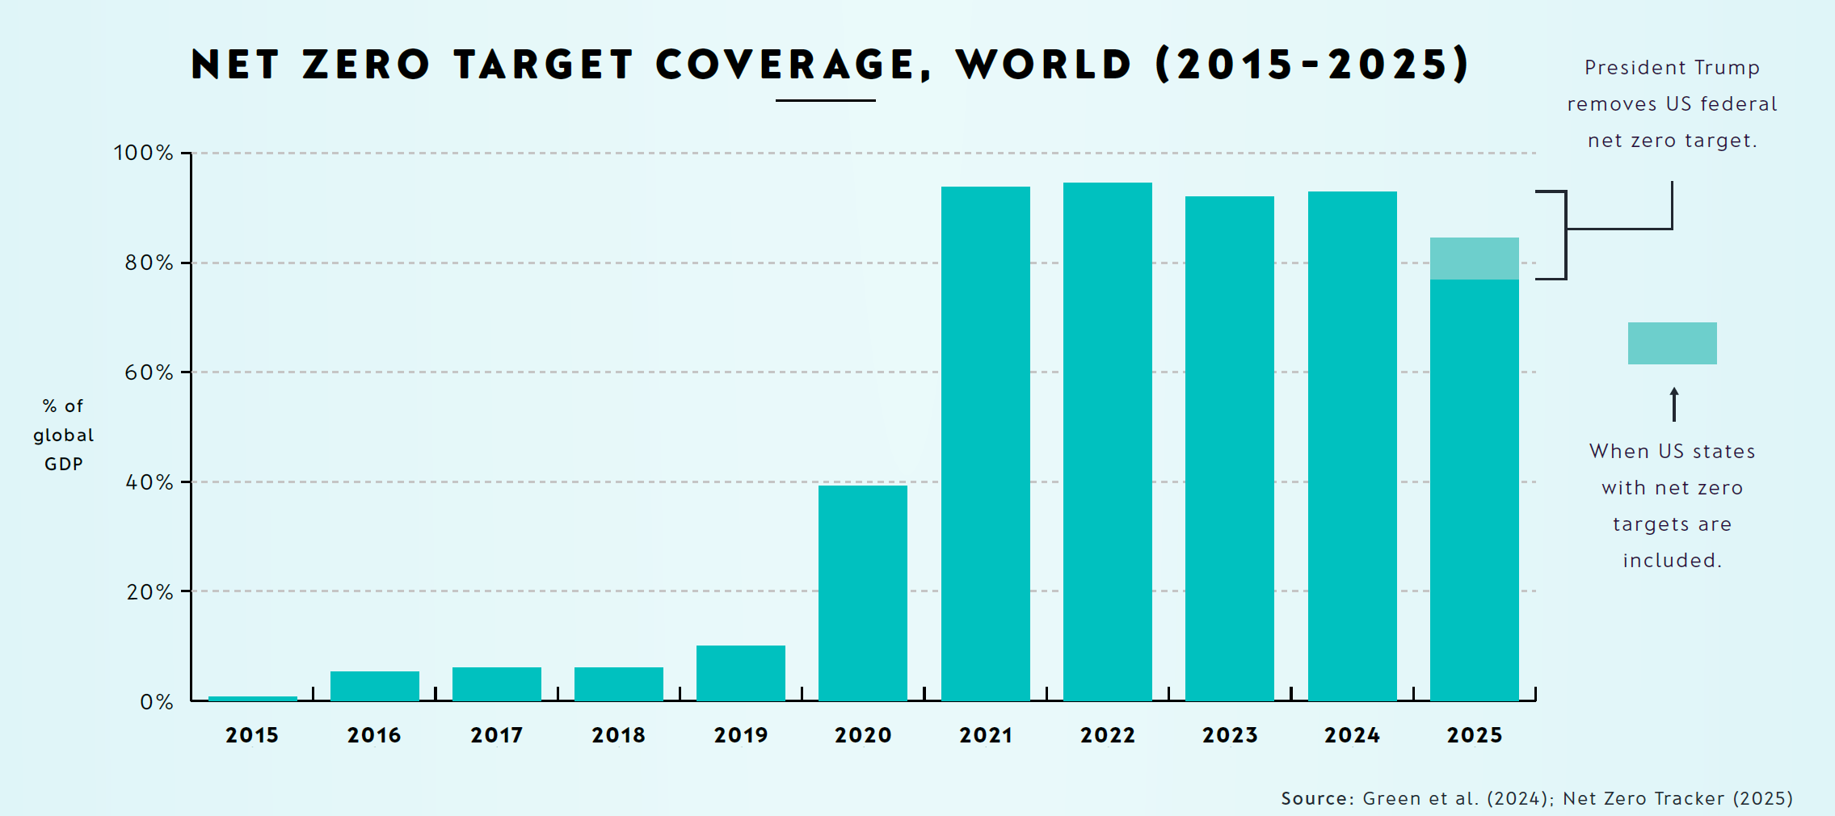
Net-Zero Has Become the Global Norm: 83% of the World Economy Covered
Achieving Results Faster, Together
Source: MSCI

Slide 6
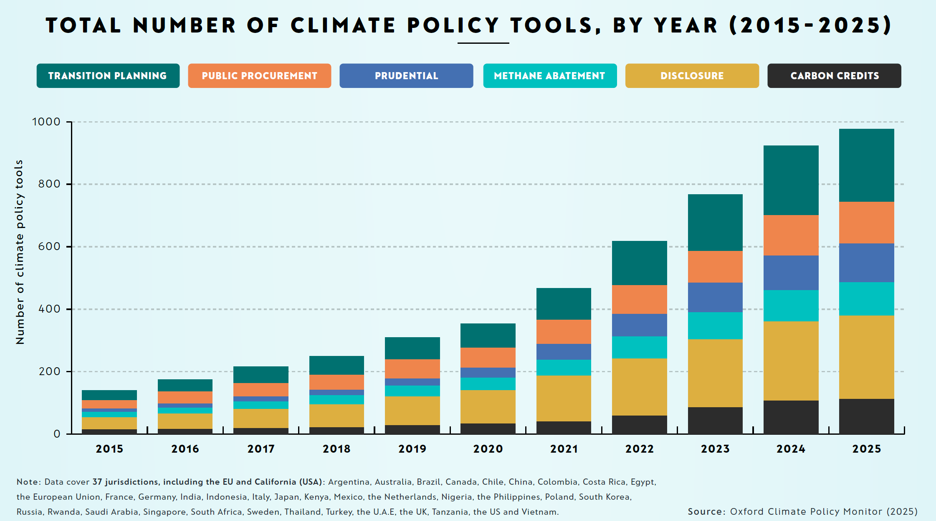
Share of Climate Policies that Support Carbon Credits Continue to Increase
Achieving Results Faster, Together

Slide 7
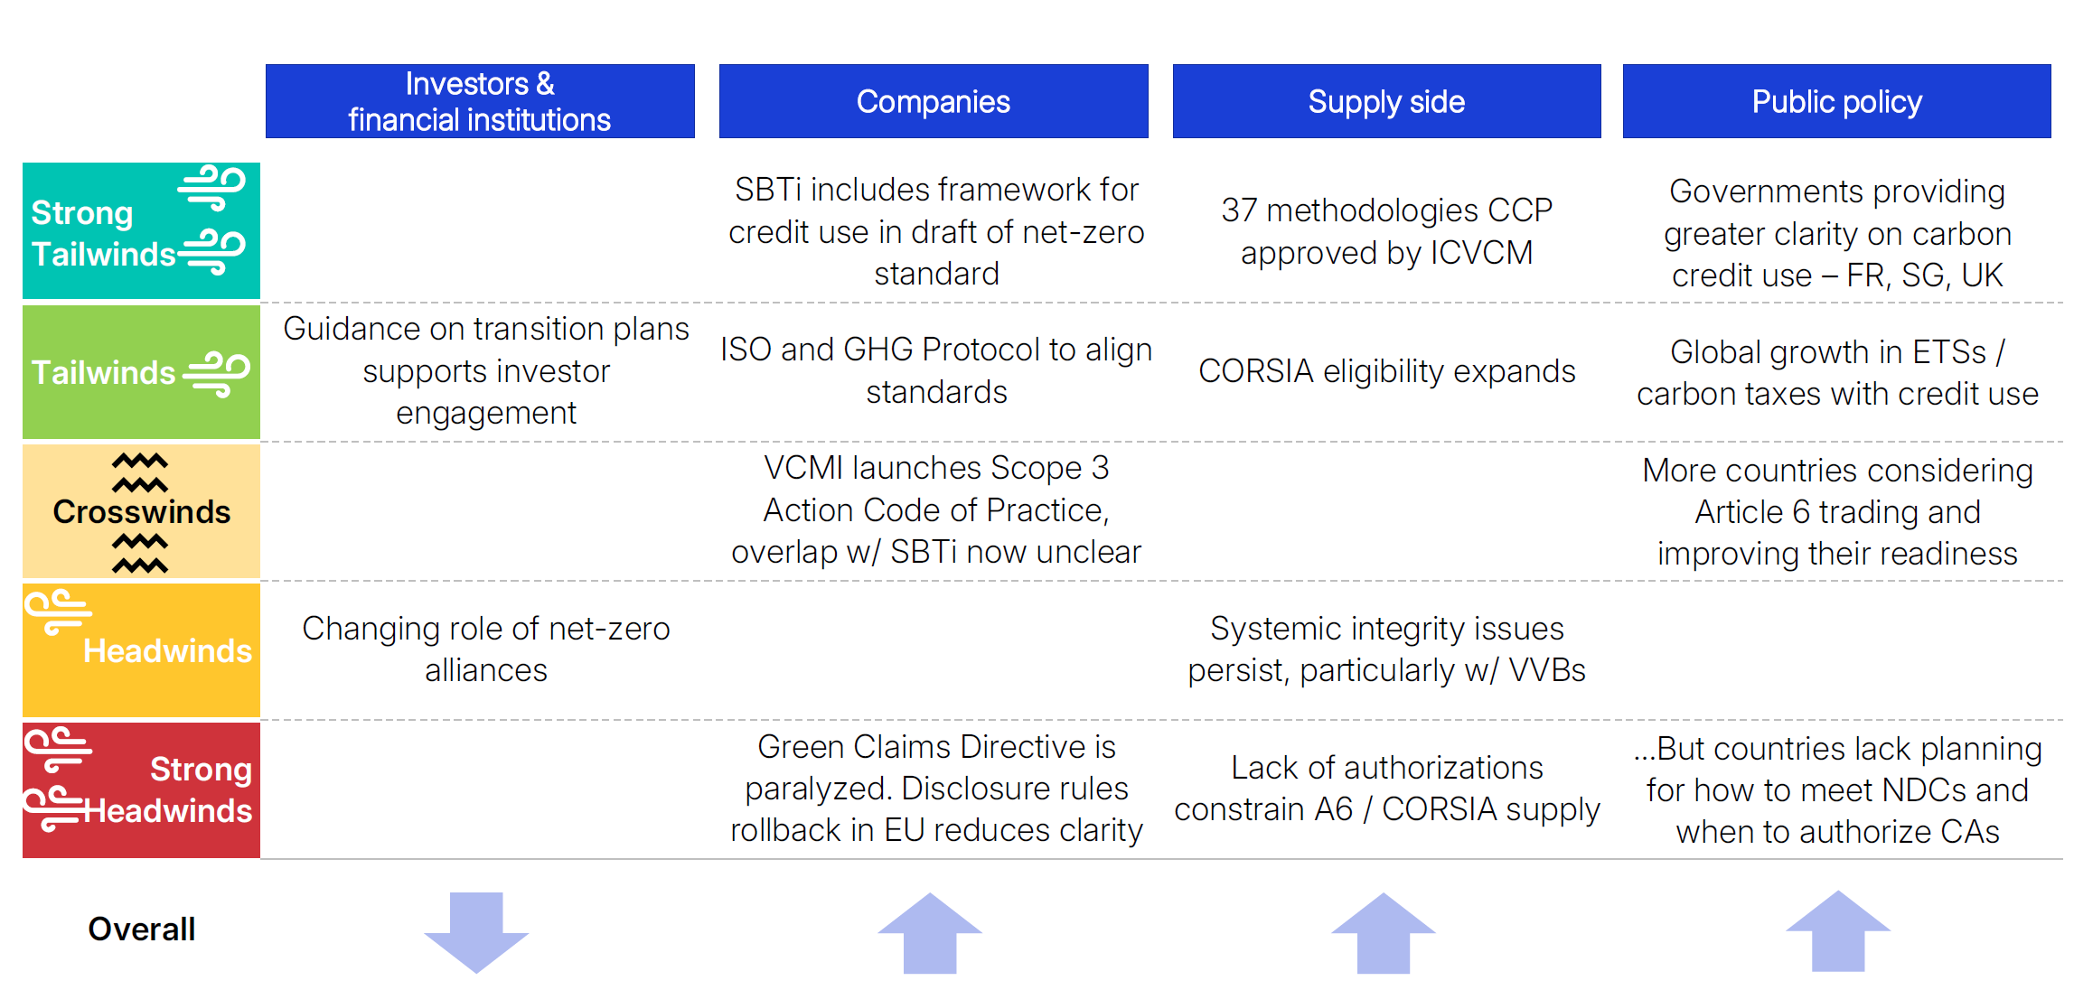
2025 Policy Developments
Achieving Results Faster, Together
Source: MSCI

Slide 8
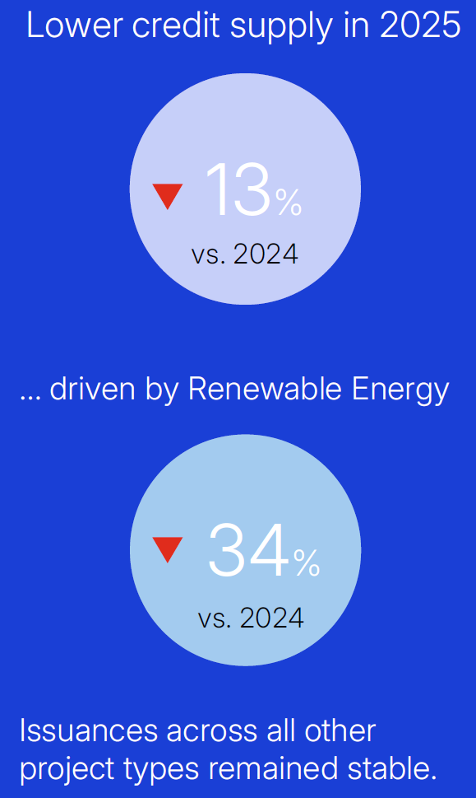
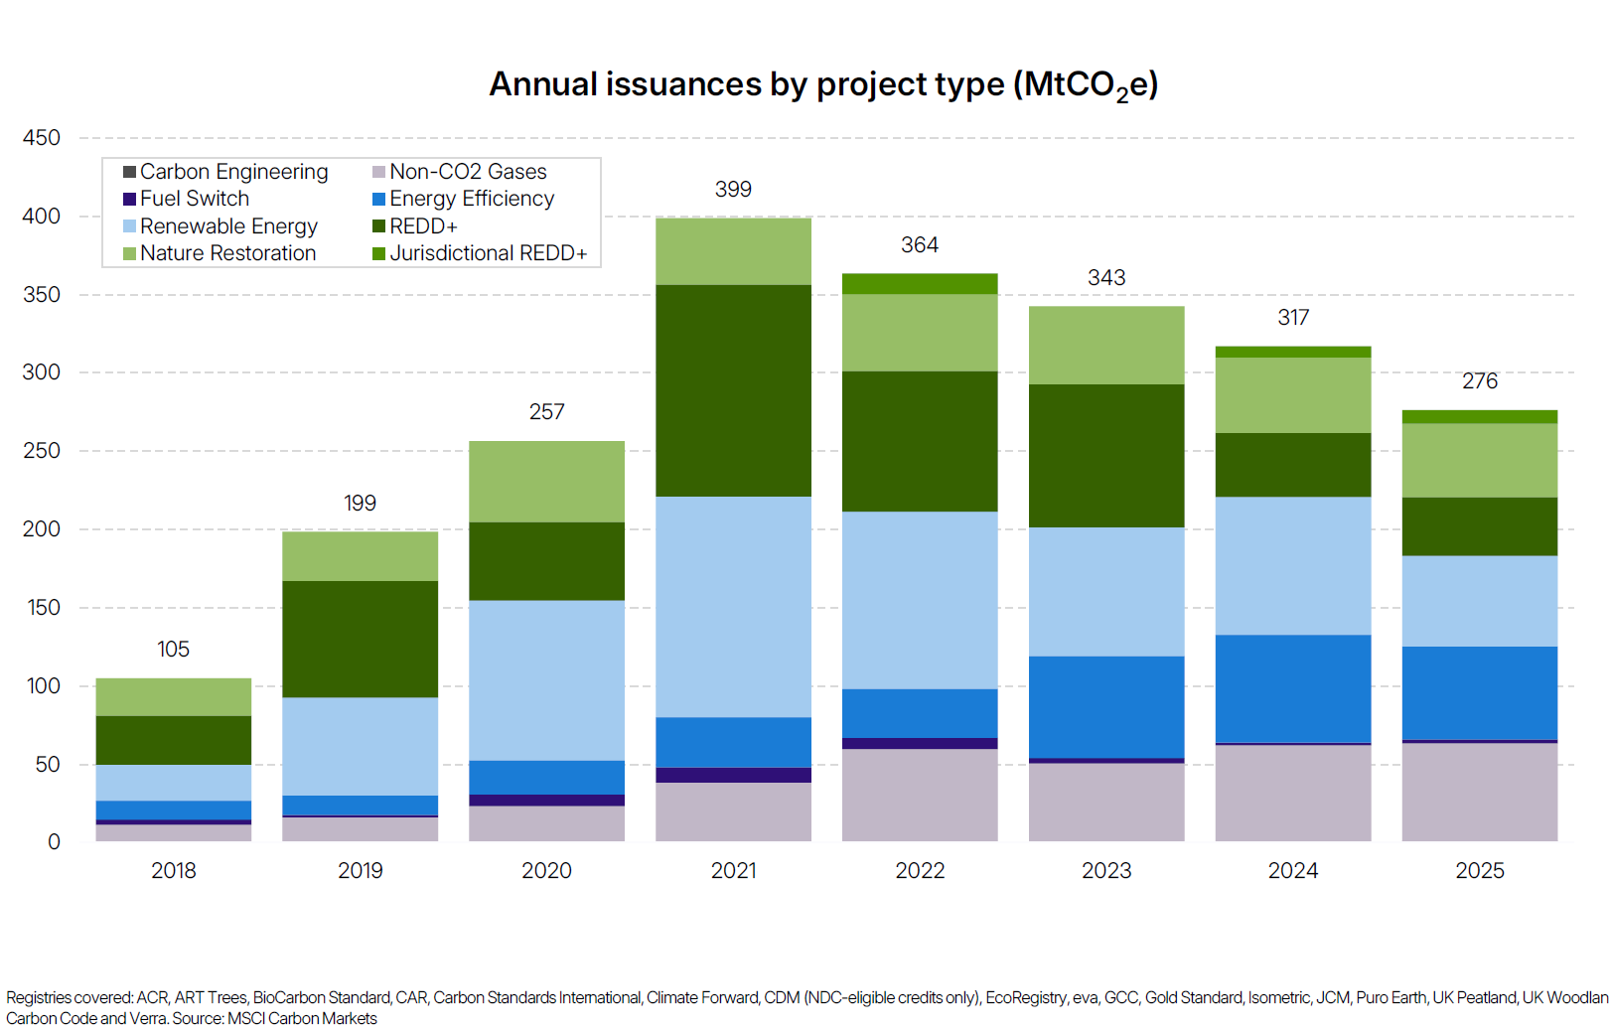
Supply of Carbon Credits Continued to Tighten
Achieving Results Faster, Together
Source: MSCI

Slide 9
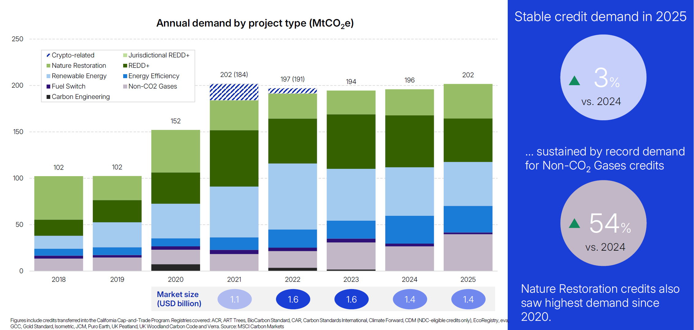
Credit Demand Matches Previous Years
Achieving Results Faster, Together
Source: MSCI

Slide 10
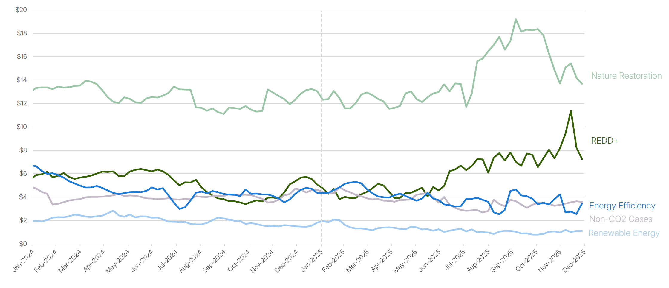
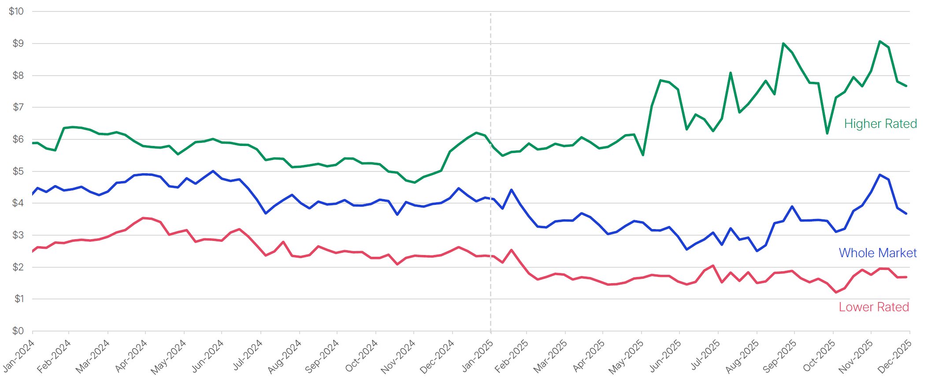
Continued Pressure on Credit Prices, with High Rating Credits Showing Uptick
Achieving Results Faster, Together
Source: MSCI

Slide 11
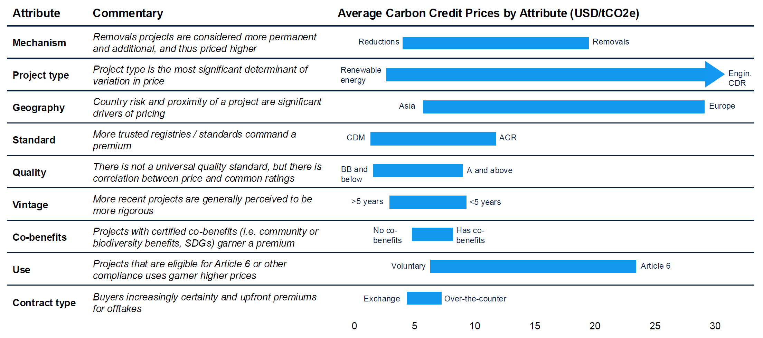
Credit Prices are Influenced by Several Attributes
Achieving Results Faster, Together
Source: MSCI

Slide 12

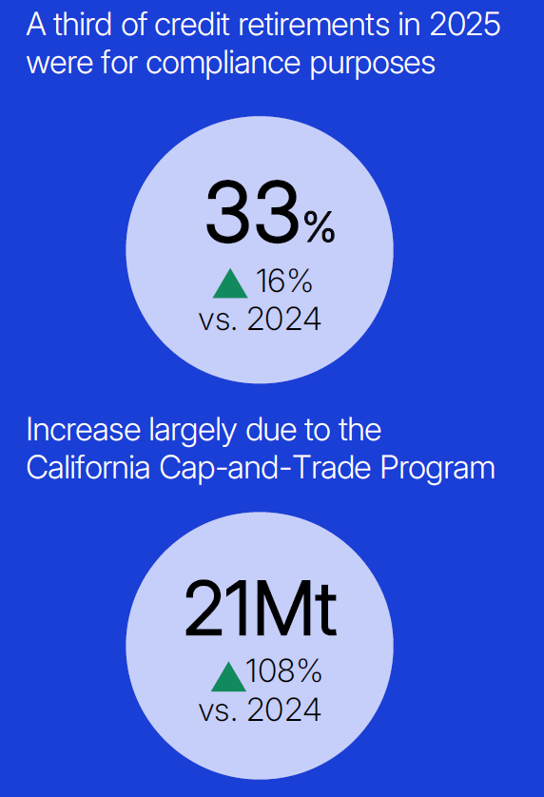
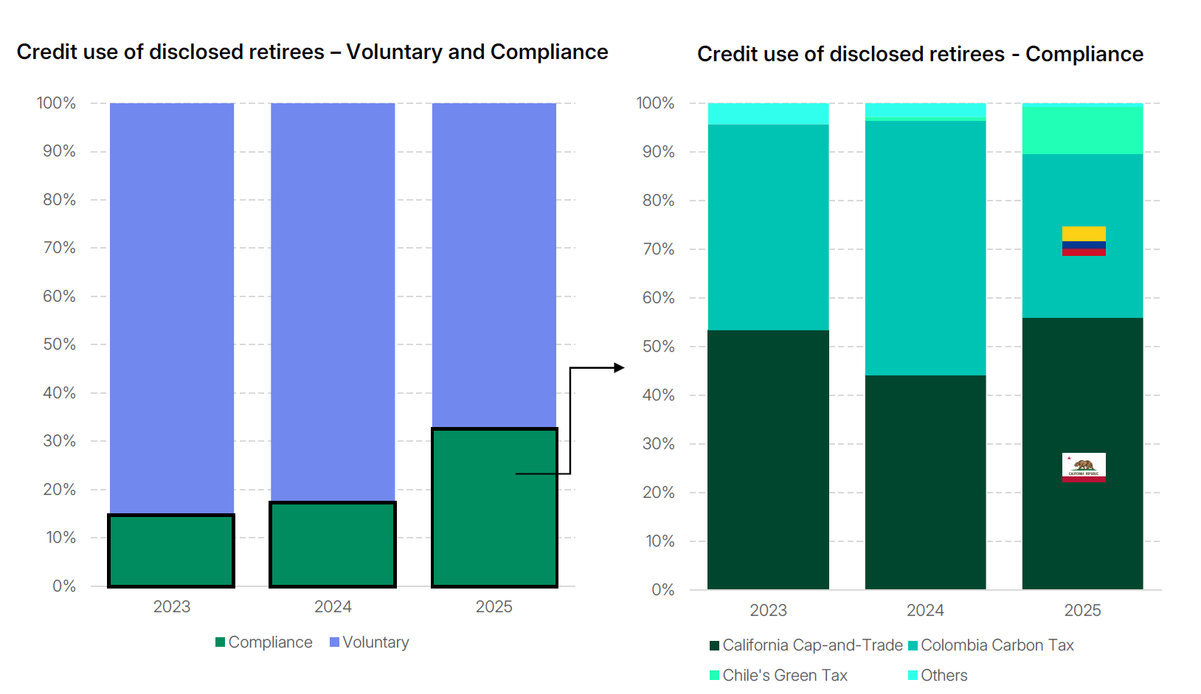
Increasing Use for Compliance Purposes Continued
Achieving Results Faster, Together
Source: MSCI

Slide 13
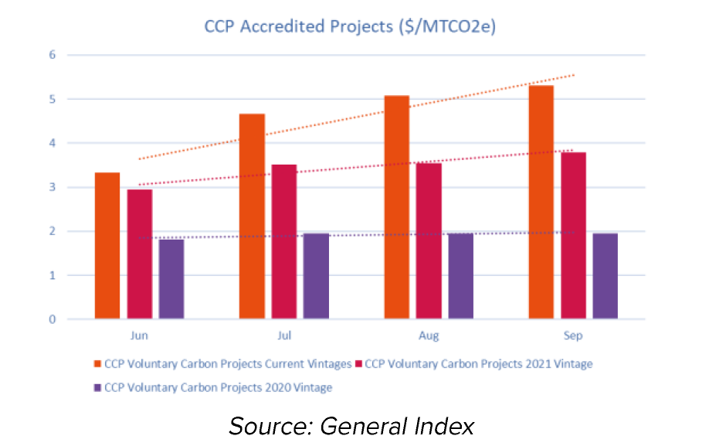
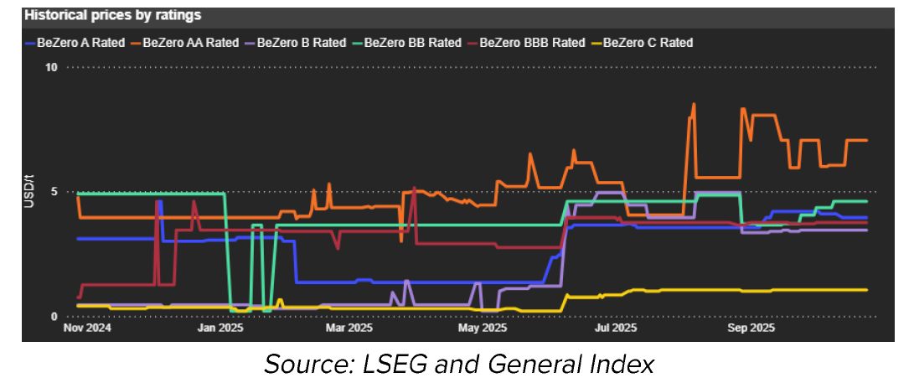
Regulatory frameworks continue to expand, overlapping with voluntary markets and blurring boundaries
New certification schemes and ratings are setting common quality benchmarks that are transforming the market.
  The Integrity Council’s VCM CCP labelled credits are increasingly becoming recognized as upholding standards of excellence
  Higher rated credits (e.g., by Sylvera, BeZero) are seeing higher prices, highlighting the financial value of credibility.
Article 6 authorized credits also compete with VCM units, with future demand determining which credits command a premium.
Harmonizing methodologies, quality labels, data standardization are accelerating the alignment between voluntary and compliance markets
  Regulatory & policy developments and market infrastructure shape the pace of convergence
Achieving Results Faster, Together
Source: MSCI

Slide 14
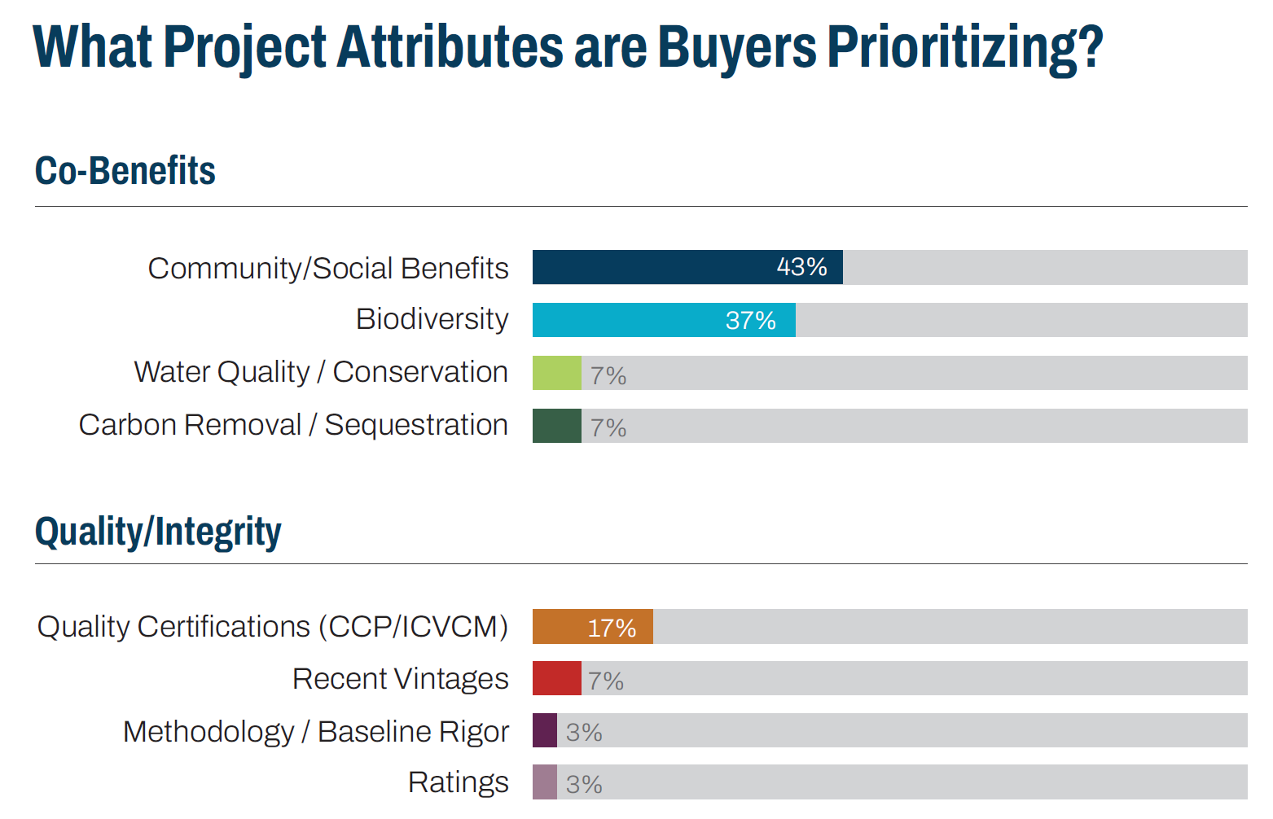
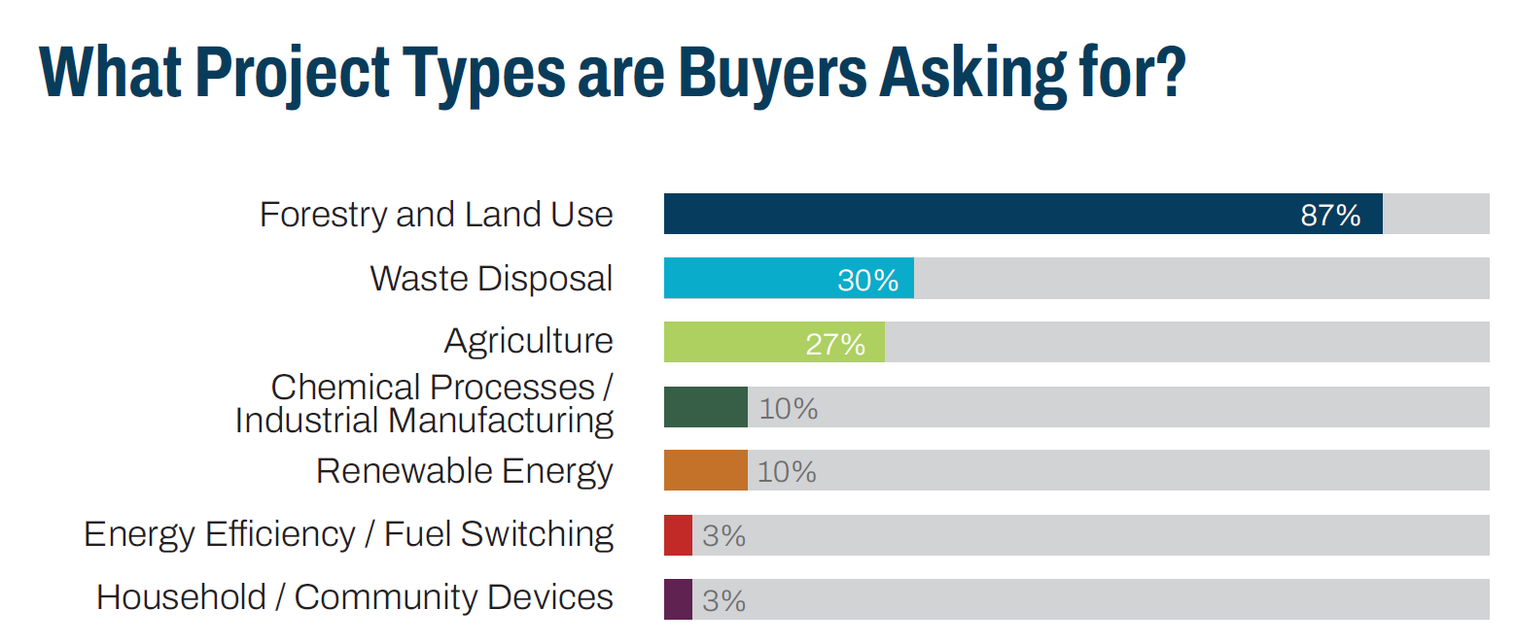
Buyer Preferences are Getting Consolidated
Achieving Results Faster, Together
Source: Ecosystem Marketplace

Slide 15
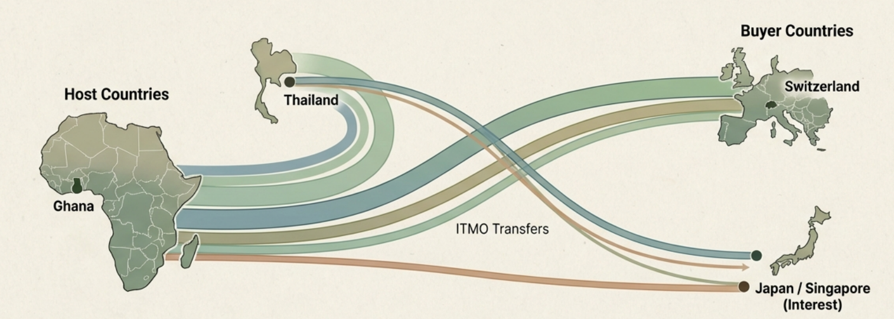
Article 6.2: The Sovereign Trading Era
Total Article 6.2 bilateral / cooperation agreement: globally | ~104
By Africa | 33
No. of Projects Identified | 23
African countries recorded as partners in agreements | 10 (Benin, Ethiopia, Gabon, Ghana, Kenya, Malawi, Rwanda, Senegal, Tanzania, Zambia)
African countries with Article 6.2 initial reports submitted to UNFCCC | 5 (Ghana, Guyana, Malawi, Rwanda, Zimbabwe)
Volume of Article 6.2 ITMO authorized from Africa | 5,946 (Ghana-Switzerland)
Achieving Results Faster, Together

Slide 16
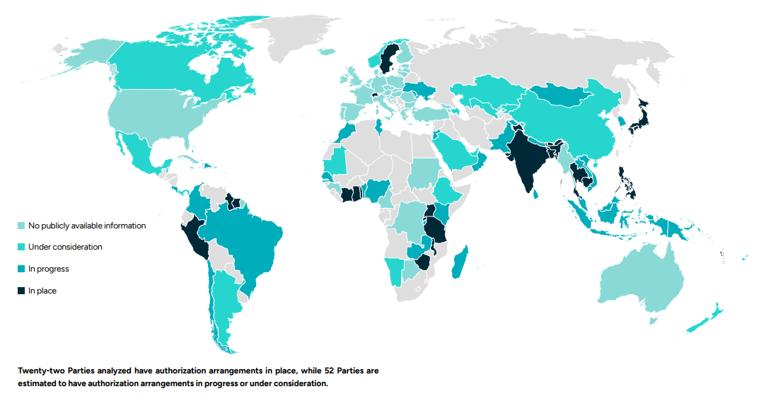
Many countries are in the process of putting authorization arrangements in place
Achieving Results Faster, Together
Source: Article 6 Implementation Status Report 2025

Slide 17
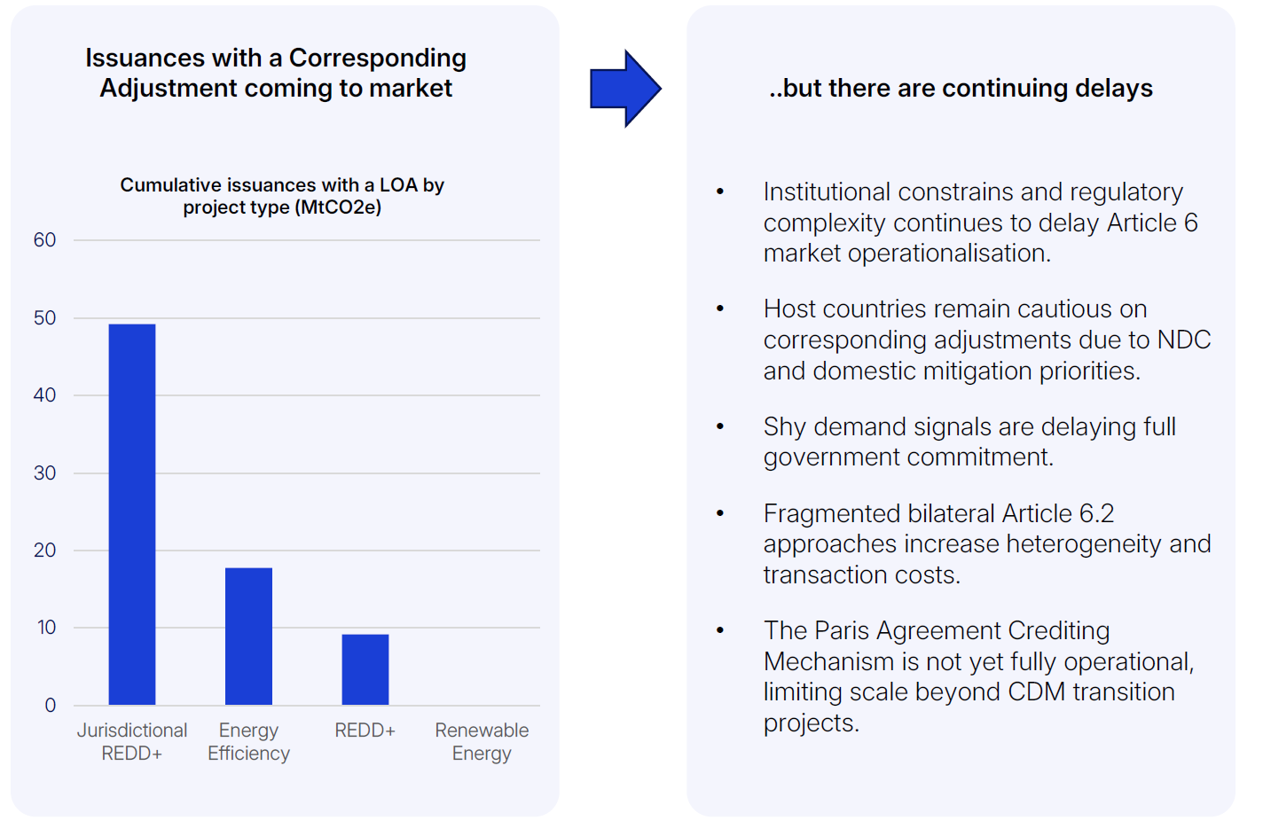
Regulatory Complexity is Slowing Down the Article 6 Momentum
Countries interest in participating Article 6.2 continued to increase
Regions | host
Africa | 33
Americas | 18
Asia | 44
Europe | 6
Oceania | 7
Total | 108
Achieving Results Faster, Together
Source: MSCI; UNEP Copenhagen Center

Slide 18
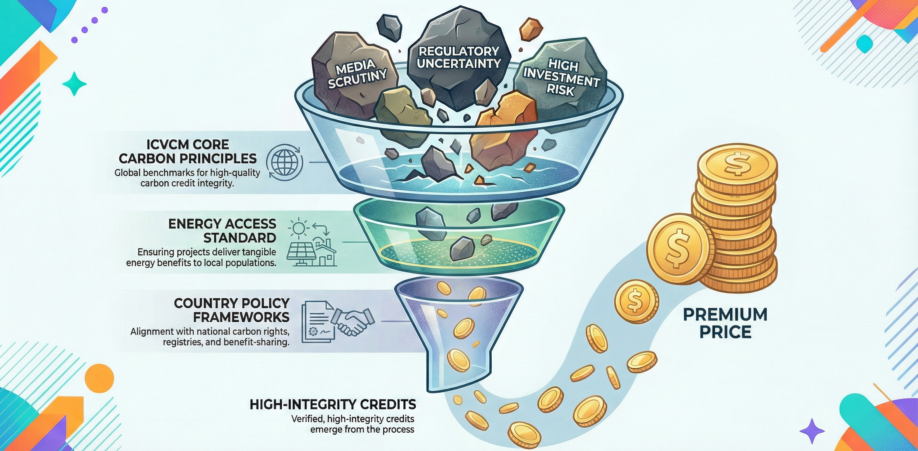
Building Trust and Credibility: The ASCENT Way
HIGH TRANSACTION COSTs
BUILD ON ASCENT DESIGN AND INFRA
Best practices for project design and implementation
Ensuring projects deliver credits aligned with A6.4 and utilizes dMRV
Achieving Results Faster, Together

Slide 19
Summary
Carbon Markets Are Entering a New Era of Integration and Scale
Article 6 Credits Are Central to Linking Global Carbon Markets
Technology and Digital Infrastructure Are Transforming Market Integrity
Voluntary Carbon Markets Are Resetting Around Quality and Integrity
Policy, Governance, and Harmonization Are Critical for Market Confidence
Achieving Results Faster, Together
Notes:
1. Carbon Markets Are Entering a New Era of Integration and Scale
Carbon markets have evolved from experimental policy tools to a backbone of global climate action, now covering nearly a quarter of global GHG emissions. The expansion of emissions trading systems (ETS) across regions, and the emergence of Article 6 mechanisms under the Paris Agreement, are driving a shift from fragmented systems to an integrated global architecture for decarbonization
2. Article 6 Credits Are Central to Linking Global Carbon Markets
Article 6 of the Paris Agreement provides the framework for international carbon cooperation, enabling the connection of markets and ensuring real, additional climate outcomes. The EU’s stance on Article 6 credits will shape the future of global carbon markets, with ongoing debates about their admissibility in compliance schemes and their potential to drive market expansion and convergence.
3. Technology and Digital Infrastructure Are Transforming Market Integrity
Digital tools—such as satellite imaging, AI-driven verification, and blockchain registries—are revolutionizing measurement, monitoring, and verification (MRV) in carbon markets. These innovations are enhancing accuracy, transparency, and interoperability, making markets more efficient and trustworthy at scale.
4. Voluntary Carbon Markets Are Resetting Around Quality and Integrity
The voluntary carbon market (VCM) is undergoing a major reset, with a strong shift toward high-quality, integrity-driven credits. New standards (ICVCM’s Core Carbon Principles, VCMI’s guidelines) and buyer preferences are raising the bar for project methodologies, price transparency, and market credibility. Demand for high-integrity credits is growing, and removals are set to overtake reductions by 2040.
5. Policy, Governance, and Harmonization Are Critical for Market Confidence
The success of carbon markets depends on clear, consistent policy frameworks, legal clarity on carbon credits, and harmonized accounting standards. Interoperability between voluntary and compliance markets, robust governance, and standardized data are essential for scaling markets and unlocking investment confidence

Slide 20

Thank you!
Achieving Results Faster, Together

Slide 21

Achieving Results Faster, Together

Slide 22
Achieving Results Faster, Together

