Slide 1

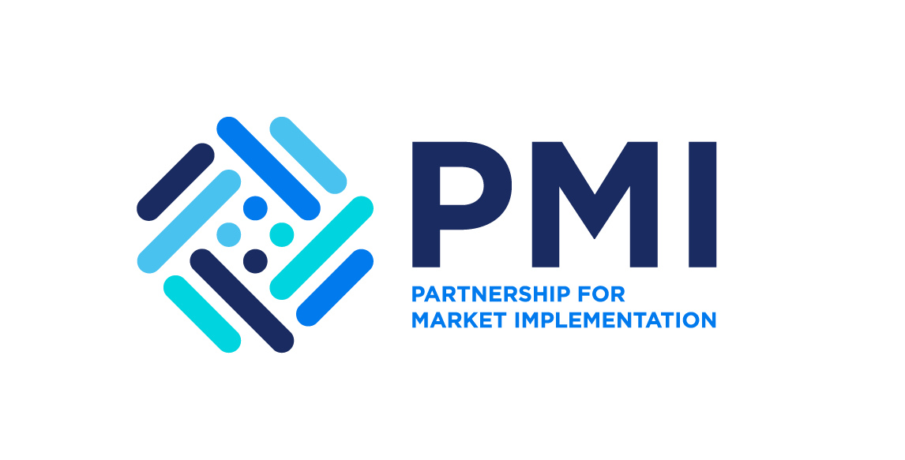



Achieving Results Faster, Together

Slide 2


Institutional Arrangements: From energy access project to generation of Carbon Credits
Session # C:
UNDERSTANDING THE INSTITUTIONAL ARRANGEMENTS FOR DECISION MAKING
Achieving Results Faster, Together

Slide 3
Understand different decision-making and oversight needs within the ecosystem.
Mapping of implementation arrangements for each country’s ASCENT Energy Access project to support the decision making and oversight.
Mapping of additional steps to generate carbon credits and identification of entities/institutions to engage in the process.
Session Objectives
Achieving Results Faster, Together

Slide 4
Which institutions in your country are involved in the implementation of the ASCENT Energy Access program?
Has your country outlined a process for the approval of carbon projects and generation of carbon credits?
Which institutions/entities in your country need to be involved to generate carbon credits?
Which institutions/entities in your country need to be involved to discuss/negotiate a carbon transaction?
Before We Start..
Achieving Results Faster, Together

Slide 5

Why Institutional & Governance Arrangements Matter?
Institutional and governance frameworks are foundations for effective, high-integrity carbon market participation.
They define who decides what, how, and when — critical for policy coherence, credit authorization, transparency, and risk management.
Carbon markets are not just technical projects — they require strategic country systems.
Governance enables credibility and investor confidence.
Robust systems help align carbon market actions with national climate and development goals.
Achieving Results Faster, Together

Slide 6
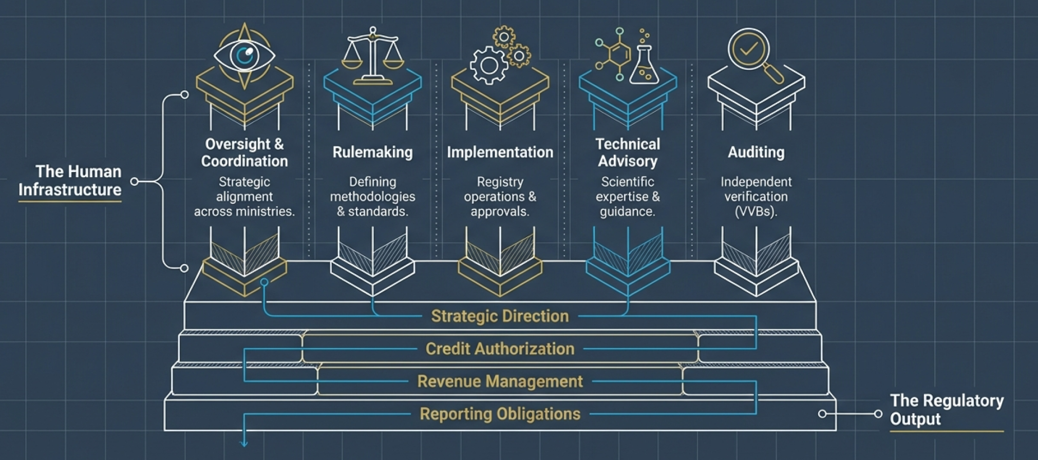
What Institutional & Governance Arrangements Look Like?
Achieving Results Faster, Together

Slide 7

Core Functions
Oversight & Strategic Direction
  Central body or committee to guide policy and strategy for carbon market engagement.
  Defines priorities (e.g., sectors, domestic vs. international credits).
  Coordinates cross-ministerial input (Finance, Environment, Energy).
Rulemaking & Regulation
  Establish laws/regs governing carbon market participation, including:
  • Approval processes for projects
  • Requirements to generate and trade credits
  • Compliance with international frameworks like Article 6 and voluntary market standards.
Implementation & Enforcement
  Entities responsible for operationalizing the regime: issuing authorizations, tracking compliance, managing MRV systems, etc.
  Clear mandates reduce duplication and institutional conflict.
Achieving Results Faster, Together

Slide 8
What Countries Should Consider
A. Decision-Making Bodies
  National steering committees or inter-ministerial councils to shepherd carbon market strategy.
  Defined roles and protocols for decision-making.
B. Authorization & Participation Framework
  Systems to approve or reject carbon crediting activities and ensure consistency with national priorities.
  Country letter of approval/authorization (LoA) processes; pricing frameworks; benefit sharing.
C. Monitoring, Reporting & Verification (MRV) & Data Systems
  National MRV protocols and digital infrastructure — ensure data integrity.
  Registry linkage and double-counting avoidance mechanisms.
D. Legal & Regulatory Clarity
  Enable enforceable contracts, protect rights, and provide certainty to buyers and developers.
Achieving Results Faster, Together

Slide 9
Lessons Learned
1. Institutional Commitment is Key
  Countries with early political backing (e.g., dedicated climate committees) progress faster in market readiness.
2. Clear Roles & Accountability Reduce Bottlenecks
  Overlapping mandates among ministries can slow approval and weaken confidence.
  Clarifying functions — e.g., which agency issues authorisations — aids efficiency.
3. Consistent Policy Signals Matter
  Stable policy and legal frameworks attract more private finance.
  Frequent changes or ambiguity undermine investor trust.
4. MRV Systems are Foundational
  Digital and interoperable systems (national/registry) help countries track and report emissions reductions transparently.
5. Social & Environmental Safeguards Increase Integrity
  Including stakeholders, Indigenous peoples, and civil society in governance builds trust and alignment with sustainable development goals.
Achieving Results Faster, Together

Slide 10
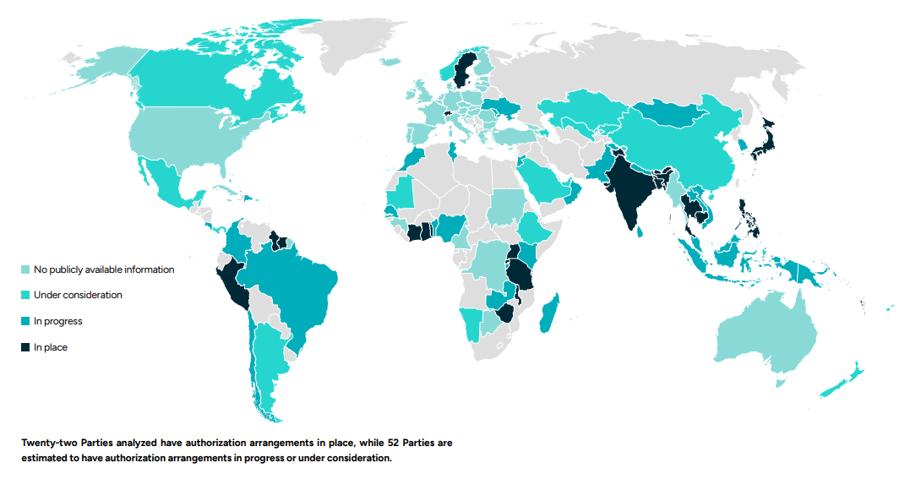
Many countries are in the process of putting authorization arrangements in place
Achieving Results Faster, Together
Source: Article 6 Implementation Status Report 2025

Slide 11
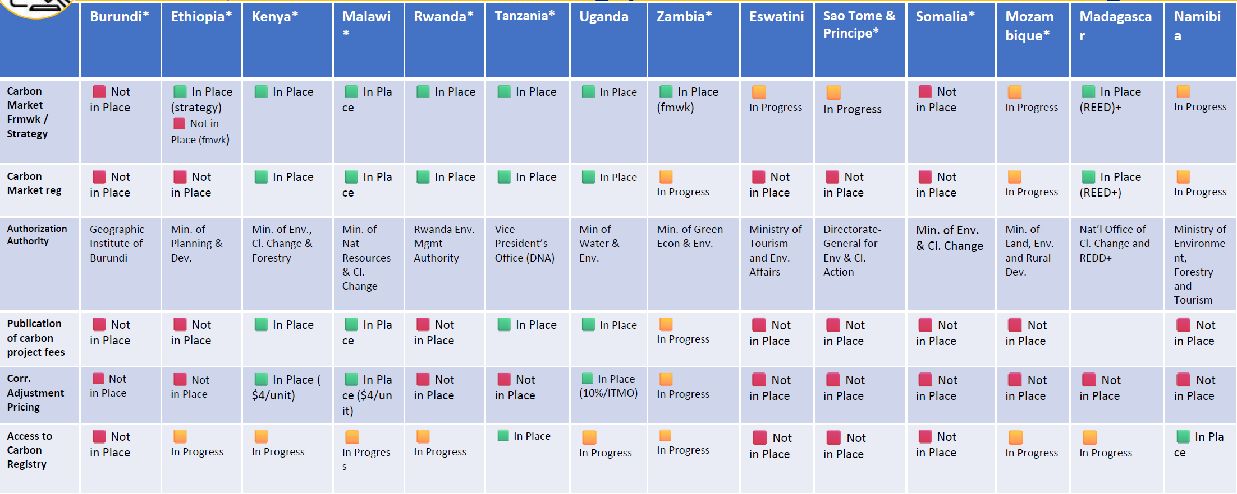
Many ASCENT countries have identified authorization bodies
Achieving Results Faster, Together
*Approved ASCENT operation

Slide 12
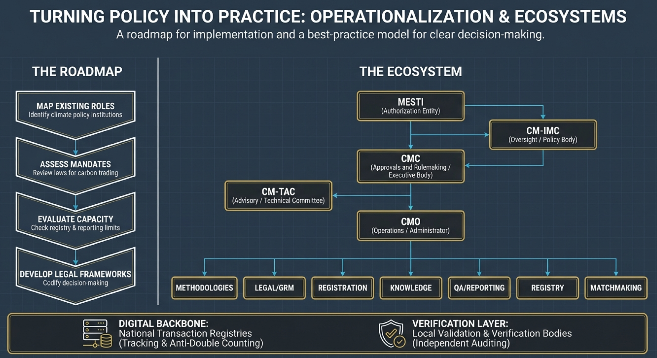
CMC: Carbon Market Committee
CM-IMC: Carbon Market Inter Ministerial Committee
CMO: Carbon Market Office
CM-TAC: Carbon Market Technical Advisory Committee
MoEnv: Ministry of Environment
MoEnv
Achieving Results Faster, Together

Slide 13
Discussion
What steps are you taking to establish the institutional arrangements?
What challenges are you facing with operationalization of the institutional arrangements?
What are the gaps you identified with the institutional arrangements in your country?
Achieving Results Faster, Together

Slide 14

Thank you!
Achieving Results Faster, Together

Slide 15
Achieving Results Faster, Together

