Slide 1

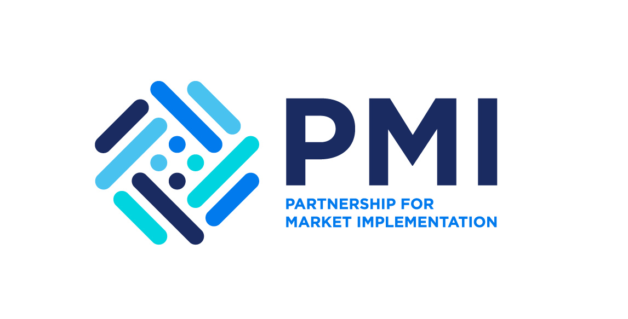



Achieving Results Faster, Together

Slide 2


The Big Picture:
From Project to Carbon Credits
UNDERSTANDING THE CARBON MARKET ECOSYSTEM
Achieving Results Faster, Together

Slide 3

Session Objectives
Introduce the full carbon market ecosystem relevant to ASCENT
Clarify key actors, documents needed, and decisions to make
Show how ASCENT projects move from implementation to credit issuance and use
Set the foundation for deeper dives in upcoming sessions
Achieving Results Faster, Together

Slide 4
How familiar are you with different components of the program cycle to generate and transact carbon credits?
Does your country have any restrictions with recognizing the Carbon Standard for Energy Access being developed by the Global Carbon Council (https://globalcarboncouncil.com/ )?
Does your country have an official list of eligible independent carbon crediting standard bodies? If so, is the GCC eligible under the national carbon crediting framework?
Before we start...
Achieving Results Faster, Together

Slide 5

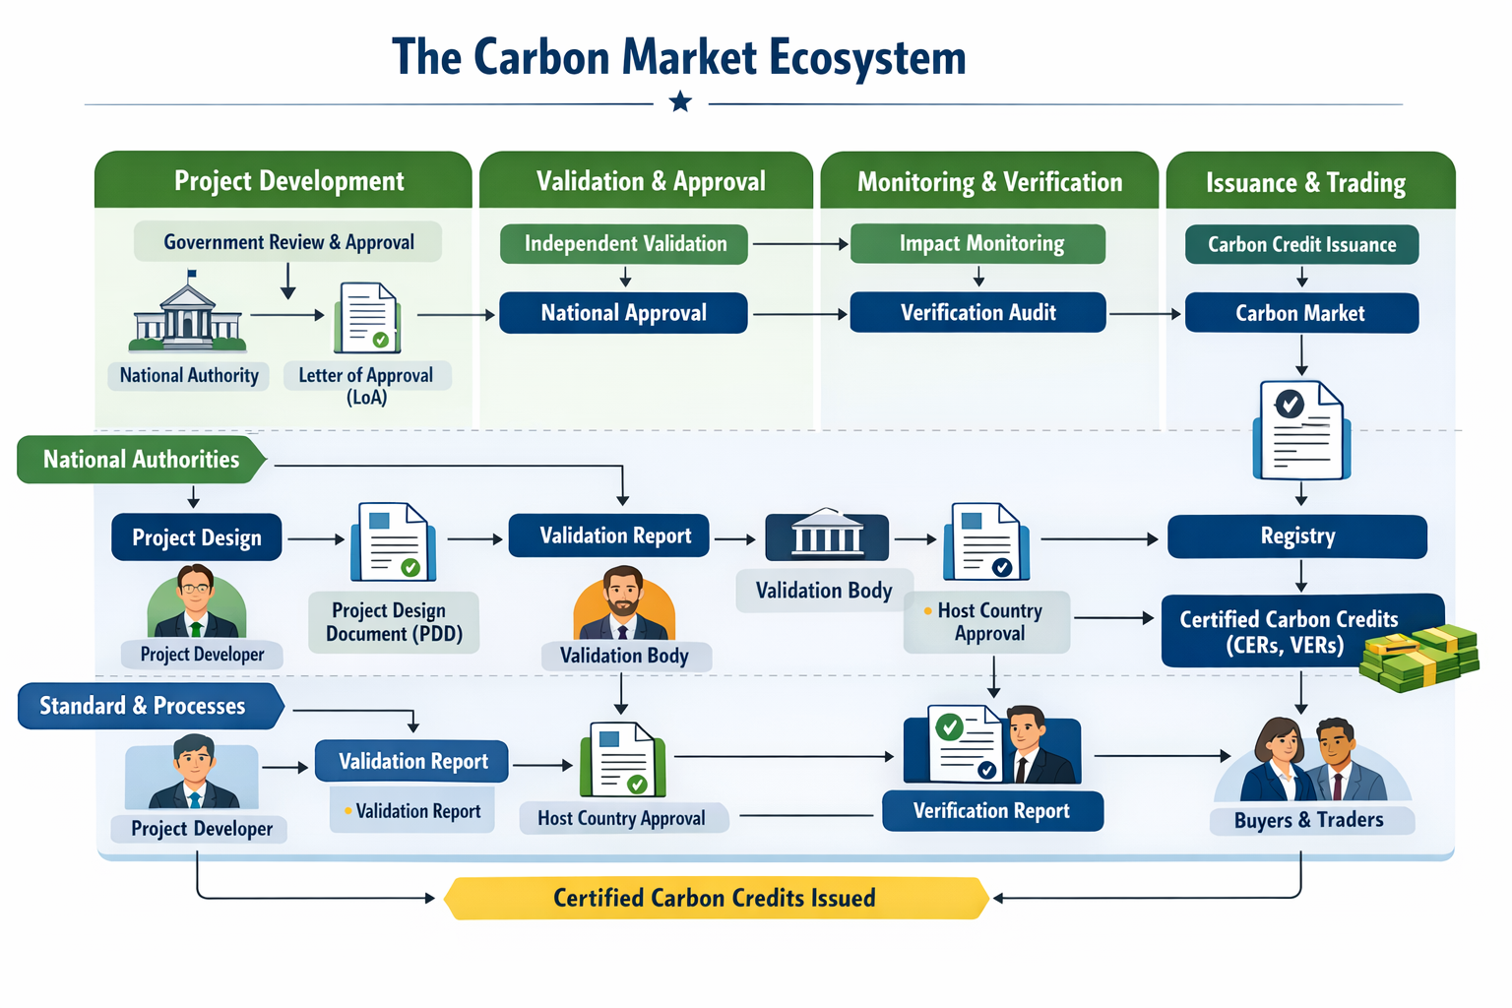
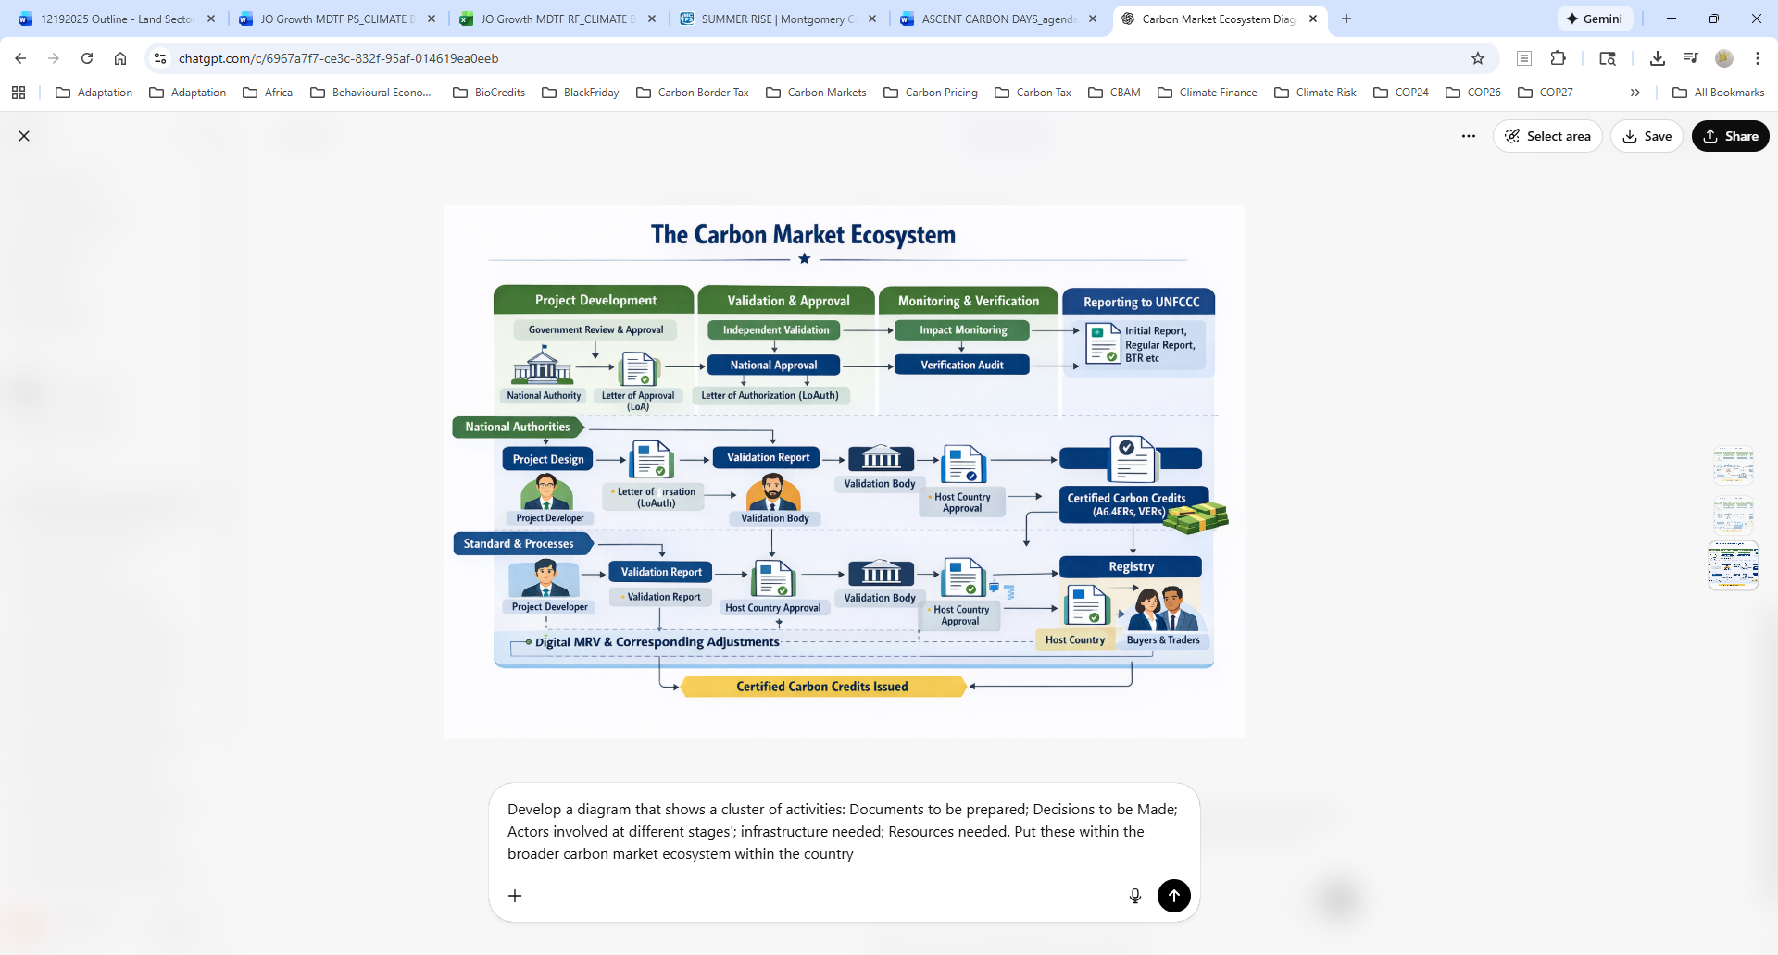
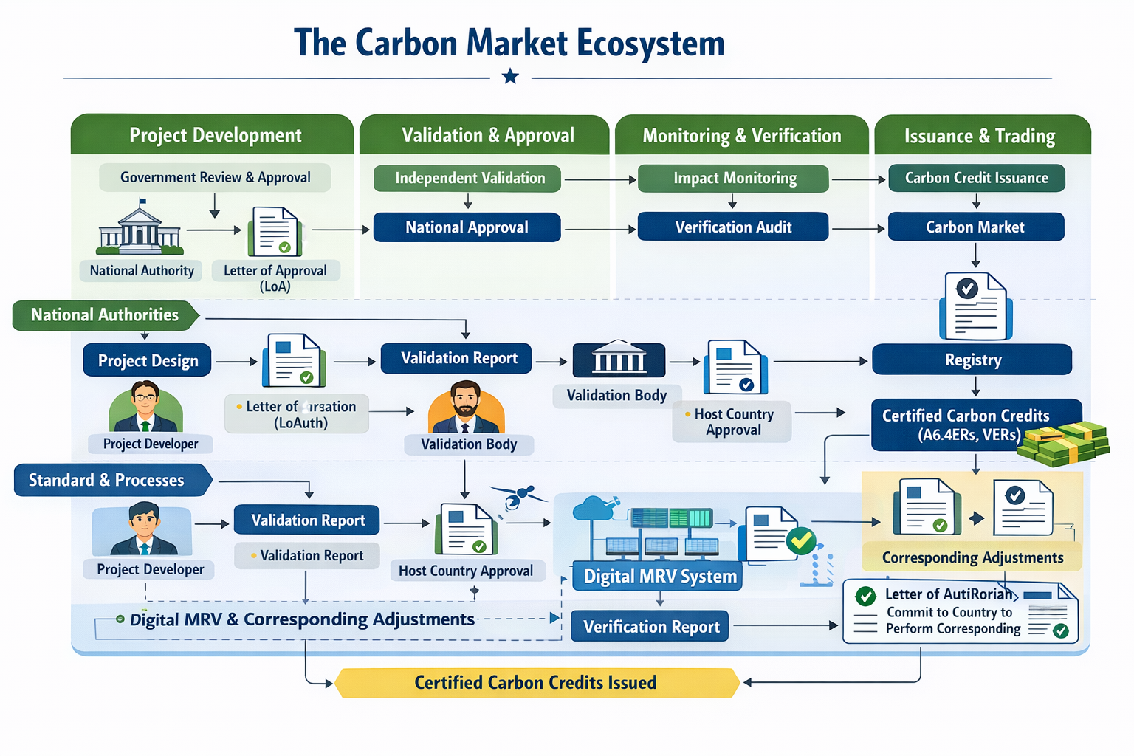
Achieving Results Faster, Together

Slide 6

Documents Needed
MAIN
Letter of Approval / Authorization;
Project Design Document
Project Design Document
Validation Report
Letter of Authorization
Operations Manual
Monitoring Report
Verification Report
Emissions Reduction Purchase Agreement
Letter of Authorization
Initial Report
Regular Report
BTR
Decisions to Make
Compliance to the program design;
Certifying the credits
Approving the Project
Positive/negative validation opinion
Authorization of credits to transfer
Submission timelines to UNFCCC
Key Actors Involved
Project Developer
Host Country DNA
Project Developer
Standard Body
Validation Entity
Project Developer
Standard Body
Verification Entity
Project Developer
Standard Body
Country DNA
Buying Entity
Country DNA
Achieving Results Faster, Together

Slide 7

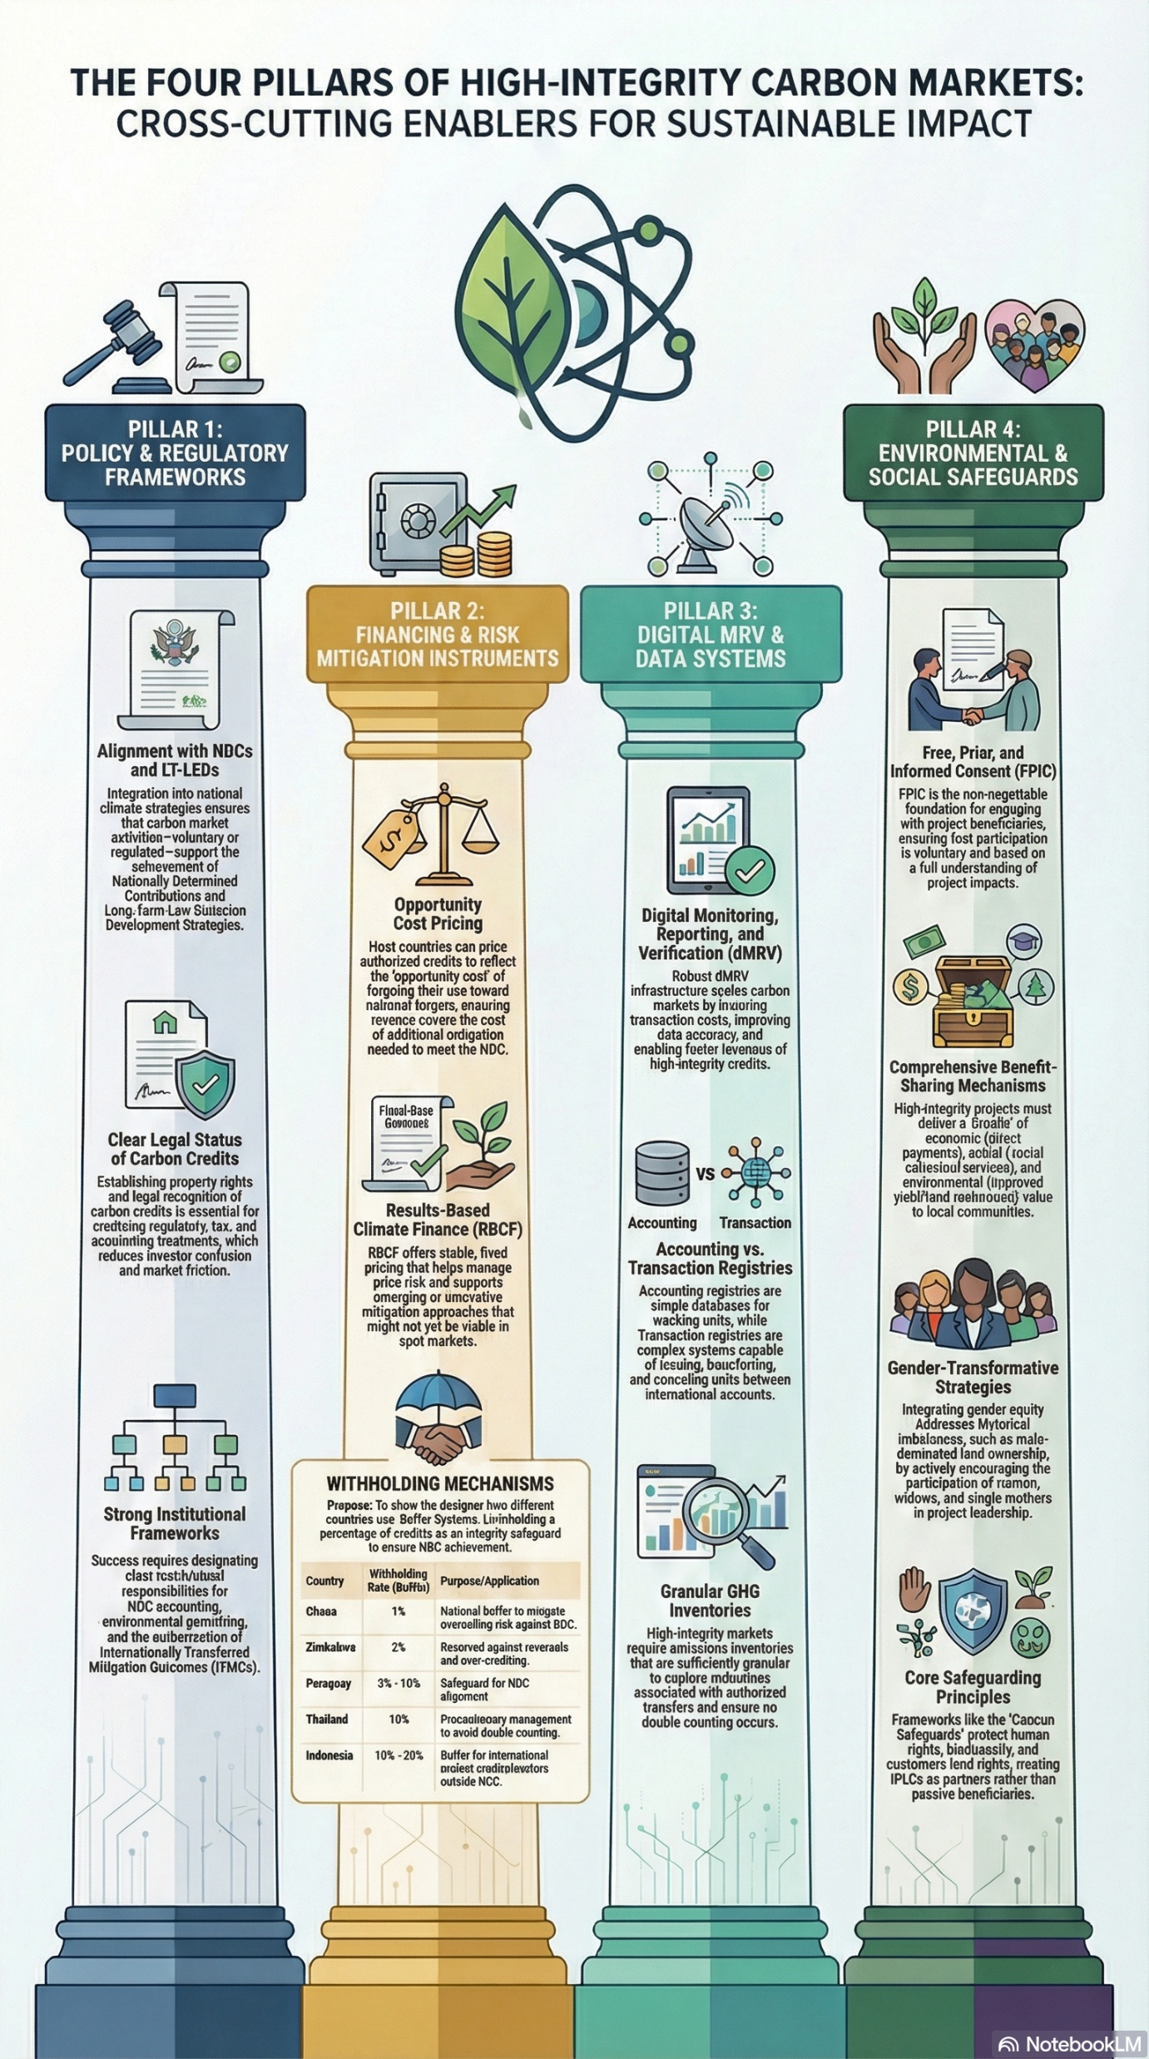
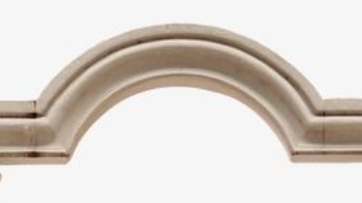
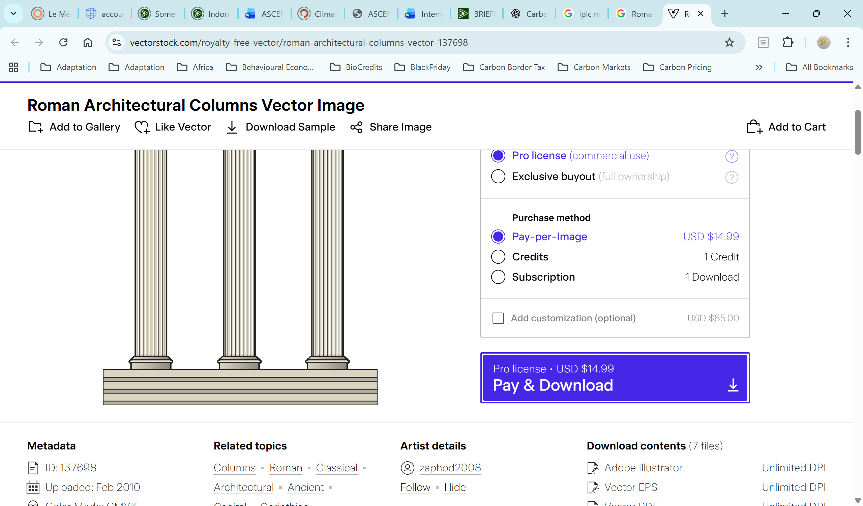
Cross-Cutting Enablers
Free, Prior, and Informed Consent (FPIC)
FPIC is the non-negotiable foundation for engaging with project beneficiaries, ensuring their participation is voluntary and based on a full understanding of project impacts.
Digital Monitoring, Reporting, and Verification (dMRV)
Robust dMRV infrastructure scales carbon markets by reducing transaction costs, improving data accuracy, and enabling future revenues of high-integrity credits.
Opportunity Cost Pricing
Host countries can price authorized credits to reflect the ‘opportunity cost’ of forgoing their use toward national targets, ensuring revenue covers the cost of additional obligation needed to meet the NDC
Alignment with NDCs and LT-LEDs
Integration into national climate strategies ensures that carbon market activities – voluntary or regulated – support the achievement of NDCs and LT-LEDs
Comprehensive Benefit-Sharing Mechanisms
High-Integrity projects must deliver a combination of economic (direct payments), social (social conscious services) and environmental (improved yield/land rehabilitation) value to local communities.
Clear Legal Status of Carbon Credits
Establishing property rights and legal recognition of carbon credits is essential for supporting regulatory, tax and accounting treatments, which reduces investor confusion and market friction
Results-Based Climate Finance (RBCF)
RBCF offers stable, fixed pricing that helps manage price risk and supports emerging or innovative mitigation approaches that might not yet be viable in spot markets
Accounting vs. Transaction Registries
Accounting registries are simple databases for tracking units, while Transaction registries are complex systems capable of issuing, transferring and cancelling units between international accounts.
Gender-Transformative Strategies
Integrating gender equity addresses societal imbalances, such as male-dominated land ownership, by actively encouraging the participation of women, widows, and single mothers in project leadership.
Strong Institutional Frameworks
Success requires designating clear institutional responsibilities for NDC accounting, environmental integrity and the authorization of Internationally Transferred Mitigation Outcomes (ITMO)
Granular GHG Inventories
High-integrity markets require emissions inventories that are sufficiently granular to explore modalities associated with authorized transfers and ensure no double counting occurs.
Core Safeguarding Principles
Frameworks like ‘Cancun Safeguards’ protect human rights, biodiversity, and customers land rights, making IPLCs as partners rather than passive beneficiaries.
Achieving Results Faster, Together

Slide 8
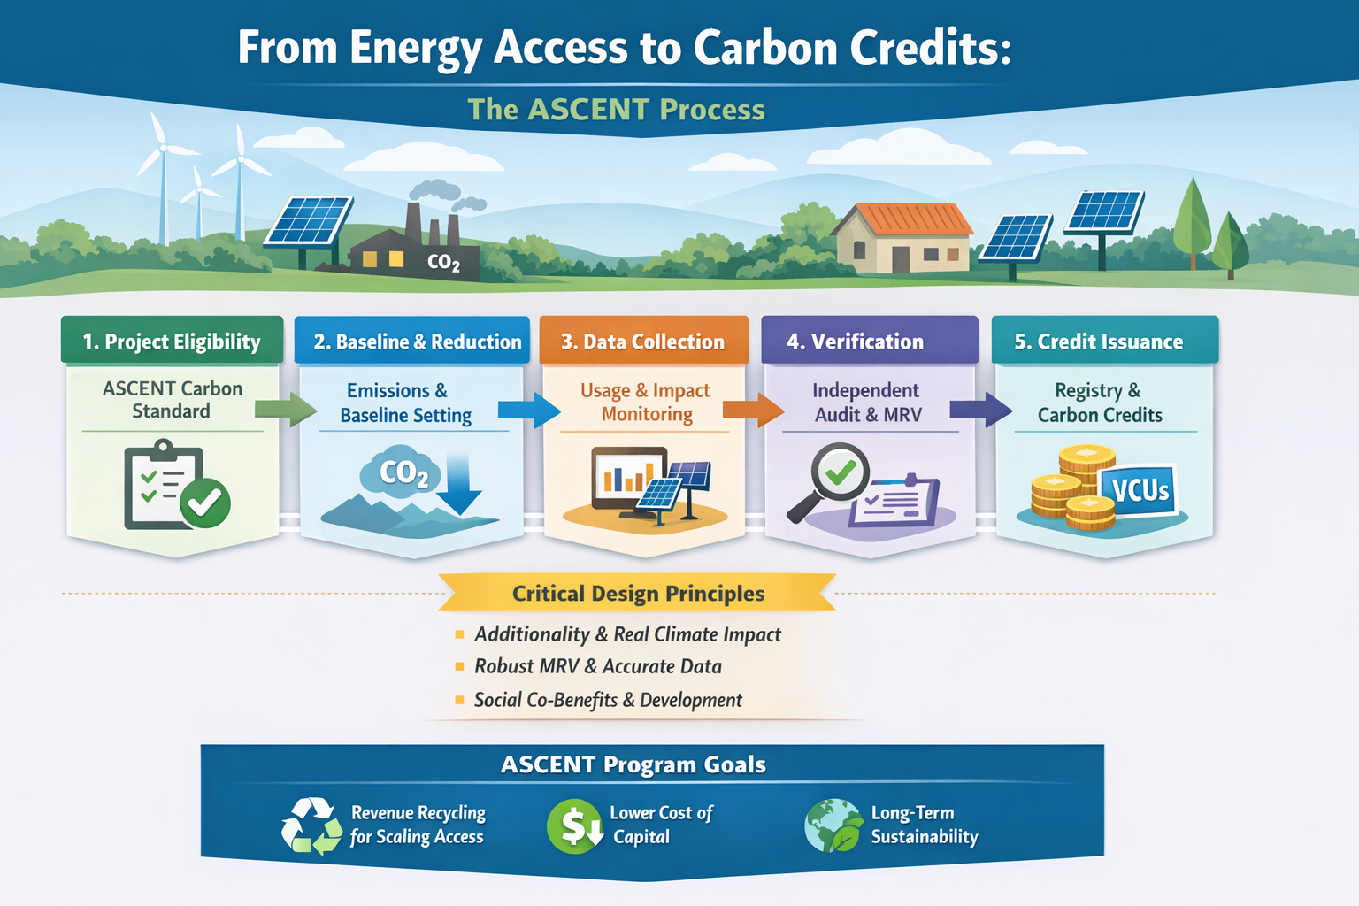
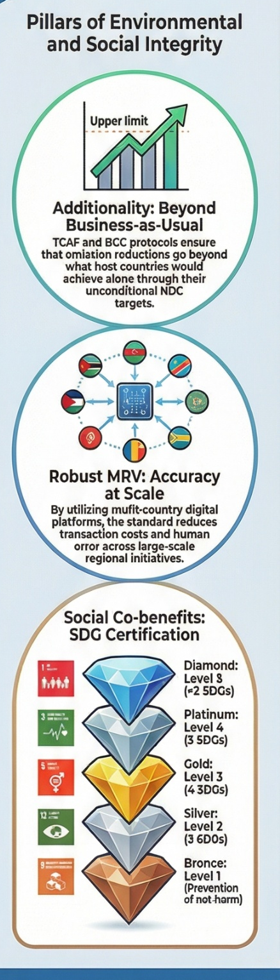
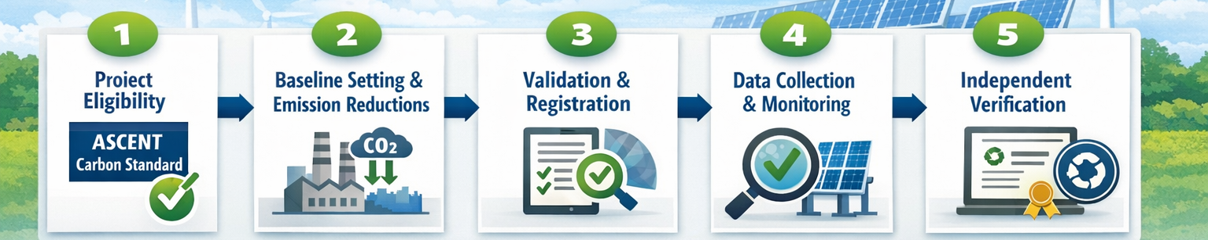
Achieving Results Faster, Together

Slide 9
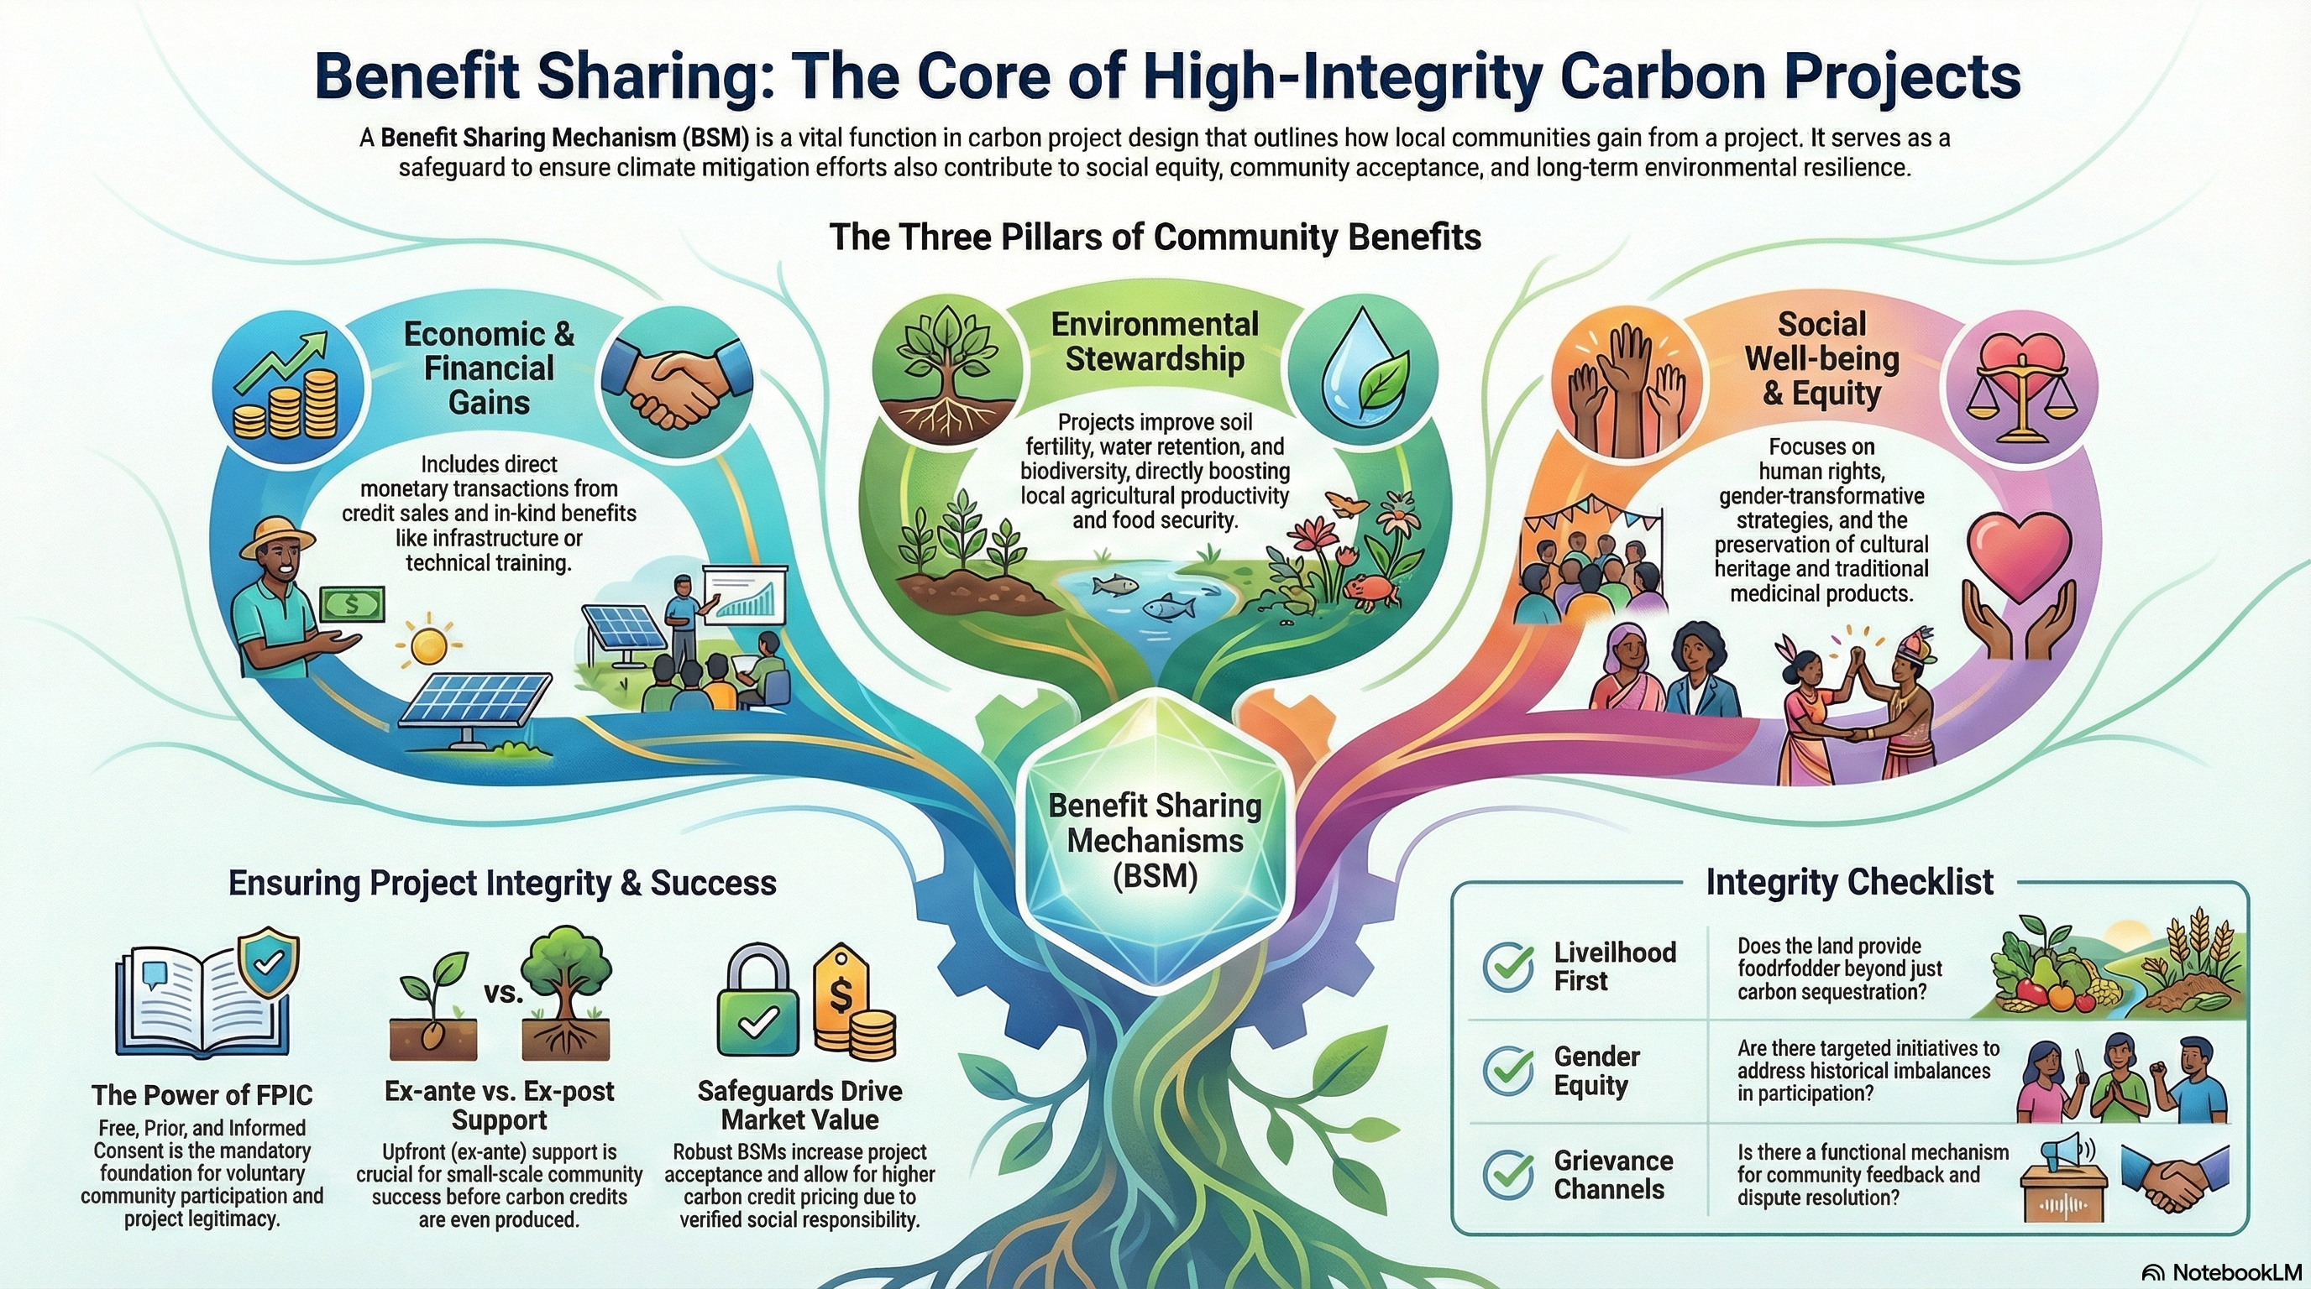
Achieving Results Faster, Together

Slide 10
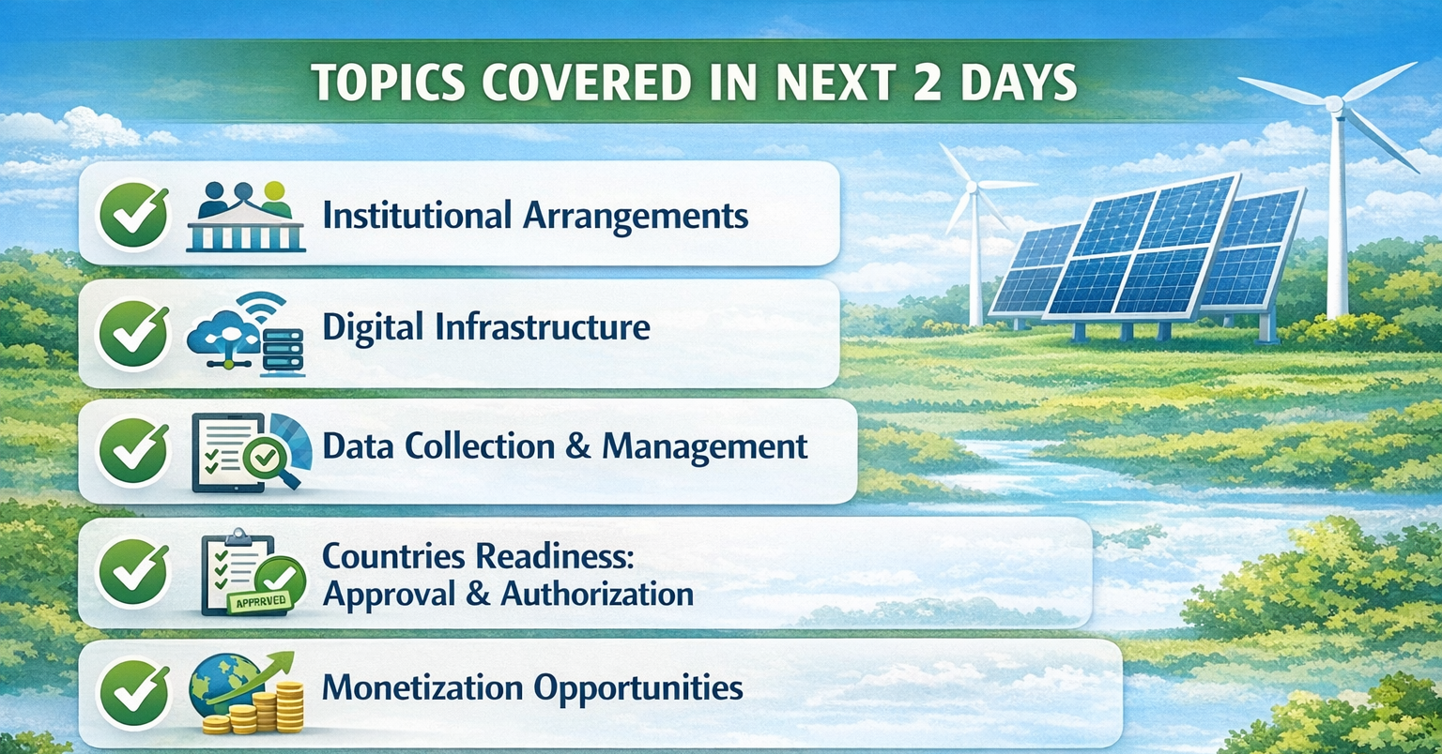
Achieving Results Faster, Together

Slide 11

Thank you!
Achieving Results Faster, Together

