Slide 1





Session D
Understanding the role of digital infrastructure
Razvan Dumitru Sandru
Consultant, Energy, World Bank
Gemma Torras Vives
Climate Change Specialist, World Bank
Karim Jabbar
CEO, Carbon Clear
Achieving Results Faster, Together

Slide 2



ASCENT Carbon – 5 inter-connected workstreams
Carbon Standard for Energy Access
Cabon Market infrastructure (carbon digital MRV)
Carbon Market policy/regulatory readiness – enabling environment
Country-level carbon asset generation & implementation support
Strategy & outcome monetization
Achieving Results Faster, Together

Slide 3

Session Outline
14:00-15:00pm – D.1 Presentation
How digital tools support monitoring, reporting, and verification (MRV) for energy access and carbon?
15:00–15:30pm | Break
15:30-16:00pm – D.2 Panel
Country insights – Current MRV practices and pathways toward digital MRV
16:00-17:00pm – D.3 Live Demo
ASCENT Carbon Digital MRV system
Achieving Results Faster, Together

Slide 4
D.1 Presentation
How digital tools support monitoring, reporting, and verification (MRV) for energy and carbon?
Understanding what is digital MRV and why it matters for energy access and carbon finance
Achieving Results Faster, Together

Slide 5
Question: Who is familiar with digital tools that support Monitoring, Reporting, and Verification (MRV) processes (apps, sensors, platforms, dashboards)?
Achieving Results Faster, Together

Slide 6
Question: Who has experience with Monitoring, Reporting, Verification processes/systems for emission reductions (either analog or digital)?
Achieving Results Faster, Together

Slide 7
Digital MRV: What it is and why it matters
Achieving Results Faster, Together

Slide 8




Key challenges in MRV process
Data & reporting challenges | Integrity & verification challenges | Scale & finance challenges
⏳Manual, slow data collection (paper surveys, spreadsheets) | Fraud risks (ghost customers, inflated installations) | High transaction and verification costs due to timing
❗Data gaps, inconsistent reporting across sites | Limited audit trail and traceability of evidence | Difficulty aggregating thousands of units/projects
🧩 Poor data quality and limited real-time visibility | Weak linkage between customer, device, and payment evidence | Delayed carbon credit issuance and long verification cycles

Slide 9

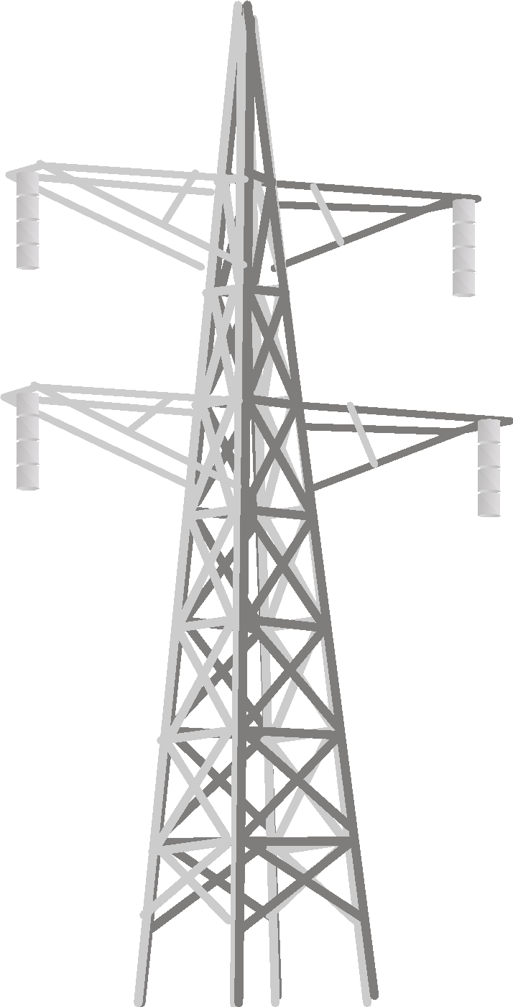





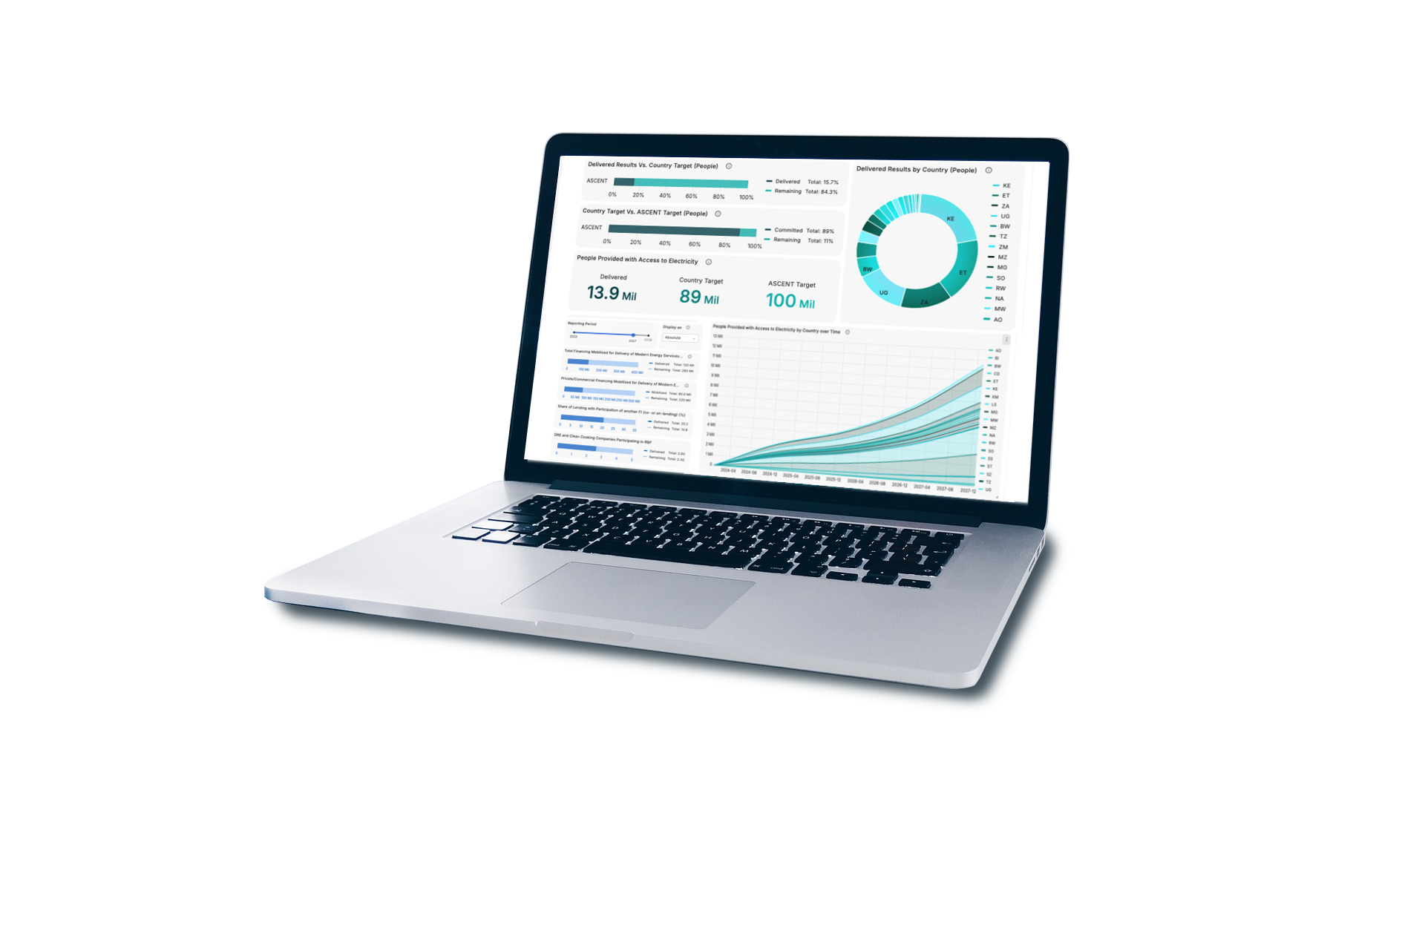
What is digital MRV?
Digital Monitoring, Reporting and Verification (dMRV) replaces manual and paper-based processes with digital tools that automatically collect, process, and report data to verify energy project performance and emission reductions.
- In practice, dMRV systems capture and link:
Customer data (identity, location, onboarding records)
Device/unit data (installation, operational status, usage/service delivery)
Payment data (mobile money, PAYGo history, repayment patterns)
Performance data (energy delivered, uptime, consumption proxies)
Core functions of a dMRV system
Data ingestion & storage
Data processing & analytics
Data sharing (for auditors, regulators, standards, registries, and financiers)
needed to quantify emissions reductions!

Slide 10
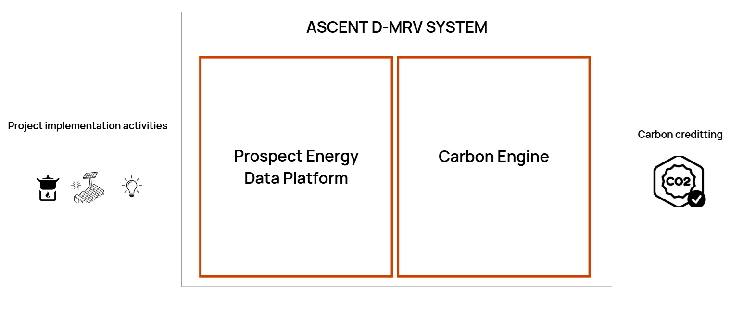


ASCENT dMRV: Converting energy access data into verified emission reductions
Energy access data
Carbon verification
engine

Slide 11
Scope of Digital MRV (dMRV) for ASCENT
- Energy Access
- Carbon Finance
Achieving Results Faster, Together

Slide 12
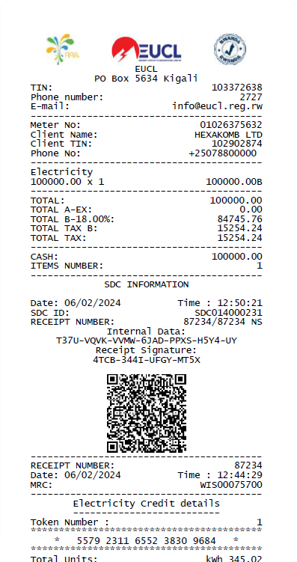
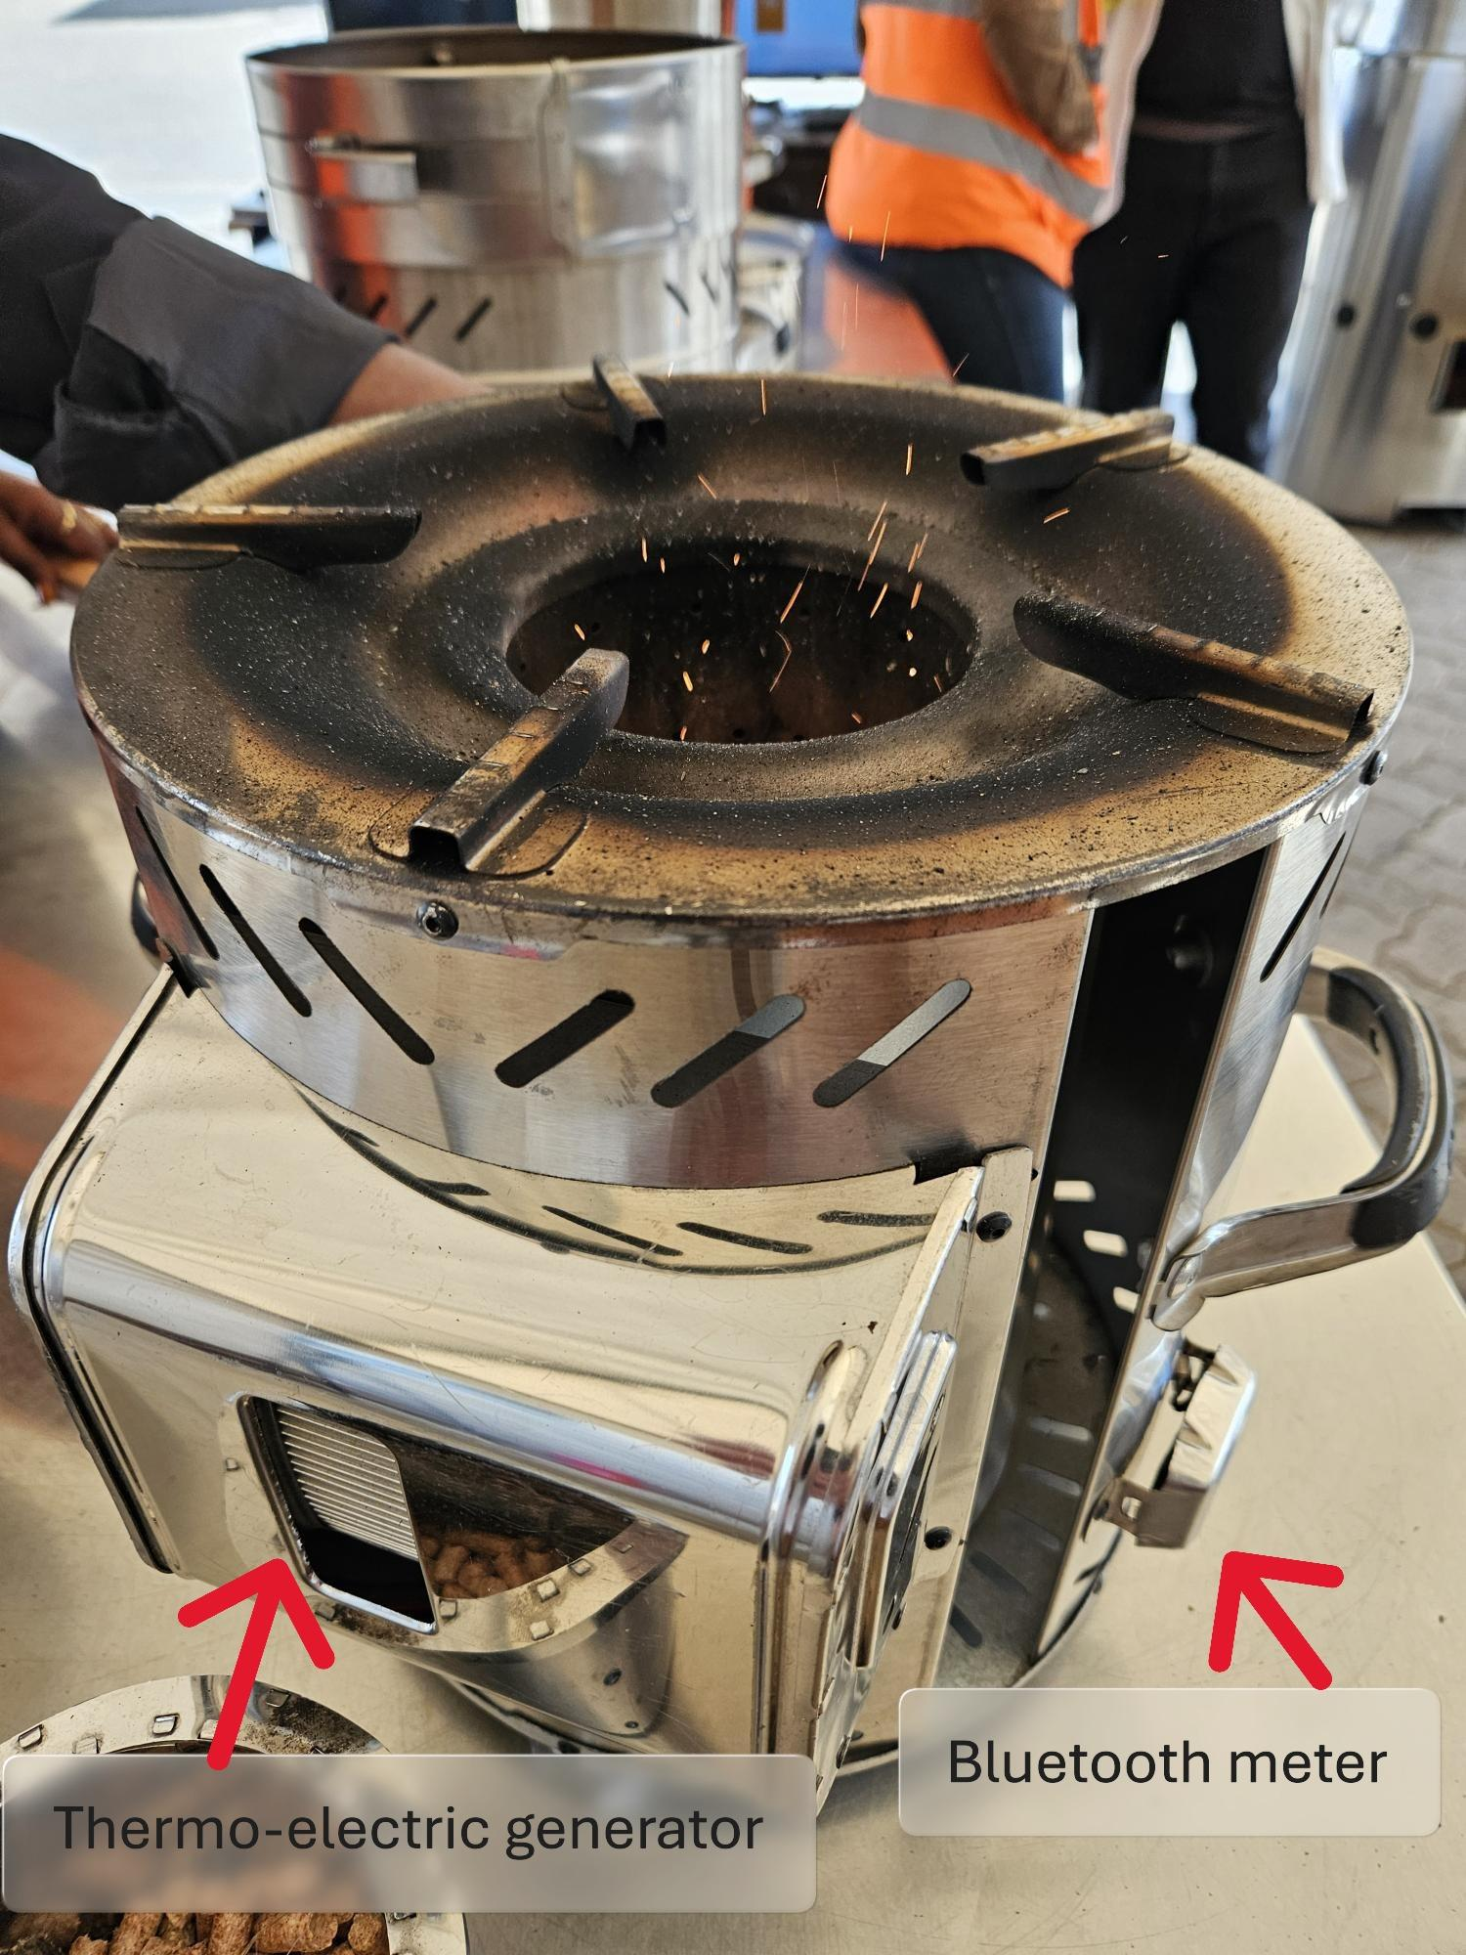

So where does the data come from?
Sales agents
Payments
Sensors

Slide 13













Energy Access dMRV data flows: From energy connections to regional MRV
Connection data
Energy access data
National dMRV
ASCENT Regional dMRV
System data
Validation & Verification
Utility
Consumption
Capacity
Meter / serial number
Automated
Mini-
grids
In-built validation checks for completeness and consistency
Verification through third-party data (triangulation)
Customer data
Customer ID
Gender
Type of customer
Analysis at different levels:
Program
Technology
Company
Connection
Off-grid solar
Objectives:
- Aggregation
- Monitoring / Results Framework
- Analytics
- Carbon finance
Manual
Payment data
Independent Verification Agent: Phone/ field surveys
Clean
cooking
Payment amounts
Payment dates
Account number

Slide 14
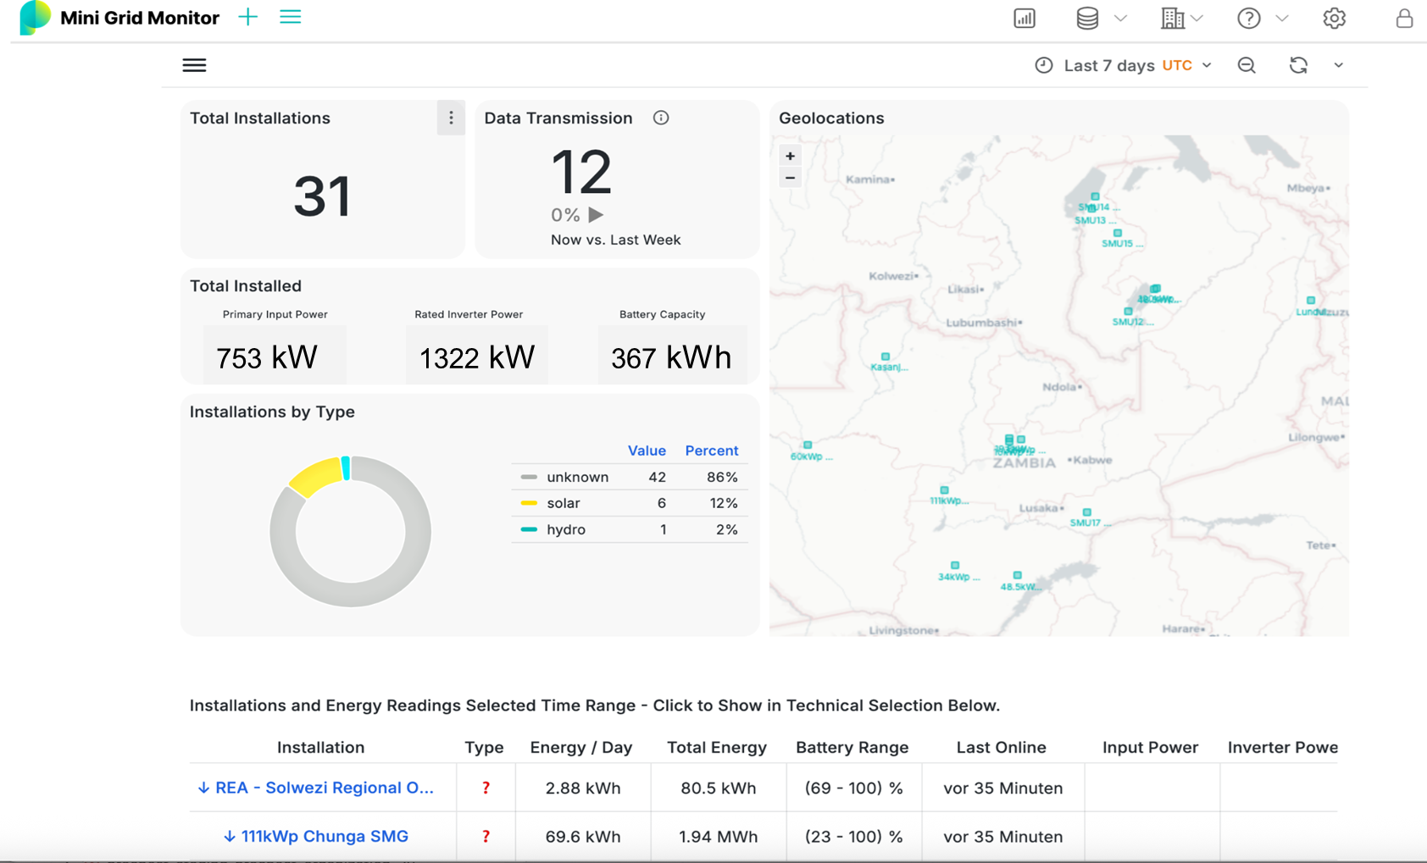
Example of energy access dMRV in practice: Real-time monitoring dashboard
Automated data collection and performance analytics enable real-time visibility of installations, energy output, and system status across sites.

Slide 15




Digital verification method: Linking independent data sources
A NOVEL APPROACH TO VERIFICATION: DATA TRIANGULATION
Link multiple independent digital data sources to verify connections, installations, and energy service reliability.
Key sources include: IoT sensors, Financial transaction data (e.g., Mobile Money), CRM systems
Fingerprint:
Combination of unique datapoints that allow the verification of a new energy connection/deployment
Heartbeat:
Automatically created and transmitted technical & financial data that show the activity of a connection
This approach delivers high-quality, independently verifiable evidence - strengthening trust, reducing costs and unlocking results-based funding opportunities.
Robust dMRV for energy access enables carbon finance (synergy – using the same system for both objectives)

Slide 16
Scope of Digital MRV (dMRV) for ASCENT
- Energy Access
- Carbon Finance
Achieving Results Faster, Together

Slide 17



Monitoring, Reporting, and Verification (MRV) systems are a key tool used to track Greenhouse Gas (GHG) emission reductions.
M = Monitoring: Collects project performance data (activity data, fuel use, ` energy output, land-use change, etc.)
R = Reporting: Translates monitored data into emission reductions/removals using an approved methodology and baseline scenario
V = Verification: Independent third-party checks data, calculations, and safeguards evidence before approval
Backbone of carbon credit integrity Formal requirement for international carbon trading under Article 6, Paris Agreement Builds trust in carbon credits by ensuring results are measurable, auditable, and aligned with global climate accounting rules.

Slide 18
Question: Do you face any questions/challenges in the MRV process? Which ones?
Achieving Results Faster, Together

Slide 19


Digital MRV systems can help enhance the MRV process for emission reductions
In a conventional MRV system, project data is often recorded manually and stored as a hard copy or in an excel worksheet. This is both difficult to analyze for reporting purposes and costly to verify. D-MRV systems use emerging digital technologies such as smart meters, remote, sensors, and even satellite can increase the reporting accuracy, reduces the time required for data collection, and lowers the cost of 3rd party verification of the project’s performance. D-MRV systems are a key component in future climate markets to ensure robustness and the smooth functioning of those markets.
Component | MRV | D-MRV
Real-Time Data Collection
Automated Data Analysis
Continuous Flagging of Outlying Data
Standardized Reporting Format
One-Off MRV Verification

Slide 20
ASCENT dMRV: Converting energy access activity data into verified emission reductions
Energy access data
Carbon Verification
Engine

Slide 21

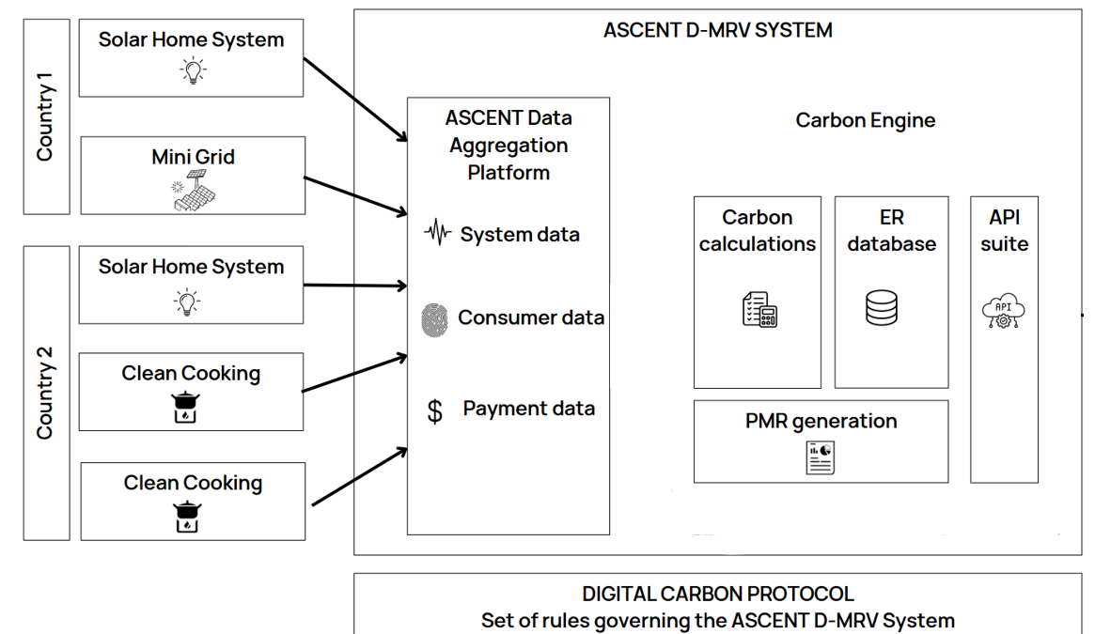



A close look at ASCENT Carbon dMRV Architecture
On-grid electrification
Standad GCC
Portal
GCC
Registry
Trading platform/ Marketplace
Climate Action Data Trust
(CAD Trust)
COMESA layer

Slide 22
Carbon Protocol
A standardized set of rules, parameters, and calculation methods that converts energy access activity data into verified and auditable carbon emission reductions for credit issuance.
1. Common parameters
  Examples: Installation ID, User ID, GPS coordinates.
2. Metering parameters
  Examples: Energy consumption load, solar irradiance, diesel usage.
3. Proxy parameters
  Examples: Battery capacity, daily allotted watt-hours, payment-linked energy consumption.
- Energy-to-Carbon Computations
  Direct measurements: Converts real-time energy data into emissions reductions using predefined factors.
  Proxy-based estimates: Utilizes payment data or usage intervals to calculate emissions in off-grid or low-resource settings.
Payments-to-Energy Computations
  Pre-computed intervals: Maps payment events to energy usage intervals.
  Dynamic calculations: Adapts energy usage estimates based on payment frequency and device configuration.

Slide 23
A modular, configurable protocol architecture
Limitations | Mitigation/Future action
Technology data is not always reliable | Establish data quality assurance (QA/QC) protocols, minimum performance thresholds, and fallback rules (manual inputs, proxy datasets).
Digital skills are uneven across local firms and partners | Apply an inclusive implementation pathway, enabling participation through digitized, semi-digital, hybrid, and fully digital workflows.
Many systems are not yet tested enough in the field, | Conduct iterative pilots with ASCENT partners to validate usability, operational feasibility, and costs.
DMRV rollout may be slow if rules are unclear on what data is acceptable, | Advance standardization and methodology finalization, including clear guidance on acceptable data processing, transparency requirements, and audit trails.
📡 ⚠️ 📊
💻 🔧 📉
🧪 🌍 🔍
⏳🗂️ ✅
Notes:
These limitations should be understood as part of a dynamic continuum, rather than binary constraints.
The Carbon Engine protocol is designed to remain modular and flexible, enabling implementation across digital, semi-digital, and hybrid MRV configurations, while progressively strengthening automation and data integrity over time.

Slide 24
How do we execute the Carbon Protocol?
Achieving Results Faster, Together

Slide 25
Carbon Engine: The digital backbone of protocol execution
The Carbon Engine is a software that will automate data collection, processing, and carbon credit generation, enabling scalable, transparent dMRV systems for carbon markets. It will be embedded within Prospect’s dMRV platform and the Global Carbon Council (GCC) MRV portal.
🧩 Data integration & processing
  Consolidate inputs from IoT devices, satellite imagery, and payment systems
  Process real-time and proxy-based energy data with high accuracy
📊 Standardized carbon computations
  Translate energy data into verified carbon emission reductions
  Apply international emissions factors for credibility and comparability
⚙️ Automation of carbon credit generation
  Streamline the generation and verification process
  Minimize manual steps to improve scalability and efficiency
Live demo today!
Achieving Results Faster, Together

Slide 26

Thank you!
Questions?
Achieving Results Faster, Together

Slide 27
D.2 Panel
Country insights – Current MRV practices and pathways toward digital MRV
Desmond Tutu Opio – Senior M&E Specialist, Uganda Energy Credit Capitalization Company (UECCC) (Uganda)
Mercedes Imasiku Mwansa – Director Strategy and Planning
Rural Electrification Authority (Zambia)
Martin Musonera – Manager, Clean Cooking solutions and Carbon finance project, Energy Development Corporation Ltd(EDCL) (Rwanda)
Achieving Results Faster, Together

Slide 28
Guiding Questions
1) Current MRV reality
2) What is your next step: where digital MRV could add value
3) Implementation and barriers
Achieving Results Faster, Together

Slide 29
D.3 Live Demo
End-to-End Digital Carbon Infrastructure
Achieving Results Faster, Together

Slide 30
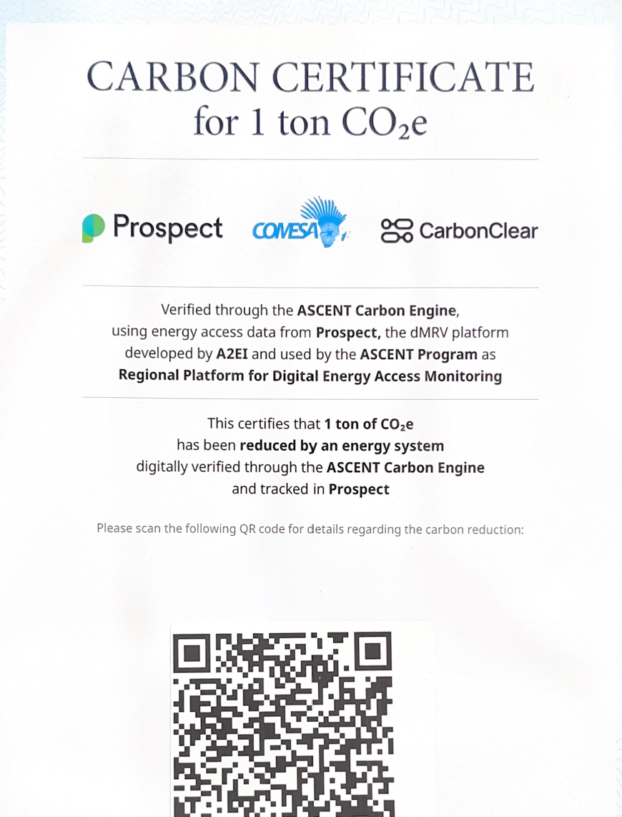

Slide 31
Thank you!
Achieving Results Faster, Together

Slide 32
ANNEX
Achieving Results Faster, Together

