Slide 1





Session E2
Carbon Market Readiness – setting the scene
Daniel Radack
Senior Carbon Finance Specialist, WB
Ashia Bio-Sawe
Carbon Finance Specialist, World Bank
Achieving Results Faster, Together

Slide 2
Session E2
Carbon Market Readiness – setting the scene
Objectives :
Enhance understanding of the critical elements of carbon market readiness
1
Collect Feedback on Carbon Market Readiness mapping
2
Achieving Results Faster, Together

Slide 3
What is Carbon Market Readiness?
…robustness of institutional and regulatory frameworks, and
infrastructure in place to generate, authorize, trade, and account for carbon credits while safeguarding NDC integrity.
Achieving Results Faster, Together

Slide 4




Why Carbon Market Readiness Matters?
Raise revenues and mobilize investment to support low-carbon development
Supports NDC achievement
Build investor confidence
Generate co-benefits such as job creation, Technology Transfer, improved livelihood ecosystem services
Achieving Results Faster, Together

Slide 5


Components of Carbon Market Readiness
Institutionalization
Dedicated resources to support oversight and implementation functions (Human & Financial)
Policy & Regulatory Framework
Alignment with NDC & Long-Term Strategy
Carbon Market Infrastructure
Digital Monitoring, Reporting, and Verification ( dMRV)
Carbon Market Strategy
Strategic Direction for carbon market
Legal Status of carbon credits
Requirements & Procedures for Carbon trading
Safeguards and Benefit Sharing mechanism
Institutional arrangement
Capacity building/ awareness/ engagement of key stakeholders
Alignment with Long term Strategy & NDC
Role of Voluntary Vs Article 6
Accounting /Transactional Registry
Greenhouse Gas Emission (GHG) Inventory
Roadmap for future regulations & institutions

Slide 6
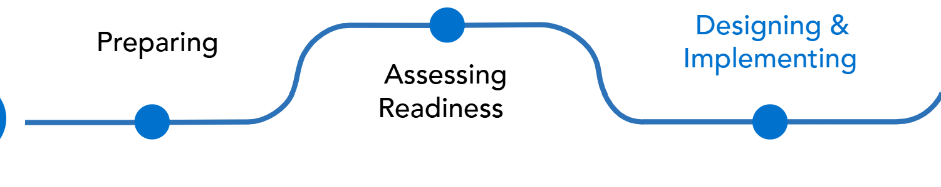

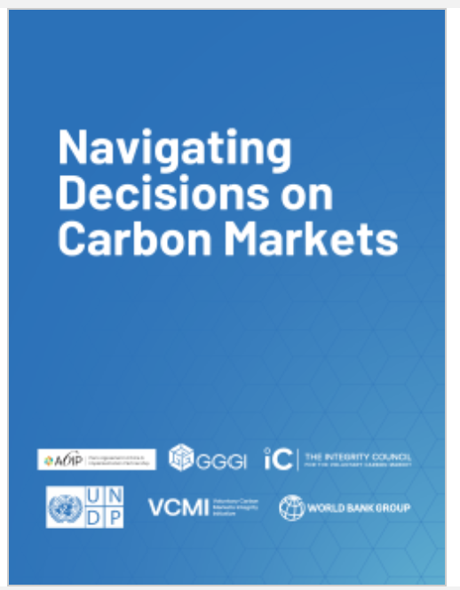
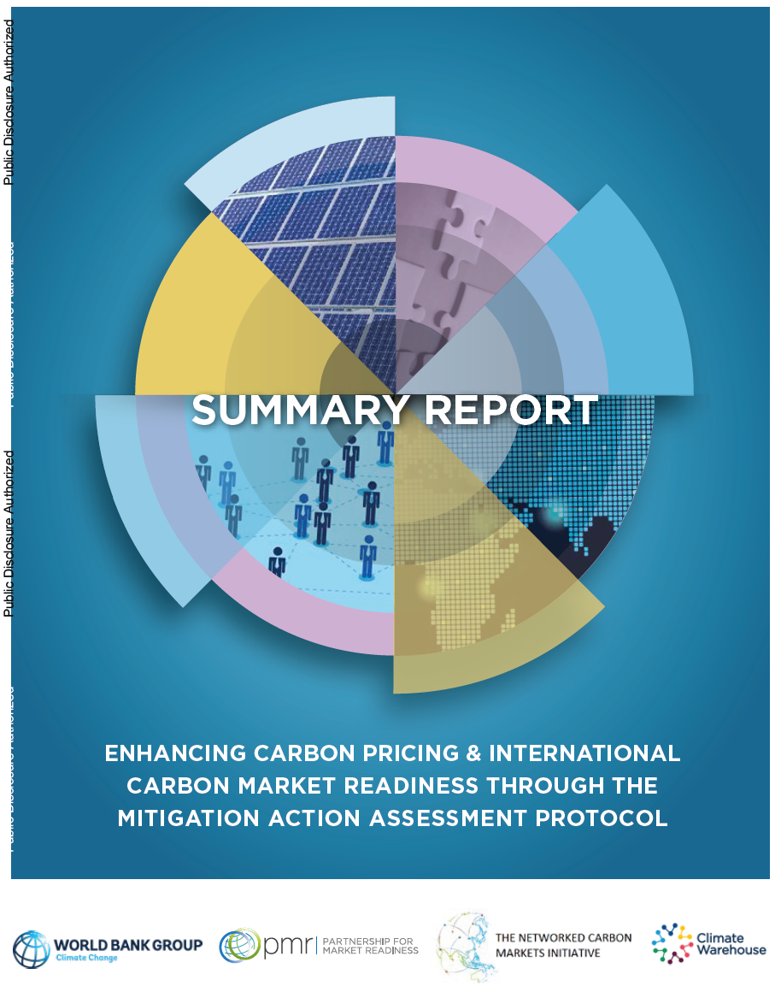
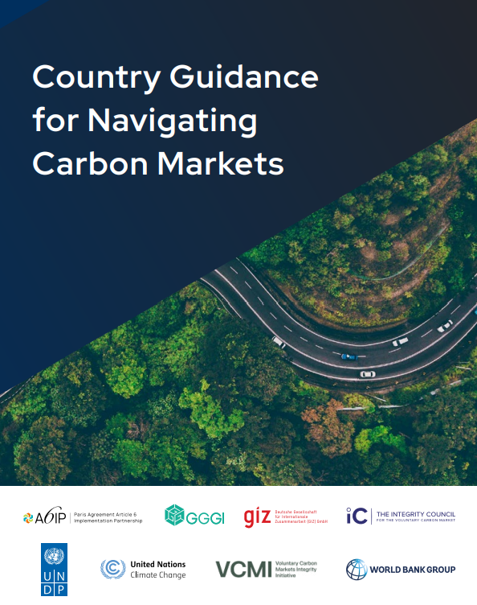
Guidance Tools

Slide 7
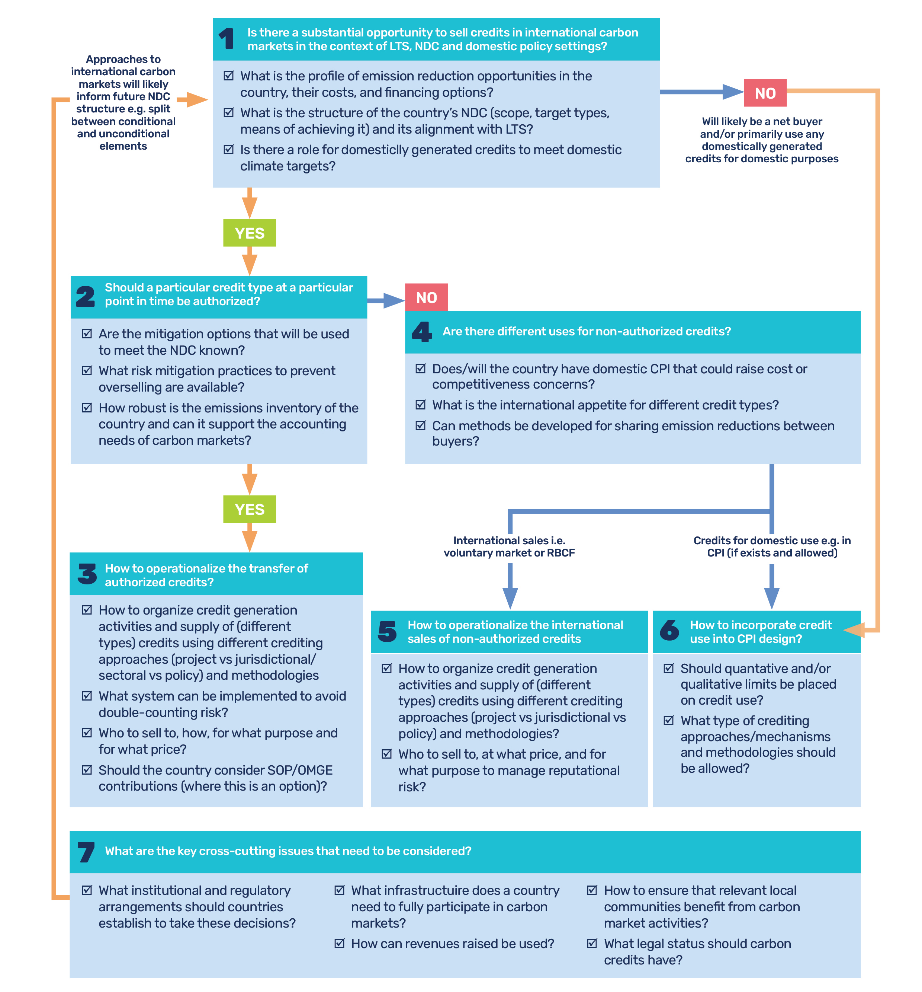
Decision framework published during COP29 turns complexity into 7 key decisions for host economies
Jointly developed in collaboration with the Paris Agreement Article 6 Implementation Partnership (A6IP), the Global Green Growth Institute (GGGI), the Integrity Council for the Voluntary Carbon Market (ICVCM), the United Nations Development Program (UNDP), the Voluntary Carbon Markets Integrity Initiative (VCMI)
Can be accessed here

Slide 8
Mitigation Action Assessment Protocol- World Bank tool for assessing readiness
Climate Change Strategy and NDC
  Assesses the consistency of climate policies with the mitigation goals established in the NDC, as well as the processes for monitoring the implementation of the measures and their accounting
Assists in understanding economies’ level of readiness to participate in carbon markets by identifying key gaps and capacity building needs
This helps develop the necessary institutional framework and market infrastructure for effective carbon market participation.
Institutionalization
  Highlights requirements and best practices for the national institutional framework for managing mitigation outcome transactions
Policy Framework and Activity Cycle
  Assesses how the country has established a carbon market participation strategy and decided on eligible mitigation actions. This is the basis to assess the policy framework and the processes for operationalization.
Reporting and Infrastructure
  Examines the processes and infrastructure, such as access to a carbon transaction register, that support the transparent management of mitigation activities and carbon transactions

Slide 9
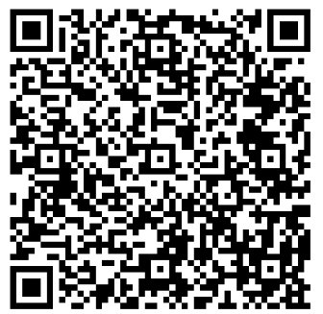
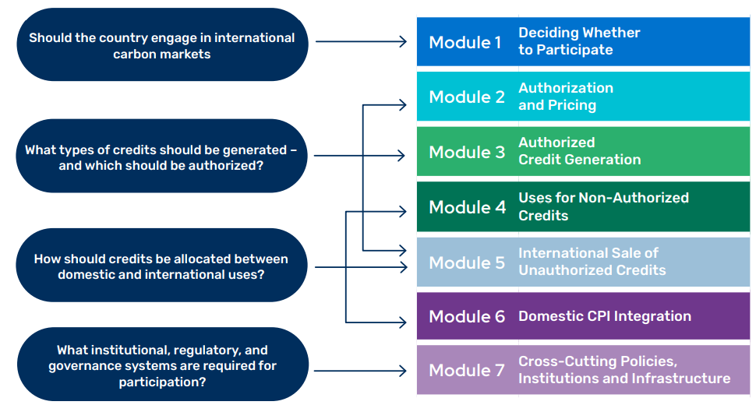
Country Guidance for Navigating Carbon Markets
Developed jointly with same technical partners with the addition of GIZ (Deutsche Gesellschaft für Internationale Zusammenarbeit) and UNFCCC
Also establishes a common foundation for harmonized approaches and aligned messaging among capacity-building partners

Slide 10






What institutional and governance systems are required to participate?
To engage effectively in carbon markets, host economies must establish strong institutions, decision-making processes and robust governance frameworks.
What are key elements of a carbon market policy framework ?
Providing strategic direction such as sectoral / technological focus
Establishing institutions and processes for registration, issuance and approval of activities seeking authorization
Providing clarity on framework for authorized credits, including pricing, corresponding adjustments and infrastructure for meeting reporting requirements under the Paris Agreement
Specifying how revenues from corresponding adjustment, if any, will be collected and allocated
Other policy considerations that can help provide clarity and certainty to the private sector:
Ensuring social integrity by:
    Securing 'free, prior and informed' consent from Indigenous Peoples and local communities (IPLCs) and recognizing their rights
    Establishing social safeguards and grievance mechanisms
    Engaging with IPLCs as partners rather than passive beneficiaries
    Implementing robust benefit sharing mechanisms
Supporting financial integrity by:
  Defining legal nature of carbon credits and provision of complementary guidance on tax and accounting
  Strengthening registry regulations to improve data security and transparency
  Establishing strong governance and risk management frameworks to prevent fraudulent activities such as by implementing AML, KYC and anti-corruption measures

Slide 11

Carbon Market Readiness
Ghana Experience
Achieving Results Faster, Together
Notes:
Please complete one form per country.
Indicate the current status of each carbon market readiness element based on official policies, regulations, or established practices.
If an element is under development, please select that option even if it is not yet operational.
For Question 8 (Capacity-Building Partners), if you select “Yes”, please specify the partners or programs supporting carbon market readiness in your country.
Use the comments section to highlight key gaps, challenges, or priority areas where support is needed.
There are no right or wrong answers—this exercise is intended to support regional mapping and capacity-building, not evaluation.
Time required: approximately 5–7 minutes.

Slide 12

Mapping of Carbon Market Readiness shows different levels of readiness
 | Burundi* | Ethiopia* | Kenya* | Malawi* | Rwanda* | Tanzania* | Uganda | Zambia* | Eswatini | Sao Tome & Principe* | Somalia* | Mozambique* | Madagascar | Namibia
Carbon Market Frmwk / Strategy | 🟥 Not in Place | 🟩 In Place (strategy) 🟥 Not in Place (fmwk) | 🟩 In Place | 🟩 In Place | 🟩 In Place | 🟩 In Place | 🟩 In Place | 🟩 In Place (fmwk) | 🟨 In Progress | 🟨 In Progress | 🟥 Not in Place | 🟨 In Progress | 🟩 In Place (REED)+ | 🟨 In Progress
Carbon Market reg | 🟥 Not in Place | 🟥 Not in Place | 🟩 In Place | 🟩 In Place | 🟩 In Place | 🟩 In Place | 🟩 In Place | 🟨 In Progress | 🟥 Not in Place | 🟥 Not in Place | 🟥 Not in Place | 🟨 In Progress | 🟩 In Place (REED+) | 🟨 In Progress
Authorization Authority | Geographic Institute of Burundi | Min. of Planning & Dev. | Min. of Env., Cl. Change & Forestry | Min. of Nat Resources & Cl. Change | Rwanda Env. Mgmt Authority | Vice President’s Office (DNA) | Min of Water & Env. | Min. of Green Econ & Env. | Ministry of Tourism and Env. Affairs | Directorate-General for Env & Cl. Action | Min. of Env. & Cl. Change | Min. of Land, Env. and Rural Dev. | Nat’l Office of Cl. Change and REDD+ | Ministry of Environment, Forestry and Tourism
Publication of carbon project fees | 🟥 Not in Place | 🟥 Not in Place | 🟩 In Place | 🟩 In Place | 🟥 Not in Place | 🟩 In Place | 🟩 In Place | 🟨 In Progress | 🟥 Not in Place | 🟥 Not in Place | 🟥 Not in Place | 🟥 Not in Place |  | 🟥 Not in Place
Corr. Adjustment Pricing | 🟥 Not in Place | 🟥 Not in Place | 🟩 In Place ($4/unit) | 🟩 In Place ($4/unit) | 🟩 In Place ($2/unit) | 🟥 Not in Place | 🟩 In Place (10%/ITMO) | 🟨 In Progress | 🟥 Not in Place | 🟥 Not in Place | 🟥 Not in Place | 🟥 Not in Place | 🟥 Not in Place | 🟥 Not in Place
Access to Carbon Registry | 🟥 Not in Place | 🟨 In Progress | 🟨 In Progress | 🟨 In Progress | 🟨 In Progress | 🟩 In Place | 🟨 In Progress | 🟨 In Progress | 🟥 Not in Place | 🟥 Not in Place | 🟥 Not in Place | 🟨 In Progress | 🟨 In Progress | 🟩 In Place
Bilateral Agreements/MOU | 🟥 Not in Place | 🟩 Japan | 🟩 SWITZ, SWE | 🟩 SING, SWITZ. | 🟩 SWE | 🟩 Japan | 🟩 SWITZ | 🟩 SING, NOR, SWE, SWITZ | 🟩 Taiwan | 🟥 Not in Place | 🟥 Not in Place | 🟥 Not in Place | 🟨 S. Korea | 🟥 Not in Place
Carbon Market cap. building partners | WB, East. Africa All/GIZ | GGGI, East. Africa All/GIZ East. Africa All, Ci-Dev; FCDO, RCC | GGGI, East. Africa All/GIZ, ACMI , Ci-Dev | RCC (AFE) | GGGI, East. Africa All/GIZ | WB (PMI) , GGGI, East. Africa All/GIZ | GGGI; East. Africa All; WB (Ci-Dev; FCPF) | GGGI, East. Africa All | RCC (AFE) | Rabobank and FAO | UNDP | FCPF, East. Africa All, ACMI | Ci-Dev; FCPF | UNDP, WB PMI
* Approved ASCENT operation

Slide 13
Table discussion :
Your Country’s Carbon Market Readiness
Achieving Results Faster, Together
Notes:
Please complete one form per country.
Indicate the current status of each carbon market readiness element based on official policies, regulations, or established practices.
If an element is under development, please select that option even if it is not yet operational.
For Question 8 (Capacity-Building Partners), if you select “Yes”, please specify the partners or programs supporting carbon market readiness in your country.
Use the comments section to highlight key gaps, challenges, or priority areas where support is needed.
There are no right or wrong answers—this exercise is intended to support regional mapping and capacity-building, not evaluation.
Time required: approximately 5–7 minutes.

