Slide 1
international carbon markets key trends, and core requirements for Article 6 participation.
ASCENT CARBON DAYS:
From Energy Access Projects to Carbon Credits
Nairobi, 10th – 12th .February 2026

Slide 2





Cooperative approaches under
Article 6 of the Paris Agreement
Parties to the Paris Agreement may choose to pursue voluntary cooperation in the implementation of their climate actions (Nationally determined contributions: NDCs) to allow for:
Higher ambition in their mitigation and adaptation actions;
To promote sustainable development; and
To promote environmental integrity.
Higher ambition
Sustainable development
Environmental integrity
Cost- effective mitigation actions,
Access to low-carbon technologies,
Carbon finance, and capacity building.
Environmental, economic and social co-benefits for the Host Country.
Progress towards Sustainable Development Goals (SDGs).
Robust, transparent governance and the quality of mitigation outcomes.
Source: Information extracted from the A6IP Capacity Building Tools, Paris Agreement Article 6 Implementation Partnership Center, June, 2024.

Slide 3
A6.2 & A6.4 Participation Requirements
Article 6.2 (Decentralized)
Article 6.4 (Centralized)
It must be a Party of the Paris Agreement
It has prepared, communicated and is maintaining an NDC
Its participation contributes to the implementation of its NDC and long-term low-emission development strategy, if it has submitted one, and the long-term goals of the Paris Agreement.
Arrangements in place for authorizing the use of ITMOs towards achievement of NDCs
Before Participating (A6.4) - Shall
Nominate a Designated National Authority (DNA).
Arrangements in place for tracking ITMOs
Publicly indicate the activities that will be considered for approval under the A6.4 Mechanism.
Submit the most recent National Inventory Report (as part of the Biennial Transparency Report).
Contribution to the sustainable development.
Additional Implications (A6.2)
Other Optional Requirements (A6.4)
Accounting and reporting requirements for ITMO transfer and Use.
Crediting periods and baseline approaches and other methodological requirements.

Slide 4




Article 6 of the Paris Agreement
Example of a cooperative approach structure
under Article 6.2
Example of a cooperative approach structure
under Article 6.4
CMA
Guidance
Guidance
CMA
Rules, modalities, and procedures (RMP)
Cooperation
Country B /
Entity
communicates
Supervisory
Body of the Mechanism (SBM)
supervises
Country A
Carbon Finance
for NDC achievement
NDC achievement
Mitigation
activity
Host Party
(A6.4 DNAs)
approves
Mitigation activities in Country A
ITMOs
Buyer Country/Entity
authorize
A6.4 ERs
Source: Illustration extracted from the A6IP Capacity Building Tools, June 2024.
Rules, modalities and procedures for the mechanism established by Article 6, paragraph 4, of the Paris Agreement (Click here)
Article 6.4 Supervisory Body (Click here)
Guidance on cooperative approaches referred to in Article 6, paragraph 2, of the Paris Agreement (Click here)

Slide 5
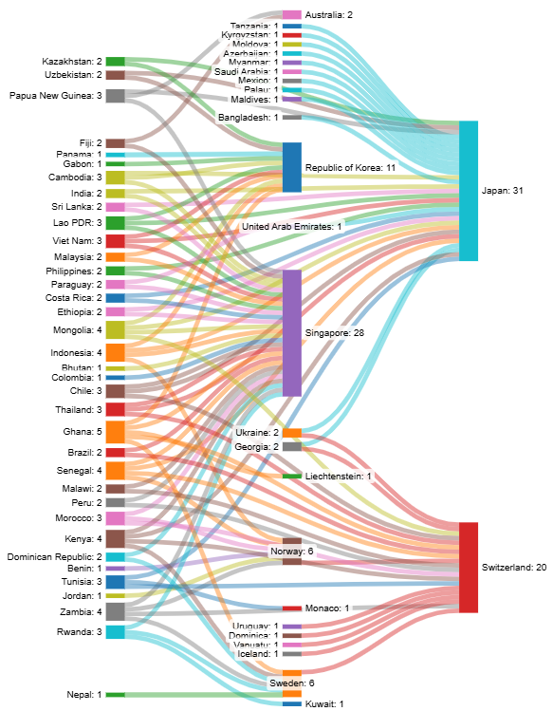
Bilateral agreements under Article 6.2
  More countries are signing bilateral agreements under Article 6.2.
  Agreements between countries for cooperation under Article 6.2
Yearly trends of agreements by buyer Party
  Source: UNEP CCC, https://unepccc.org/article-6-pipeline/

Slide 6
Article 6 Technical Expert Reviews so far
Centralized review 1 (October 2024)
Centralized review 2 (December 2025)
Switzerland | CA0002, CA0003, CA0004
Ghana | CA0002
Vanuatu | CA0004
Thailand | CA0003
Guyana | CA0005
Suriname | CA0006
Japan | CA0007; CA17-39
Mongolia | CA0008
Maldives | CA0012
Palau | CA0014
Tunisia | CA0015
Sri Lanka | CA0032
Cambodia | CA0009, 10
Zimbabwe | CA0011
Malawi | CA0013
Honduras | CA0016
Rwanda | CA0040, CA0041
A6TER report
Published
Review ongoing
Review ongoing
6 Parties, covering 8 CAs
11 Parties, covering 40 CAs
6

Slide 7

Understanding Cooperation under Article 6.4
The new Paris Agreement Crediting Mechanism
"Overseen by a body designated by the CMA and established within the Secretariat of the UNFCCC."
The mitigation outcomes of proposed activities will be accredited under units known as
Article 6.4 Emission Reductions (A6.4ERs)
A6.2 Guidance (Reporting and Accounting Rules)
A6.4 ERs
Depending on their use
“Internationally Transferred Mitigation outcomes” (ITMOs)
AERs
MCUs
(Mitigation
Contribution Units))
Transferred internationally
Used at national level. No CA required.
Authorized
Non-Authorized
Other International Mitigation Purposes (OIMP)
Other purposes
Use of the Units
NDC
Voluntary climate action.
Domestic NDC compliance.
Results-based climate finance.
CORSIA (Aviation Sector Scheme)

Slide 8
PACM Implementation
Where are we and What’s next?
2023
2024
2025
2026
- Activity standard
- Validation and verification standard
- Activity cycle procedure
Appeals and grievances procedure
Sustainable development tools
Procedure on Host party responsibilities
AS,ACP,VVS for PoA
Authorization process
Revision of the ACP, AS and VVS
Update of the ACP, AS and VVS to include new methodological standards and requirements of reversal standard
Activity cycle
Infrastructure
Operationalization of UNFCCC registry
Internal workflows, digital/ web interfaces
Accreditation
Accreditation standard and procedure
Applications by validators and verifiers
Processing of accreditation applications
Methodology process
Methodology and standardized baseline development procedure
Risk assessment tool, … Expansion of existing standards to PoAs + new mechanism methodologies
Recommendation to CMA: Methodologies and Removals;
Further guidance and tools on baseline guidelines and removals.
Removals, additionality, methodology, Baseline, leakage, suppressed demand and reversal standards adopted + tools + First mechanism Methodology
Activity submissions
Methodology submissions
Registration and issuances
Authorizations
Project submission
Activity submissions (transition)
Registration and issuances
Parties’ participation requirements
Preparation by countries to fulfill the participation requirements
Interface to submit participation requirements
Submission by countries
Processing of participation applications
CDM transition
Transition standard and procedure
Applications by project developers
Processing of applications
Capacity building
Support to countries on institutional arrangements, reporting, tracking, fulfillment of the participation requirements, baseline development and contribution of mechanism to ambition

Slide 9
Benefits of participation in PACM (Article 6.4)
Multilateral governance and International oversight under UNFCCC
One and only centralized Global carbon market mechanism established under Paris Agreement.
Tackle double counting under UNFCCC – Integrated reporting and tracking mechanism
Two track national approval process & enhanced host party role - Nationally Approved and Authorized.
Multi prone Quality and Quantity assessment – [independent third party DOEs, UNFCCC secretariat, 6.4 SBM]
Multilaterally approved standards – a global benchmark for baseline and crediting mechanism.
Strong provisions regarding sustainable development and continuous stakeholder inputs
Robust Appeals and Grievance mechanism.
Equitable sharing of benefits between two participating parties
Contributes to adaptation.
Contribute to Overall mitigation of global emissions (OMGE).
Use for both compliance and non-compliance purposes (NDC, MRV of climate finance, green bonds etc).
Fulfillment of reporting obligation under Paris Agreement pre-fill all the information needed to report AEFs to the A6DB.

Slide 10
Key Outcomes from Belem: CDM
31 Dec 2023
31 Dec 2025
31 Mar 2026
30 Jun 2026
30 Sep 2026
31 Dec 2026
Glasgow decision
(3/CMA.3)
Submission of transition requests
(excl. A/R activities)
Submission of transition approval
(all activities)
6 months extension
Baku decision
(6/CMA.6)
Submission of transition requests
(A/R activities)
SBM
018
Submission of additional documentation for the transitioned activities
Belem decisions
(-/CMA.7
-/CMP.20)
Cessation of
the ITL operation
Submission of transition approval
ITL Administration closes
Submission of requests for CER transfer to the PACM registry
Disconnection of the CDM registry from the ITL
Submission of requests for CER issuance
Cancellation of CERs and any other transactions in the CDM registry
Immediate effect:
Discontinuation of the methodological processes (revision, clarification)
Cessation of submission of accreditation/reaccreditation requests
Submission of requests for post-registration changes approval
Cessation of the operations related to DOEs, panels and WGs

Slide 11
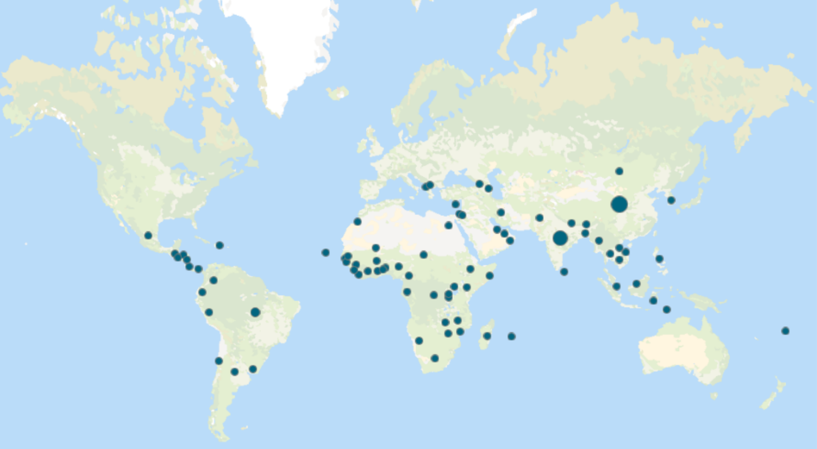

Geography of the CDM activities that have requested transition
Host Parties in EASA
11
CDM activities in EASA
94

Slide 12

Article 6.2 International registry
Mandate for developing the international registry and Additional Registry Services
Decisions 2/CMA.3, 6/CMA.4 and 4/CMA.6.
Documents available on the UNFCCC website
Procedure (initial version): International Registry and Additional Registry Services
Terms and conditions for entities
Interim process for Parties to open a Party section in the international registry
Two functionally connected components:
International registry: records and tracks ITMOs under Article 6.2, covering actions relating to authorization, first transfer, holding, use (for NDCs or other international mitigation purposes), and cancellations, in line with CMA guidance.
Additional Registry Services: provided upon request, records and manages mitigation outcomes (MOs) before first transfer, including issuing them as units and preparing relevant information.
UNFCCC received Parties’ submission to open a Party section in the international registry.
https://t1p.de/5levp

Slide 13
PACM Registry Article 6.4
  System overview (para 27-28 7/CMA.4):
  Standardized electronic database for tracking A6.4ERs and CERs.
  Consistent with requirements for registries in A6.2, and relevant CMA decision.
  List of transactions tracked available in the procedure (para 10 – 19).
  Account types (para 20 – 21)
  Accounts for Parties and authorized entities.
  Secretariat acts as Administrator.
  Currently operated as interim registry.
Document framework
  Decisions: 3/CMA.3, 7/CMA.4 and 6/CMA.6.
  Procedure: Article 6.4 Mechanism Registry
  Terms and conditions
  Development:
  SBM020: a Concept Note on “Registry processes for suspension, termination and reactivation of accounts” with a view to informing a future update to the registry procedure.
  A draft procedure on “Registry processes relating to authorization” is currently under development and is expected to be presented at an SBM in 2026.

Slide 14
Core components & expected impacts
Key products being delivered
Minimum Viable Product (MVP);
Article 6.2 International Registry;
Paris Agreement Crediting Mechanism Registry (Article 6.4);
Interoperability Hub.
Expected impacts
Forms the backbone of future international carbon markets.
Strengthens transparency and market readiness.
Supports the mandate from Parties to operationalize the Article 6 digital ecosystem.
Will be deployed within UNFCCC‑hosted environments and aligned with global technical and security standards.
Indicative target dates (approx.)
International registry: Aug 2026
Mechanism registry: Oct 2026
Interoperability Hub: Dec 2026
Key milestones
Feb 2026: SBM – MVP demo
June 2026: SB sessions – AEF-aligned outputs needed
Oct 2026: SBM → CMA reporting deadline
Nov 2026: COP 31 (change freeze applies)
-> Dates remain subject to delivery and procurement risks.

Slide 15
Methodologies - status-quo
Decision 3/CMA.3 (Rules Modalities & Procedures)
Glasgow (2021)
Application of the requirements of Chapter V.B (Methodologies) for the development and assessment of Article 6.4 mechanism methodologies
Requirements for activities involving removals under the Article 6.4 mechanism
Baku (2024) decision 5/CMA.6 (took note)
Methodology: Flaring or use of LFG (ACM0001)
Tool: Technical lifetime
fNRB tool
Additionality
Sampling guideline
Baseline
Tool: emission from solid wastes
Tool: EF electricity system
Sampling standard
Leakages
Lock-in risk tool
Tool investment analysis
Reversal
Reversal risk tool
Suppressed demand
Tool: mass flow from GHG in gaseous stream
Baseline efficiency tool
Tool common practice
Cookstove methodology
Tool: project emissions from flaring
RE methodology
Approved
Call for public input
Work in progress

Slide 16
Status-quo of bottom-up methodologies submissions
  Total: 30 bottom-up methodology submissions
  Proposed mechanism methodologies which have passed the initial assessment: 6
Reference number | Title
A6.4 – PMM006 | Fertilizer production with renewables-based ammonia
A6.4 – PMM005 | Savana fire management (SFM)
A6.4 – PMM004 | Comprehensive lowered emission assessment and reporting methodology for cooking energy transitions
A6.4 – PMM003 | Pumped hydro storage and supply of electricity to the grid.
A6.4 – PMM002 | N2O abatement from nitric acid production.
A6.4 – PMM001 | Production of ammonia through electrolysis of water, air separation and synthesis of hydrogen and nitrogen

Slide 17






Reporting under Article 6.2
When a party decides to participate in a cooperative approach
When a party implements the cooperative approach
(Authorize, first transfer, use, …)
Regular Information:
Both quantitative and qualitative information relating to Article 6.2 implementation, including corresponding adjustments
What?
Initial Report(IR):
Fulfillment of participation requirements and other Info related to NDC, accounting approach, and cooperative approaches.
Annual Information: Quantitative ITMOs information, including authorization, transfer, use, cancellation, etc. and the accompanying information
When?
No later than ITMO Authorization
(or in conjunction with next due BTR)
By April 15 every year
By 31 December every 2 years as part of the BTR
BTR Annex IV outline
Decision 6/CMA.4, annex VI
Updated draft agreed electronic format (AEF)
Decision 4/CMA.6, annex II
How?
Initial Report Outline
(Decision 6/CMA.4, annex V)
Supplementary elements
IR Template available on interim CARP
Structured summary *
Decision 5/CMA.3, annex II, table 4 (CTF)
Where?
CARP (Interim Solution)
CARP (Interim Solution)
Article 6 Database
Integrated submission portal
(CARP & Article 13)

Slide 18



UNFCCC Support - CiACA:
Design of national carbon pricing policy frameworks
Funded by the government of Germany
Implemented through the six UNFCCC Regional Collaboration Centres.
Launch at COP22 in Marrakech.
To assist Parties in the design of carbon pricing policy frameworks effective to incentivize domestic emission reduction, foster international collaboration, facilitate inflow of FDI and generate fiscal revenues.
Objective
Types of
support
Providing targeted trainings and capacity-building activities.
Conducting studies tailored to countries’ needs in cooperation with local experts.
Contributing to public consultations for informed decision-making.
In coherence with countries:
investment frameworks
fiscal systems
labor market regulations
Types of instruments
Carbon Taxes
Emission Trading Systems
Carbon market framework

Slide 19

Thank you!
Contact us: mmraz@unfccc.int
RCCEASAfrica@unfccc.int

Slide 20
Additional slides on A6.2
Article 6.4 Mechanism
(PACM)
Own crediting mechanisms
agreed by participating parties

Slide 21
Different paths to generate ITMOs
Crediting Process to ensure ITMOs can be real, verified and additional
Under Article 6.2 Guidance
Cooperative approaches
A6.2 Tracking, Reporting, Review and Accounting
A6.2
Authorization
Article 6.4 Mechanism
(PACM)
MCUs
A6.4ERs
Mitigation
Activity
(Host Country)
ITMOs
(Buyer Country)
Mitigation Outcomes
(diverse ER Units)
ITMOs
Independent crediting Mechanism
Domestic mechanism (JCM)
Own crediting mechanisms
agreed by participating parties
Diverse ERs
Authorization (mandatory) Process by the Host Party

Slide 22
Additional slides on A6.4
Article 6.4 Mechanism
(PACM)
Own crediting mechanisms
agreed by participating parties

Slide 23

Governance Structure of the PACM
CMA
Guidance and Rules
A6.4 Supervisory Body (SBM)
12 Members
12 Alt. Members
Methodological Expert Panel (MEP)
Accreditation Expert Panel (AEP)
Supervised by
At national level
At global level
Designated Operational Entities (DOEs)
Designated National Authorities (DNAs)
Source: Information extracted from https://unfccc.int/process-and-meetings/the-paris-agreement/article-64-mechanism
Source: Image extracted from https://evetamme.com/2023/05/21/challenges-for-carbon-removal-under-the-un-standard/

Slide 24
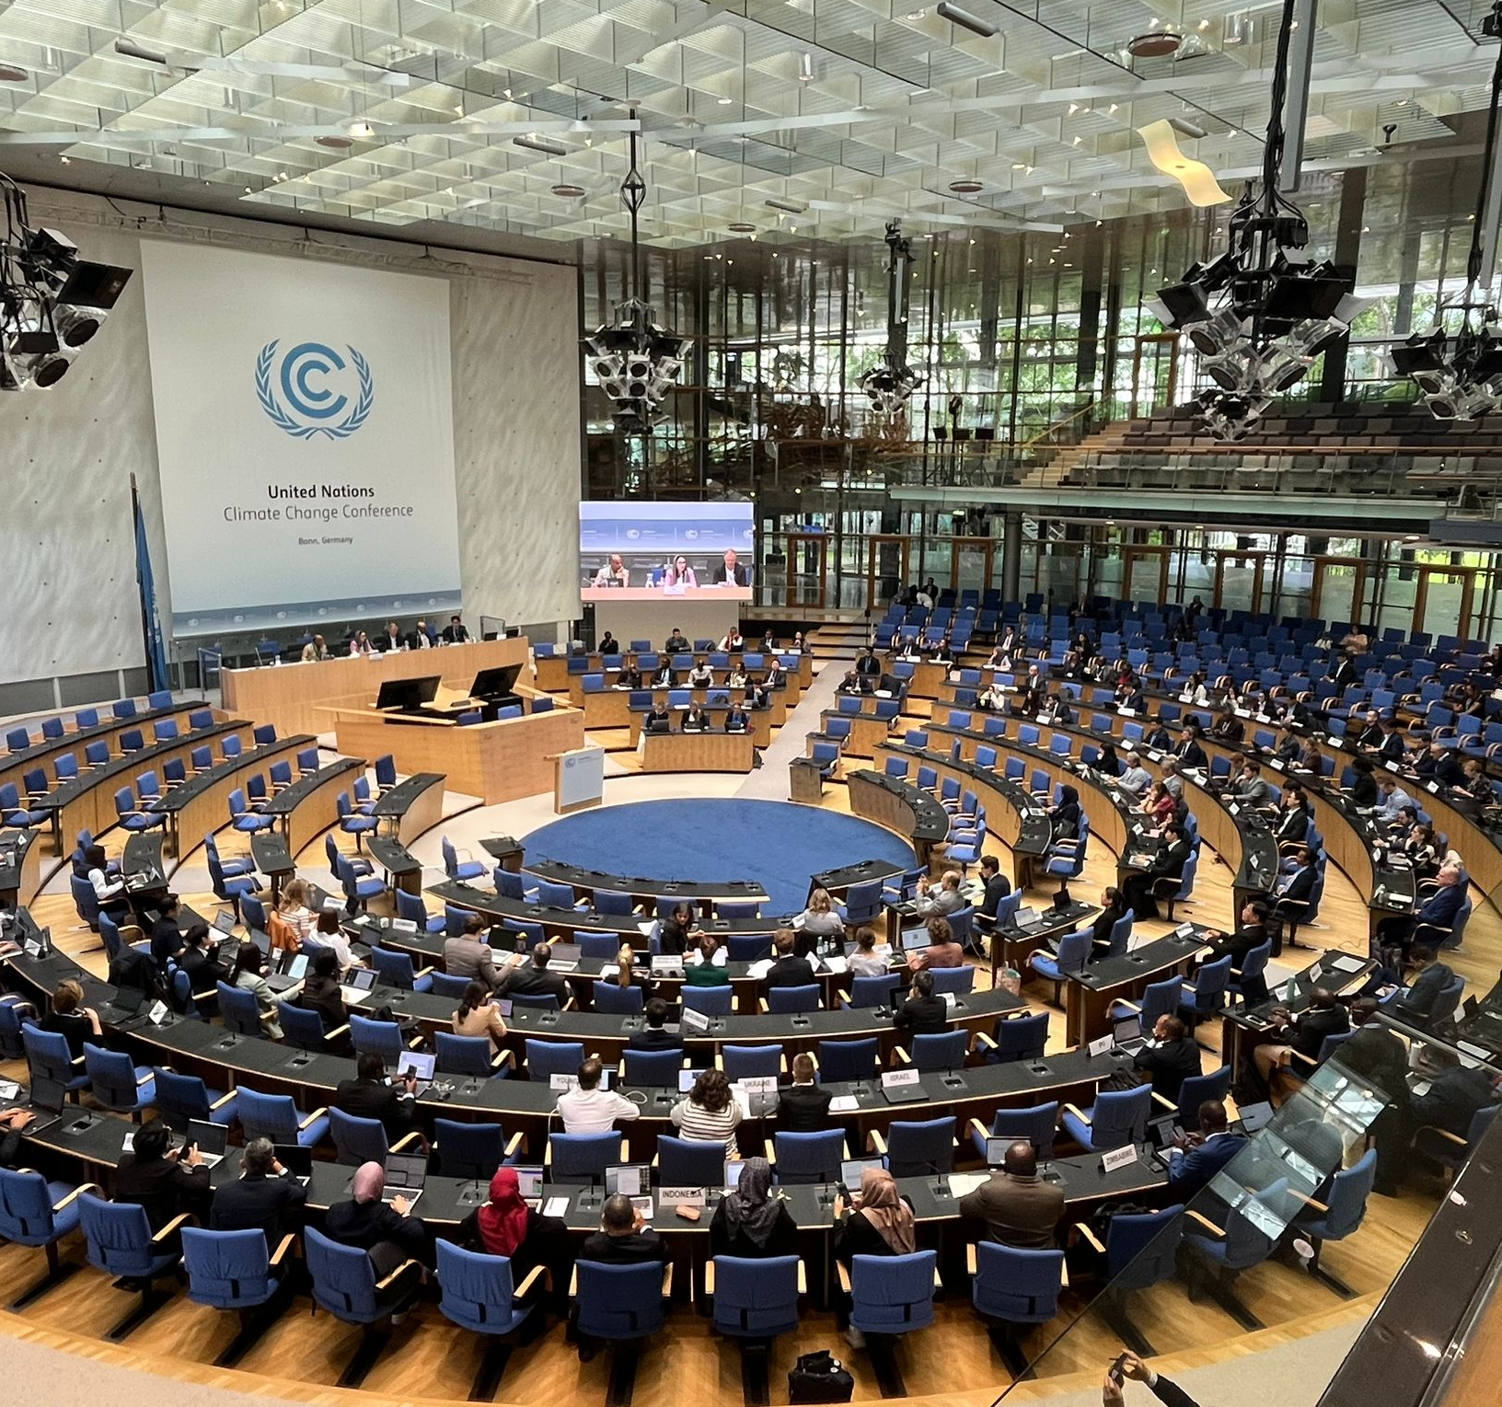
What is the Article 6.4 Supervisory Body's remit?
The Supervisory Body is tasked with developing and supervising the requirements and processes needed to operationalize the mechanism.
This includes:
Developing and/or approving methodologies;
Registering activities & approving issuance of credits;
Accrediting third-party validation & verification bodies
Managing the Article 6.4 Registry.
The Supervisory Body holds an event to engage with Parties and stakeholders at SB60. Image credit: UNFCCC

Slide 25
Article 6.4 activity cycle procedure for projects
Post-registration
Voluntary deregistration
Withdrawal of approval / participation
Pre-registration
Registration
Pre-issuance
Issuance
Renewal

Slide 26














Pre-registration
01
Project
Conceptualization
Project Prior
Consideration
PDD
Development
02
03
04
Submission of PDD for Global
Stakeholder Consultation
Activity Participant
(Project Proponent)
Activity Participant to
communicate to UNFCCC
Secretariat
Activity Participant to communicate
the PDD to UNFCCC Secretariat
A6.4 M - PDD - Form
UNFCCC Website
UNFCCC Website
No Later than 180 days after the
start date of the project
No Later than 180 days after the
start date of the project
Project
Validation
08
MoC
Preparation
07
Host Party
Approval
06
Global Stakeholder
Consultation
05
Activity Participant to hire
DOE for project validation
Activity Participant to
communicate
UNFCCC to inform the
host party
UNFCCC publishes the PDD
90 Days from the
start date of step 4
UNFCCC Website
28 Days
09
Submission of Project
for Registration
10
Completeness
Check
11
Substantive
Check
12
Request for
Registration
13
Registration
of the Project
DOE submit, MoC Preparation
+ Project Validation + other
relevant docs
21 Days
SB Approves the
project
28 Days
UNFCCC Website
Payment of fees in one year from
of the issuance of the statement of
registration fee

Slide 27







Methodology requirements and procedures
Requirements for the development and assessment of
mechanism methodologies
Meth Procedure
Bottom-up process: Stakeholders submit new methodologies (possibly building on existing methodologies or completely new)
Top-down process: Supervisory Body initiates development of methodologies (building on existing methodologies or completely new)
Technical Review by Methodological Expert Panel
Stakeholder consultation
Decision by the Supervisory Body
Meth00x
Meth00x
Meth00x
Meth00x
Meth00x
Meth00x

Slide 28
A6.4 accreditation process overview
  Accreditation is an important process within the framework of the Article 6.4 mechanism under the UNFCCC. ​
  Once accredited, the organization, known as a Designated Operational Entity (DOE), plays two important roles:​
    It validates and seeks registration for new activities or renews existing ones under the Article 6.4 mechanism; and​
    It verifies and certifies emissions reductions of registered activities.
Status Article 6.4 DOEs and applicants
    Accredited: 10 A6.4 DOEs
    Applicants: 11 A6.4 AEs
        Application stage: 1 ​
        Global stakeholder consultation: 0
        Preparation of assessment: 0 ​
        Conducting assessment: 10​

Slide 29
Eligibility for transition – PAs & PoAs
Aspect to be considered for Transition | Description
Activity Type | Shall be among those indicated publicly by the host party to the Supervisory Body.
Crediting Period | Active as of 1 Jan 2021. Ends either at the end of the current CDM CP or 31 Dec 2025 (whichever is earlier) or as specified by the host party; Type (renewable or fixed) – not to change at or after transition. Renewals – following the RPMs unless the Host Party specifies no-renewal
Use of CDM Methodologies | May continue to use currently applied CDM meth until renewal or 31 Dec 2025 (whichever is earlier) May voluntarily (or if requested by the host party if incompatible with its meth approach) replace the meth or as requested Additionality demonstration is deemed fulfilled if CDM meth is applied Global Warming Potential – apply values from the IPCC 5AR. For a PoA that continues applying CDM meths, no new CPAs may be included until renewal of PoA under Art. 6.4.
Additional activity design requirements | Long-term benefits to climate change. Addressing non-permanence (all types of activities) – analysis of risks and planned monitoring and counter measures. Social impacts.

Slide 30
Demand: CORSIA and VCM
    The volume of issued credits has declined since 2021, possibly due to continued concerns about integrity, regulatory uncertainty and ongoing revisions of methodologies.
    Demand (air traffic, emission reductions):
      No final offsetting requirements have been accrued for CORSIA’s pilot phase (2021 –2023).
      Estimated demand is 68ｰ110 Mt for the First Phase (2024-2026).
      Estimated demand is 502ｰ1330 Mt for the Second Phase (2027-2035).
Source: Committee on Aviation Environmental Protection (CAEP) “initial assessments in support of the 2025 CORSIA periodic review”, https://www.icao.int/environmental-protection/CORSIA/Documents/CAEP_Inputs%20to%202025%20CORSIA%20periodic%20review%20(C232).pdf

Slide 31
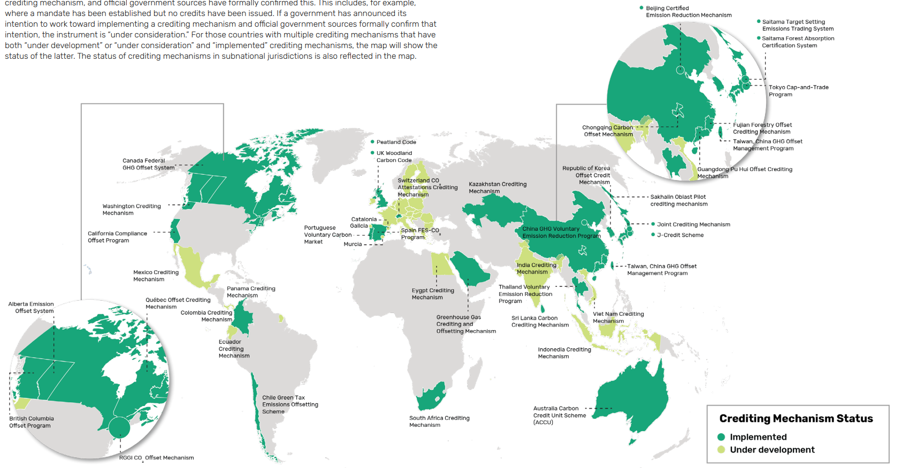
Governmental crediting system
  Governmental carbon crediting mechanisms are often established by a jurisdiction to meet domestic compliance demand* and/or voluntary demand.
    Examples include Australia, Canada, Colombia, Chile, China, EU, Japan, Kazakhstan, Portugal, Republic of Korea, Saudi Arabia, South Africa, Spain, Sri Lanka, Thailand, UK, USA (Regional) and Viet Nam.
Map of governmental crediting mechanisms
* either in conjunction with carbon pricing or some form of carbon commitment
Source: World Bank, State and Trends of Carbon Pricing 2025, Open Knowledge Repository

Slide 32
A6.4 DNA Statistics
Country | DNA | Host Party Participation Form
Angola | Nomination awaited
Mozambique | Nomination awaited
South Sudan | Nomination awaited
Botswana | Yes | To be submitted
Eritrea | Yes | To be submitted
Eswatini | Yes | To be submitted
Kenya | Yes | To be submitted
Lesotho | Yes | To be submitted
Malawi | Yes | To be submitted
Mauritius | Yes | To be submitted
Namibia | Yes | To be submitted
Seychelles | Yes | To be submitted
Zimbabwe | Yes | To be submitted
Ethiopia | Yes | Yes
Rwanda | Yes | Yes
South Africa | Yes | Yes
Tanzania | Yes | Yes
Uganda | Yes | Yes
Zambia | Yes | Yes
Countries in EASA | 19
A6.4 DNA Focal Point | 16
PACM Host Country Participation Form Ethiopia Rwanda South Africa Tanzania Uganda Zambia | 6

Slide 33
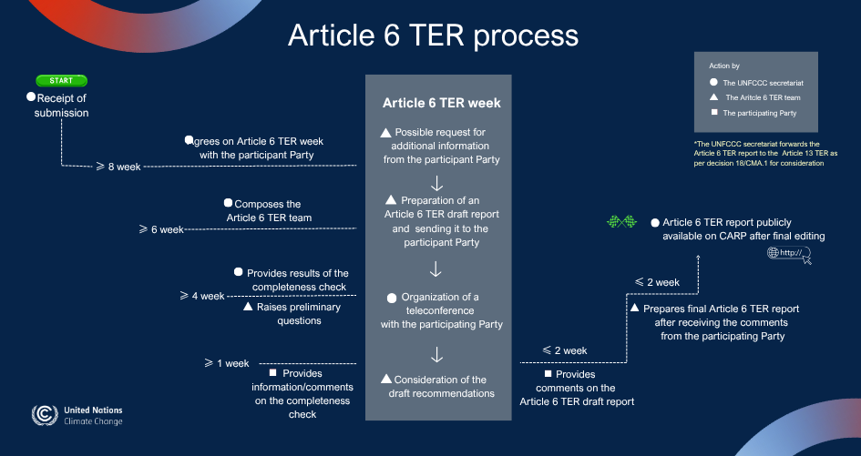
Governmental crediting system

