Slide 1




Achieving Results Faster, Together

Slide 2
Day 3: 9:00-9:30
Session 1
Key Carbon Market Trends
Achieving Results Faster, Together

Slide 3


Session Outline:
1
Key Insights from Buyer Outreach
2
ASCENT Carbon Transaction Options
3
Envisioned Monetization Support for ASCENT Countries
Achieving Results Faster, Together

Slide 4
What have we learned from Buyers?
Buyers Want
Buyers Don’t Want
Implications
ASCENT Carbon Credits
Reliable credit delivery
Authorization/Corresponding Adjustments and CORSIA-Eligibility (higher price potential)
Robust environmental and social safeguards
Trust and credibility in transactions
High integrity methodologies
Small and dispersed projects with high transaction costs
Country capacity constraints
Uncertainty linked to authorization and regulatory frameworks (red flag for buyers)
Unclear transaction responsibilities within governments
Marketing of ASCENT credits is key to communicate value and attract demand
WBG involvement seen as crucial for trust and credibility
Credit supply aggregation may simplify transactions, reduce delivery risk and lower transaction costs for buyers
Clarity on authorization process critical for ASCENT countries
Achieving Results Faster, Together

Slide 5


If Buyer’s Needs are fully met…
Many buyers may be willing to pay prices around US$ 20-30 or even higher if ALL required criteria are met
Private Sector buyers have a positive outlook on compliance market credit demand
Public Sector buyers have increasing targets for ITMO purchases but face a lack of eligible, high-quality projects
High Integrity
Reliable Delivery of Carbon Credits
Certainty linked to Corresponding Adjustments / CORSIA-Eligibility
Certainty of Regulatory Frameworks
Achieving Results Faster, Together

Slide 6
Session Outline:
1
Key Insights from Buyer Outreach
2
ASCENT Carbon Transaction Options
3
Envisioned Monetization Support for ASCENT Countries
Achieving Results Faster, Together

Slide 7
What are possible transaction options?
Sellers
Buyers
Transaction options
Sovereign buyers
Zambia
Bilateral
Tanzania
Corporate buyers
ASCENT/M300 Carbon CRMF
Rwanda
Intermediaries
Intermediaries / Brokers
Uganda
Ethiopia
Buyer Pools
Exchange / Auction
Country <…>
Brokers
Company A
M300/ASCENT Carbon “Marketplace” Partner
Company B
IFC buy-in facility
Company <…>

Slide 8


Seller-Buyer Transaction Pain Points To Be Addressed
SELLER
Lack of transparency (buyers, pricing)
Lack of buyer commitment
Lack of seller transaction capacity
Lack of upfront finance
Risk of not meeting own NDC (over-selling)
Buyer demand sensitivity
Buyer integrity
BUYER
Environmental integrity of credits
Sufficient financing of project activities
Transaction revenue use
Transaction risks / costs
Legal and regulatory risks
Usability of credits (e.g. Art.6/NDC, CORSIA)
Seller capacity

Slide 9
Session Outline:
1
Key Insights from Buyer Outreach
2
ASCENT Carbon Transaction Options
3
Potential Monetization Support for ASCENT Countries
Achieving Results Faster, Together

Slide 10
Key Monetization Support Goals
SIMPLIFICATION
STANDARDIZATION
GOALS
DIGITALIZATION
TRANSPARENCY
Which goals are most interesting to you?

Slide 11
Potential Monetization Support Areas for ASCENT Countries
Transaction Readiness
Transaction Readiness
Buyer Identification & Intelligence
Transaction Negotiations
Contract Signing & Implementation
Regulatory frameworks / infrastructure
Credit ownership (legal title)
Transaction responsibilities in government
Transaction team / capacity
Transaction training
Building „marketplace“
Supply aggregation
Buyer outreach / buyer intelligence
Marketing material
Country readiness profiles
Buyer-seller roundtables
Buyer roadshows
Transaction option selection (bilateral, intermediaries, auctions etc.)
Buyer-seller matchmaking
Facilitation of negotiation process
Legal transaction templates / training
Signing ceremony
dMRV
Delivery & issuance
Transfer & accounting
Transaction revenue use

Slide 12


Poll: Identify 3 areas in which WBG support would be most valuable?
Transaction Readiness
Buyer Identification & Intelligence
Transaction Negotiations
Contract Signing & Implementation
Any further requested monetization-related support
Achieving Results Faster, Together

Slide 13
BACK UP SLIDES
Achieving Results Faster, Together

Slide 14
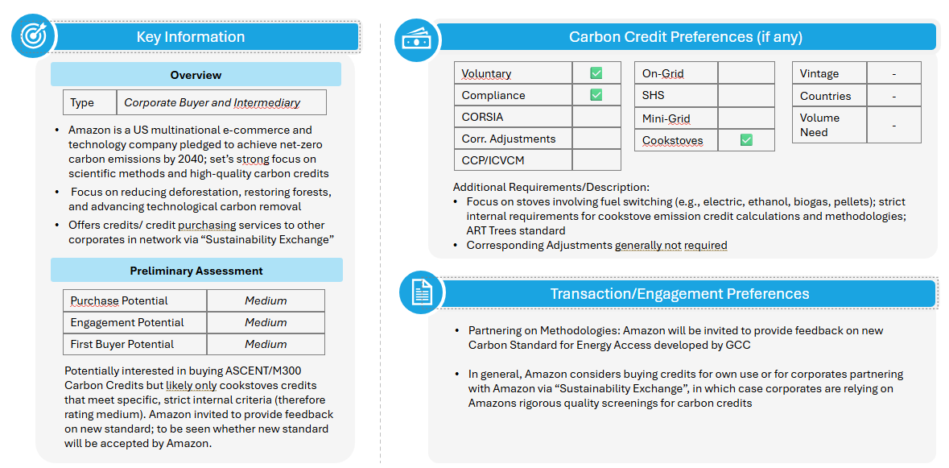
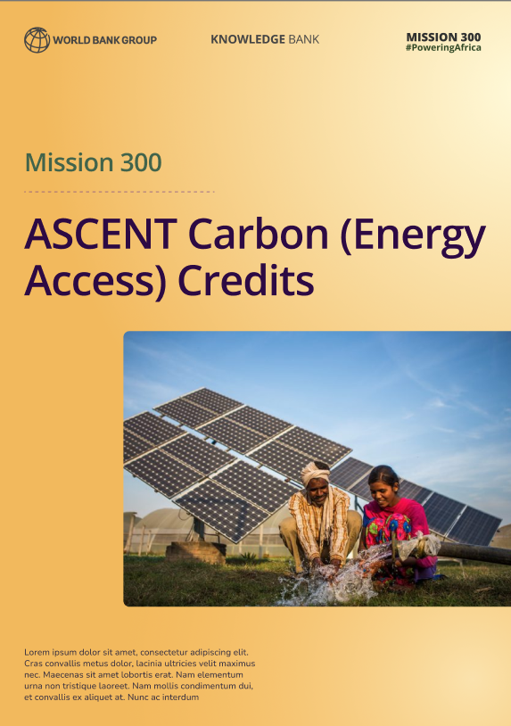
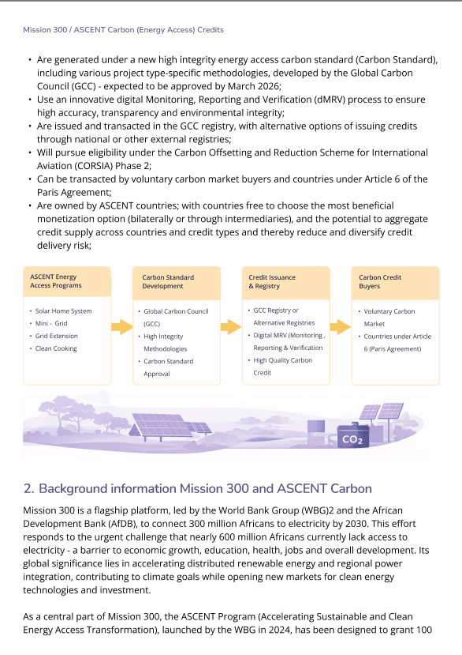
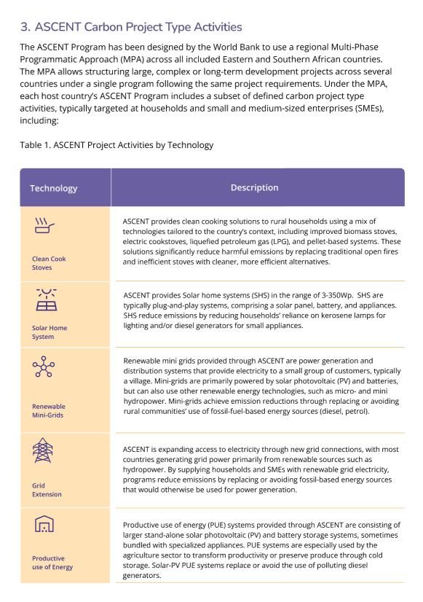
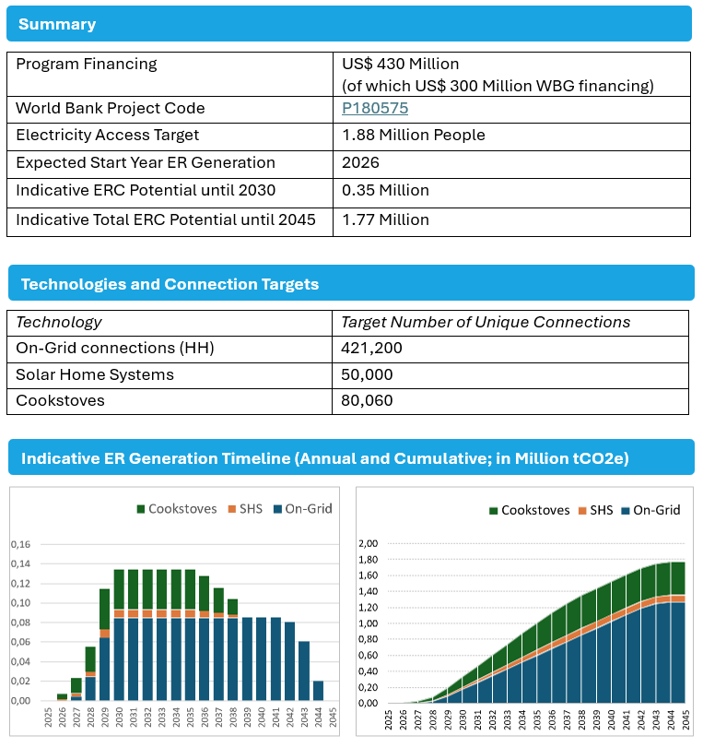
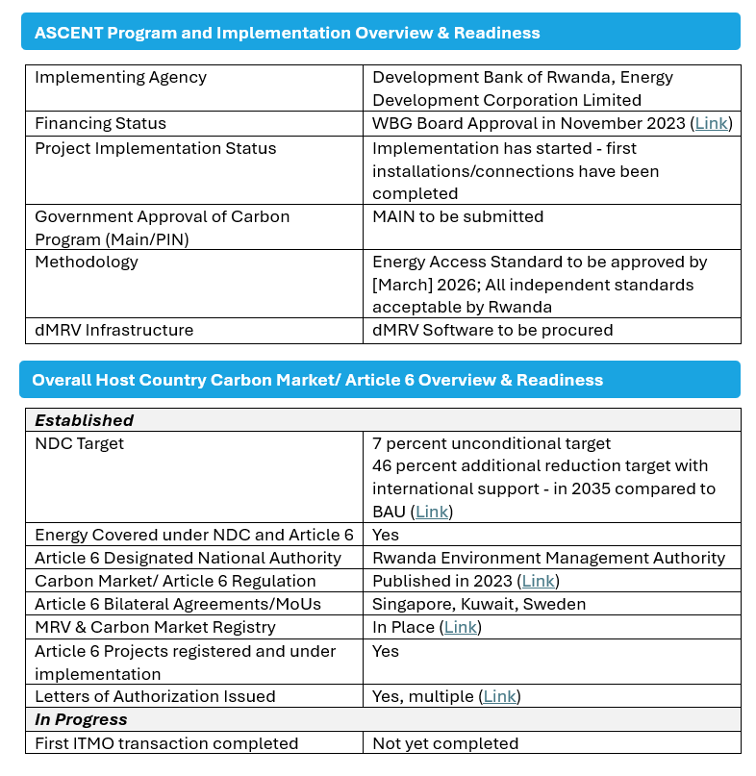
Current Monetization Support Offerings for ASCENT Countries (1/2)
Buyer Outreach & Buyer Intelligence
Country Readiness Profiles
Marketing Material
Achieving Results Faster, Together

Slide 15

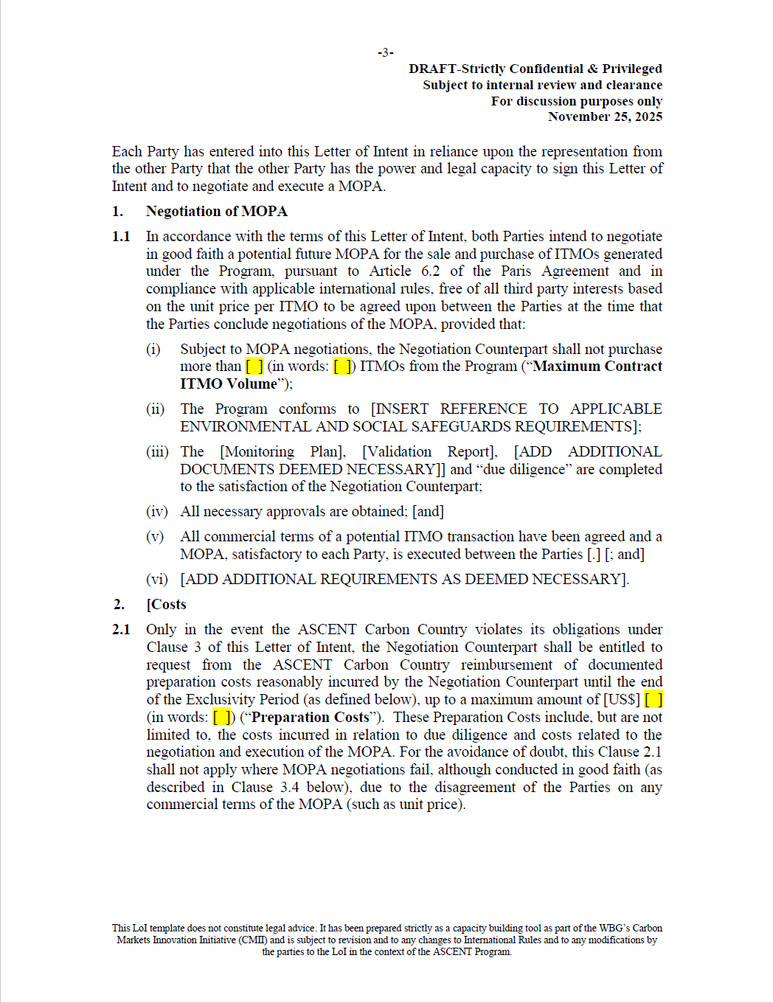
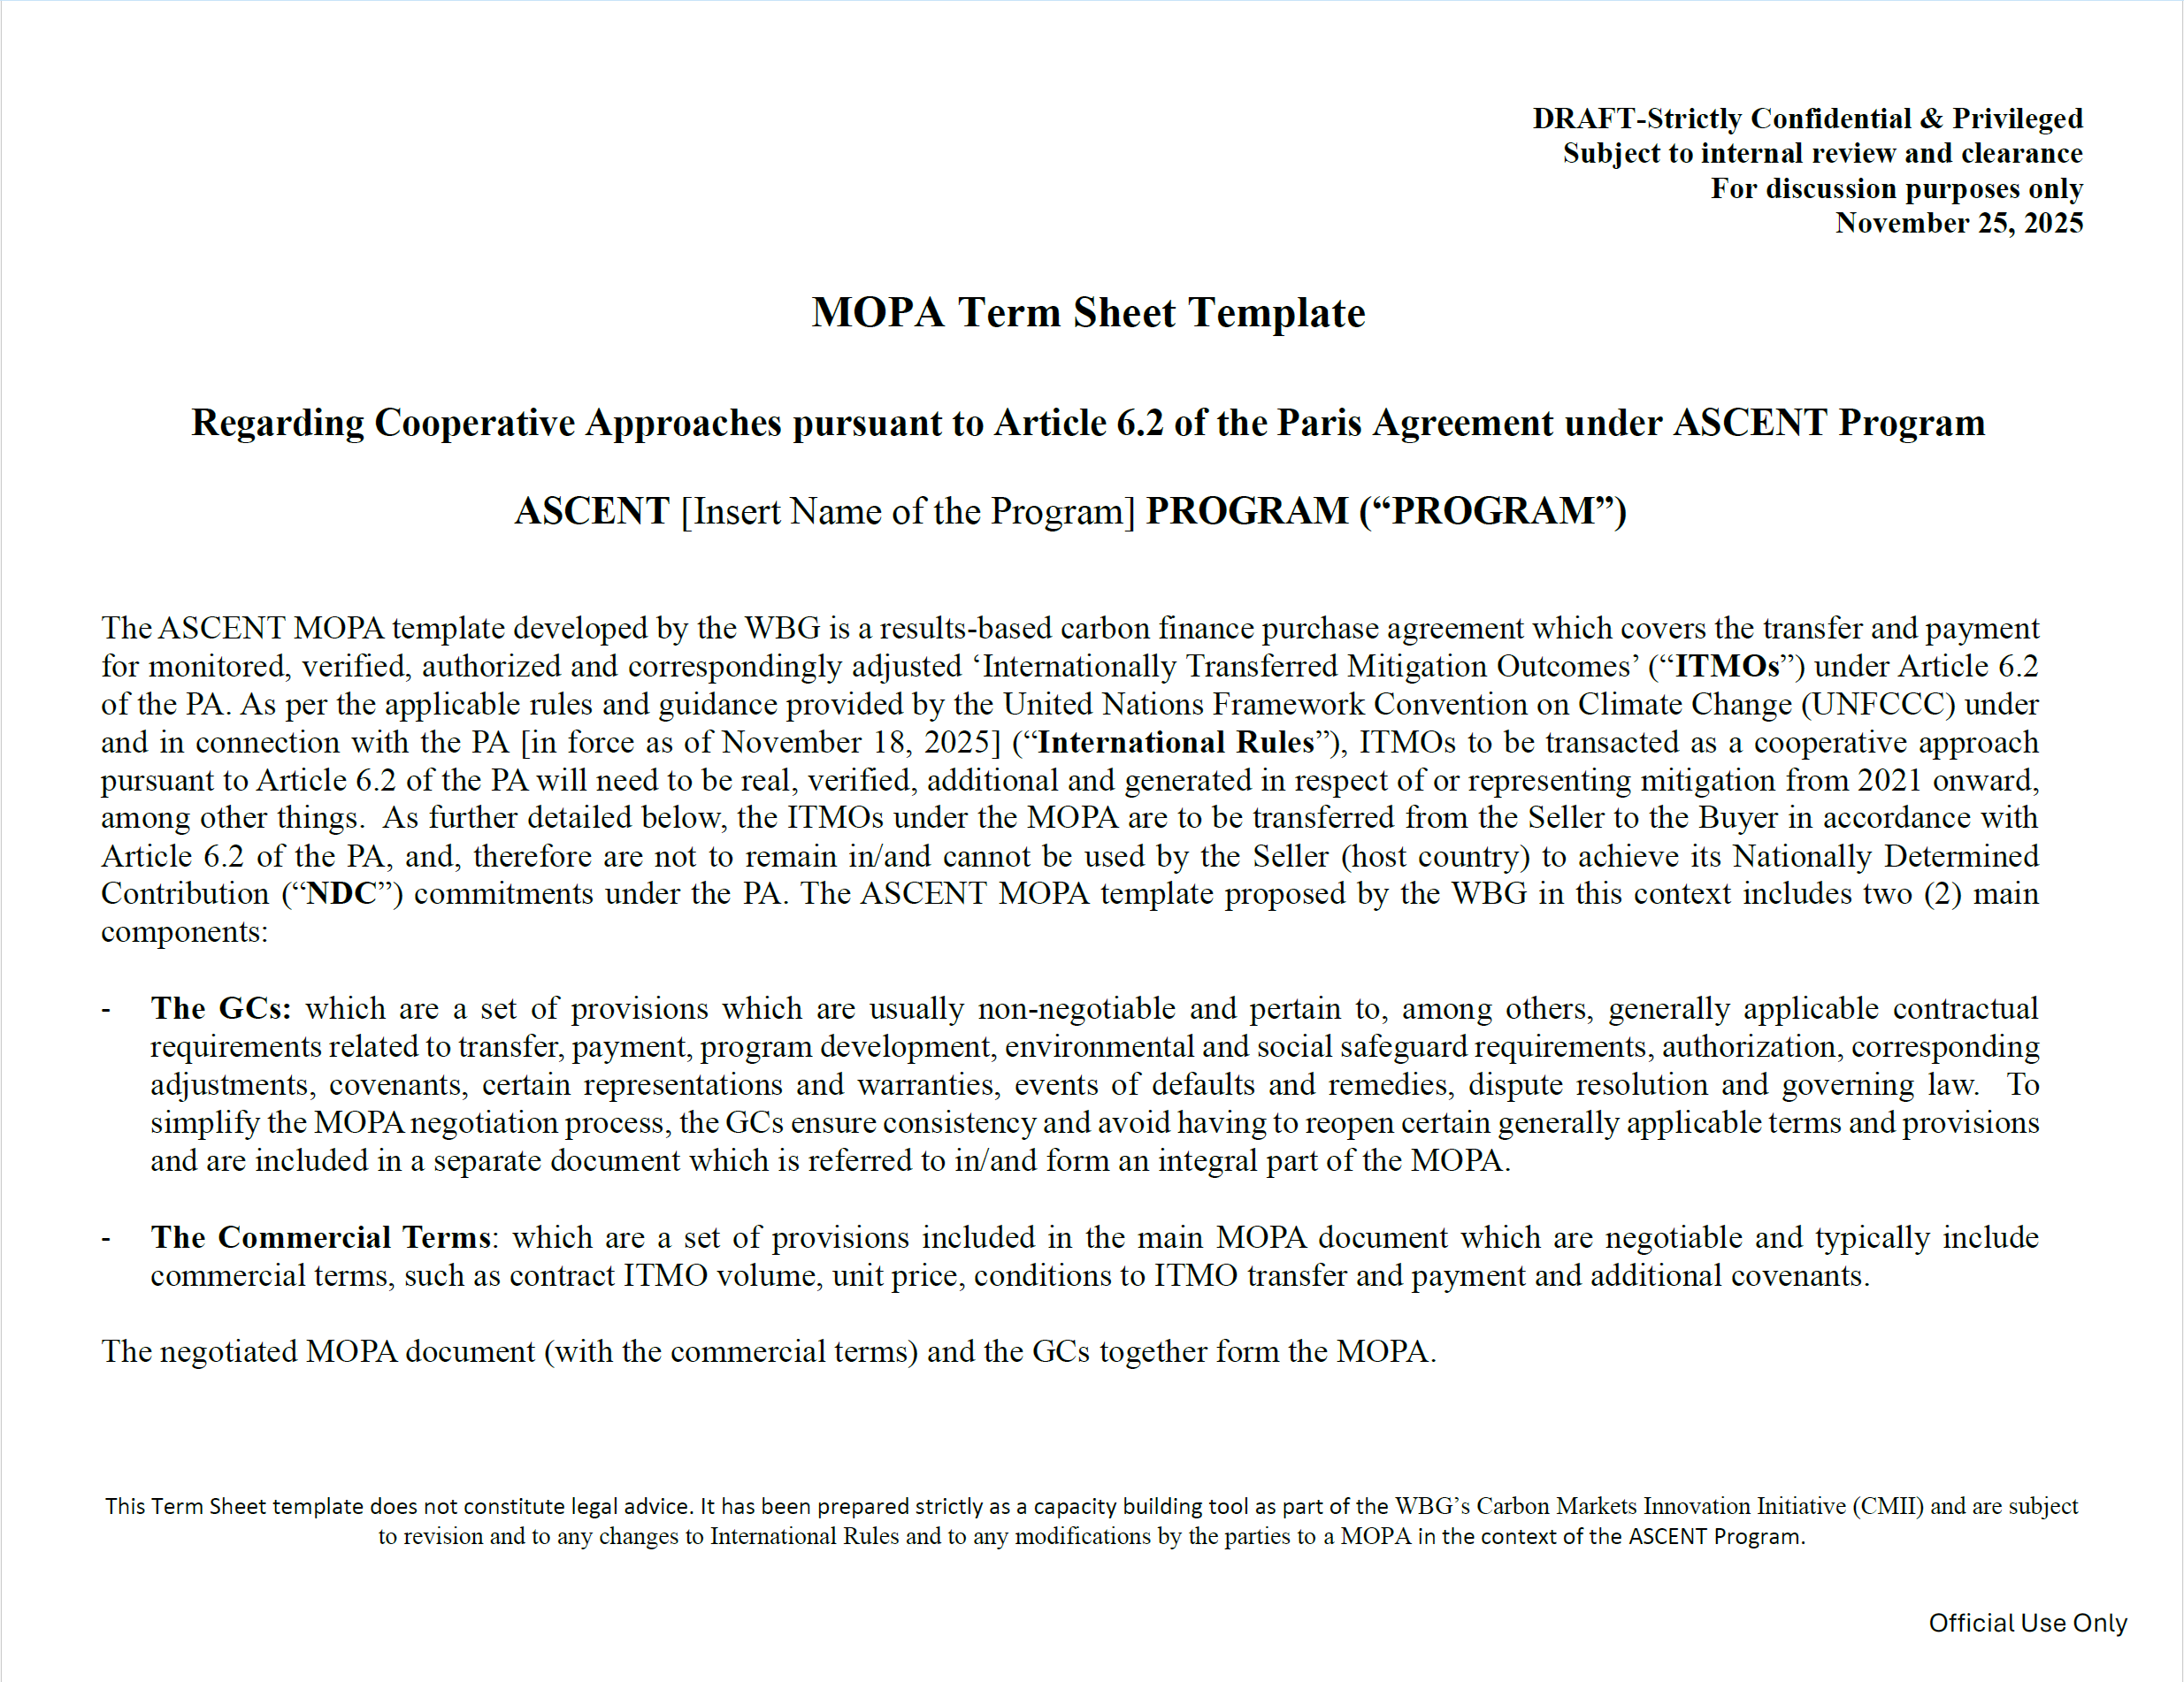
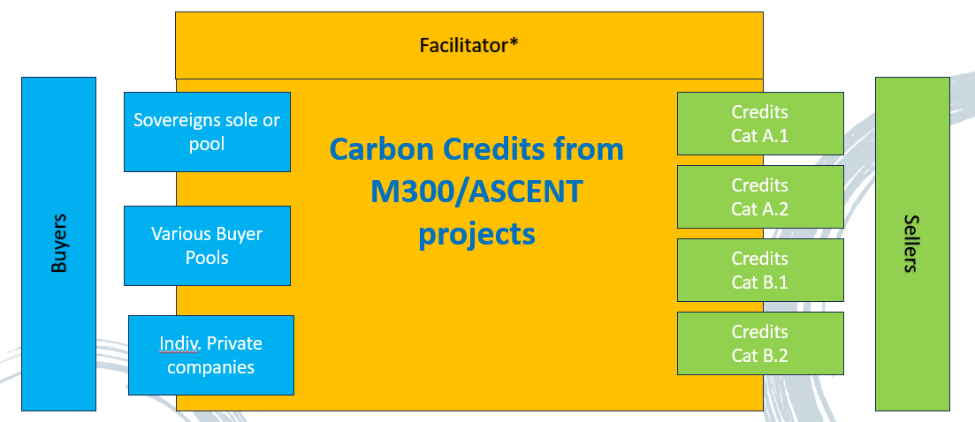
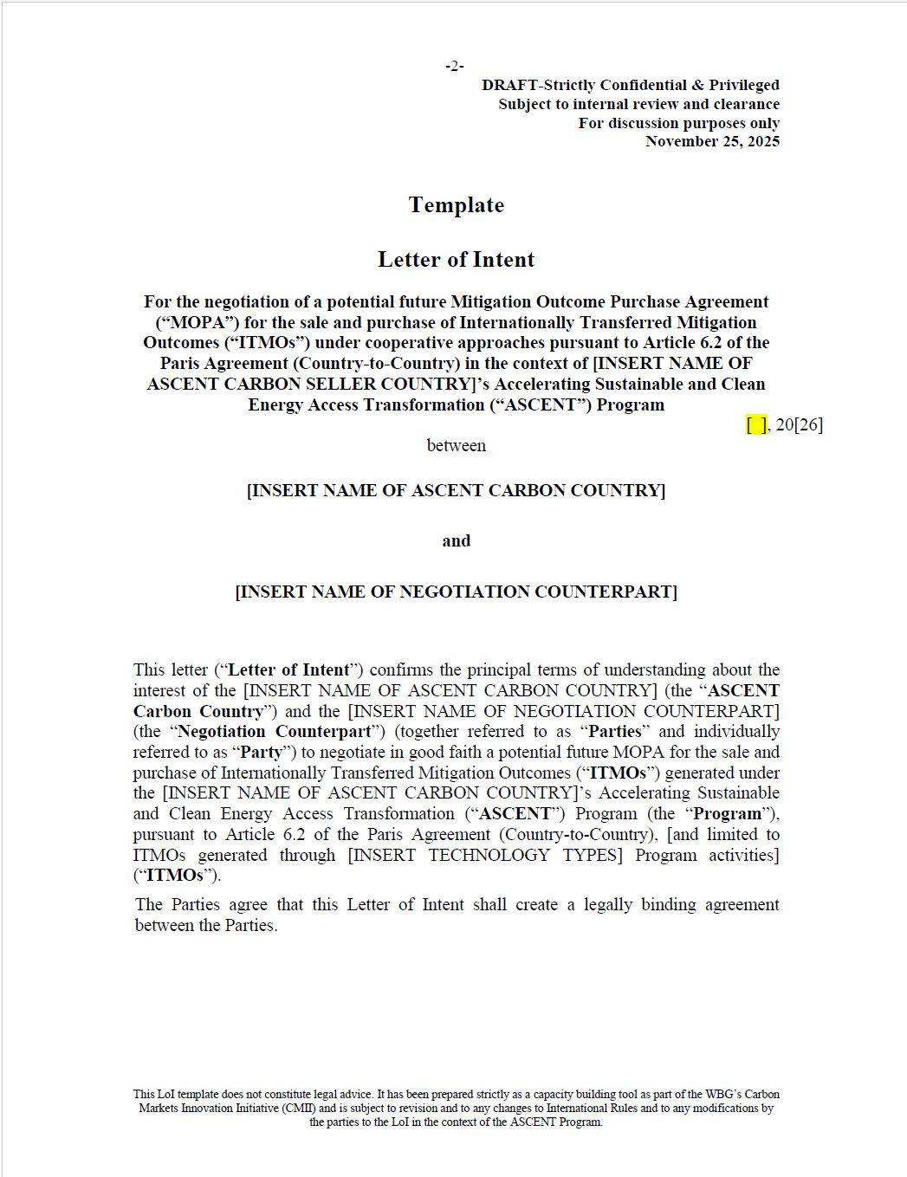
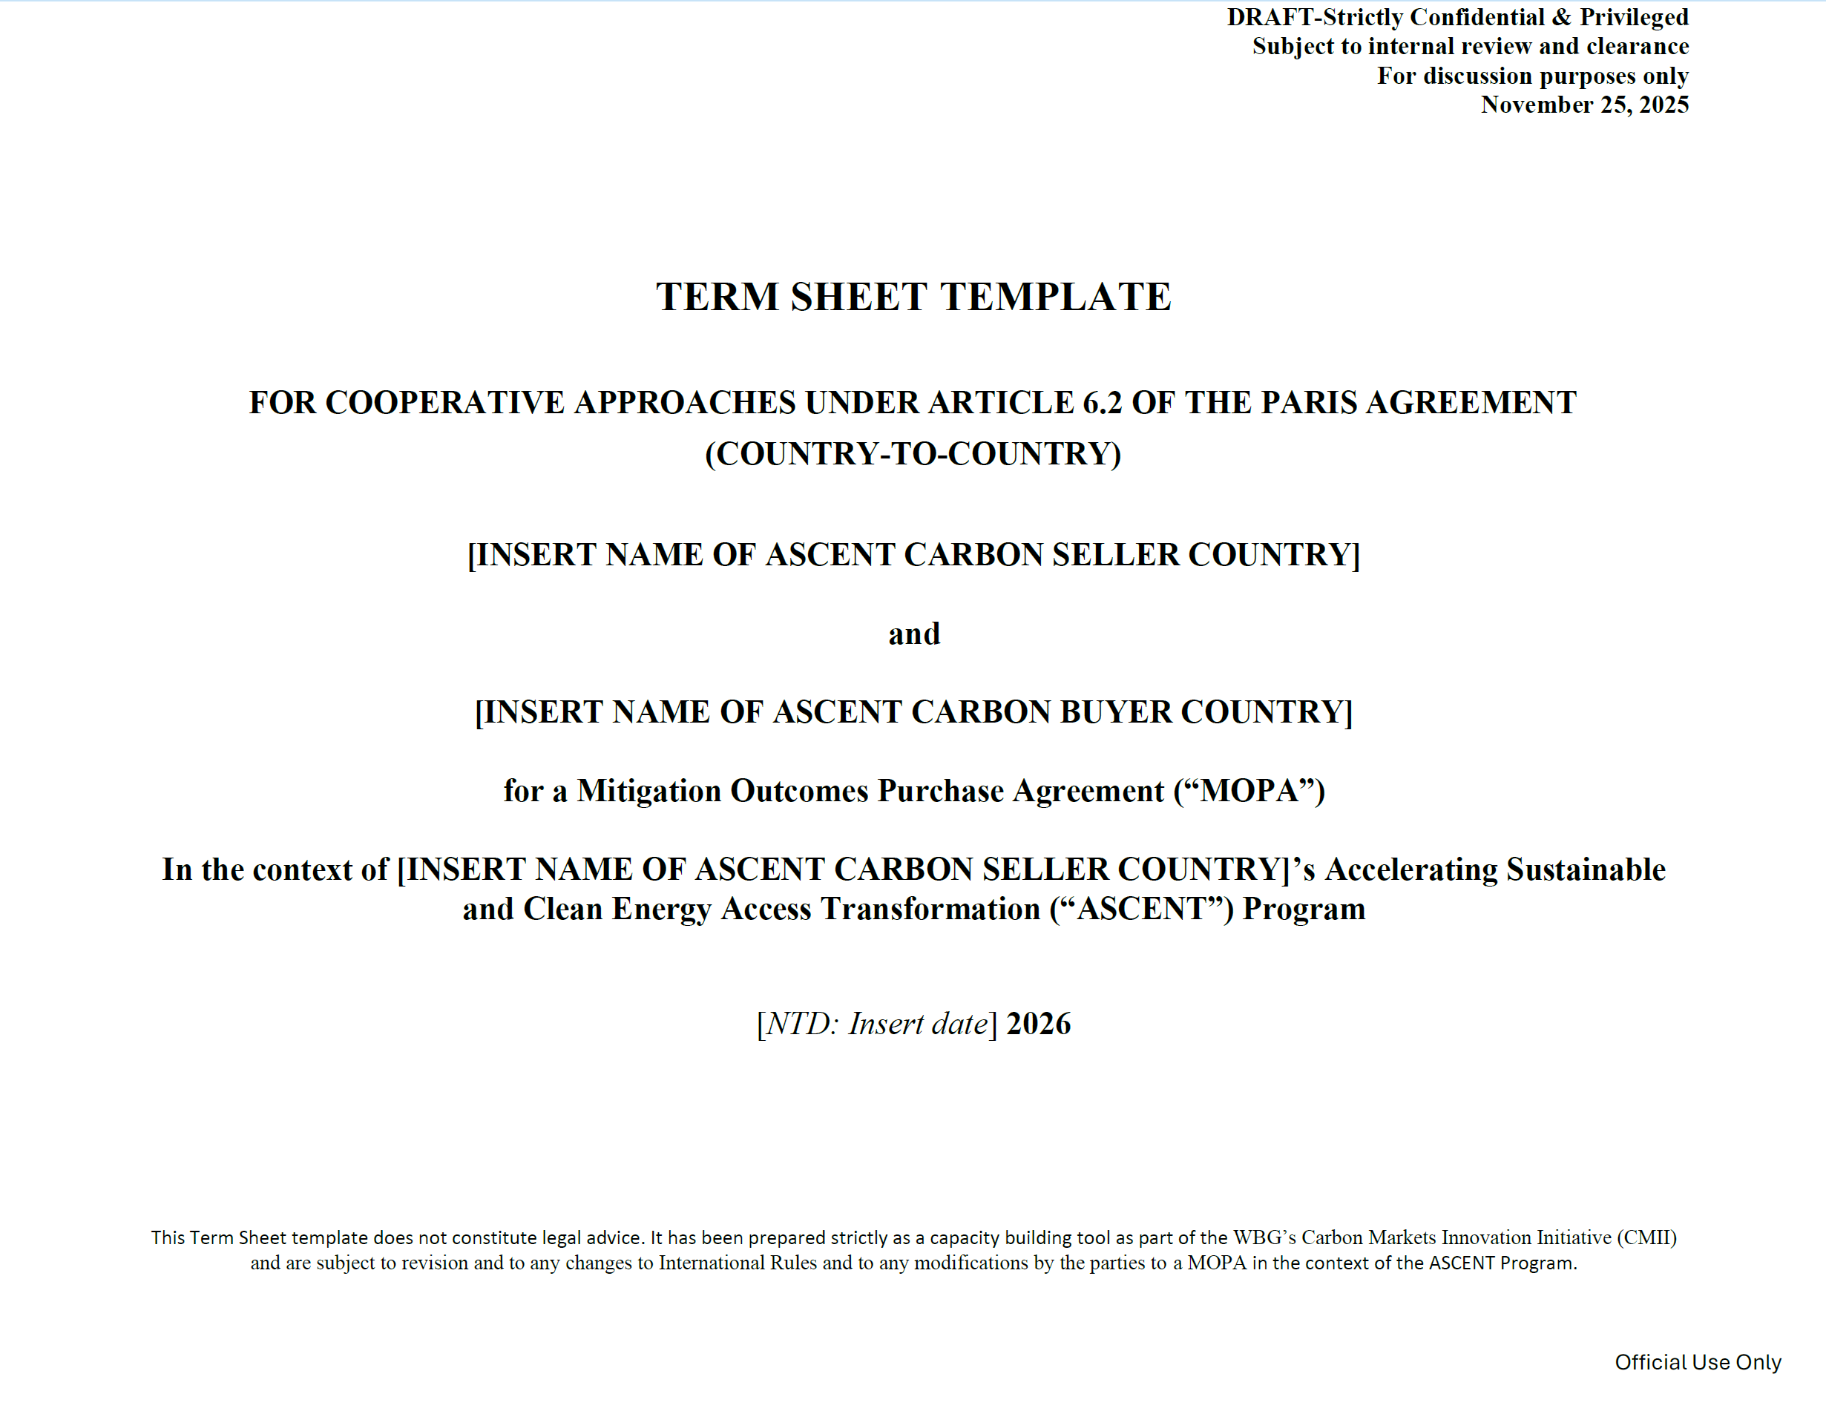
Current Monetization Support Offerings for ASCENT Countries (2/2)
Standardized Legal Transaction Templates & Training
(Indirect) Transaction Advisory and Negotiation Support
Marketplace
(Transparency & Aggregation)
Achieving Results Faster, Together

