Slide 1





DAY 1 – Session A. ASCENT Projects and ASCENT Carbon
Achieving Results Faster, Together

Slide 2
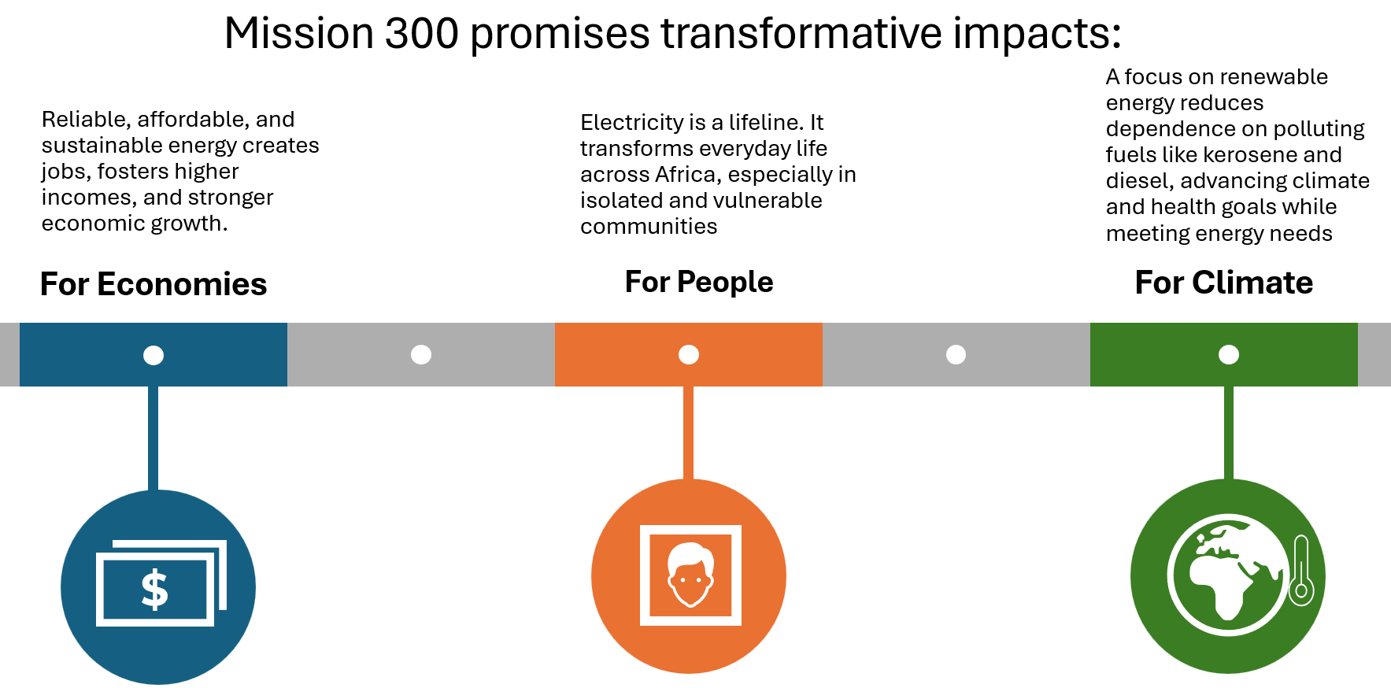
ASCENT is a flagship of Mission 300, led by the World Bank, AfDB and partners to scale up energy access to reach 300 mn people with electricity by 2030

Slide 3


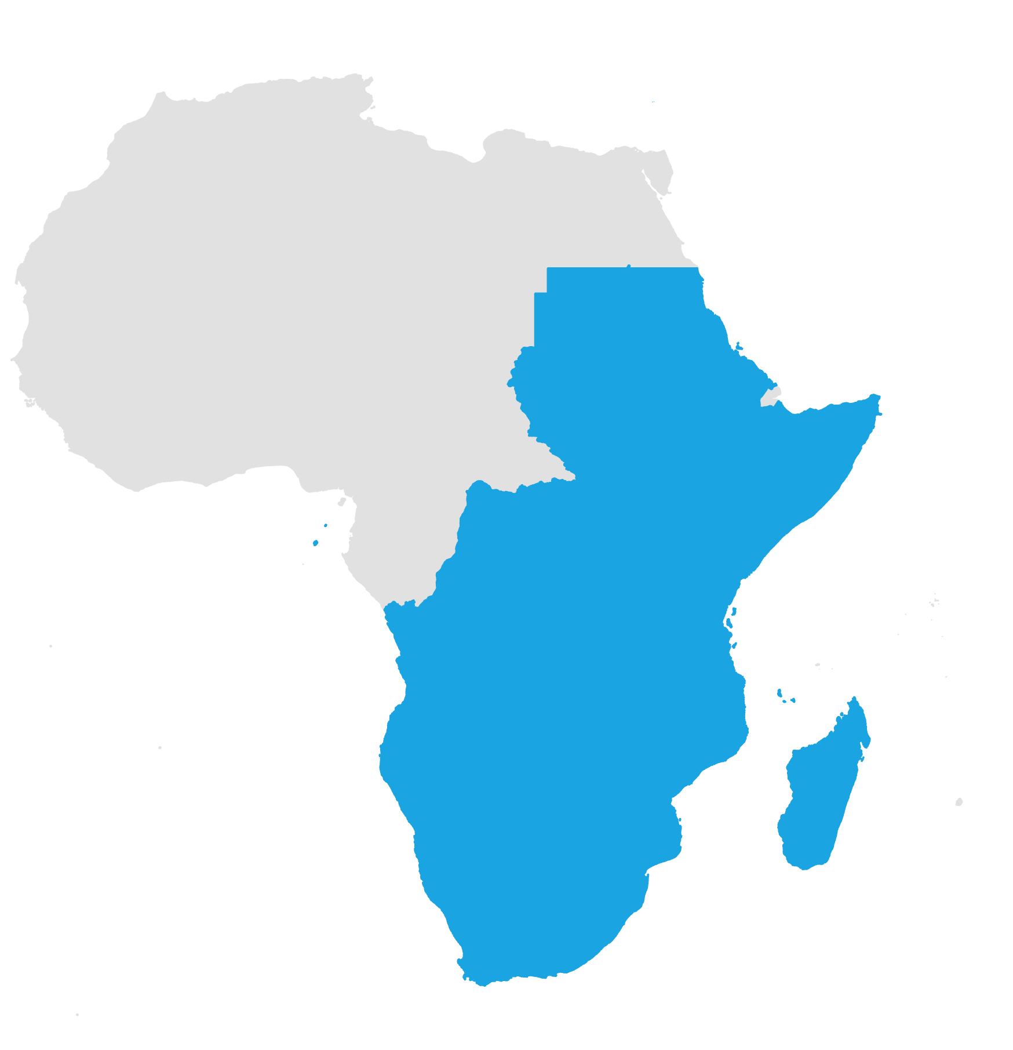







ASCENT: an ambitious program to achieve energy access goal in Eastern and Southern Africa
20+ countries
in Eastern and Southern Africa will be supported by the program
7 years
Timeframe for program to achieve goals - until 2030
$5 billion IDA
Leveraging an additional $10 billion of financing, incl. carbon markets
Impact
100,000,000
people
with access to electricity
50,000
health and education facilities provided with access
20,000,000
people provided with clean cooking solutions
10,000,000
farmers and rural SMEs provided with power and equipment
+80,000,000
tCO2 emissions reduced

Slide 4





ASCENT is implemented through a multi-phased approach, combining mutually reinforcing country programs and regional platforms
Approved
Under Preparation / Expected to Join
Botswana
Comoros
Democratic Republic of Congo
Lesotho
Kenya
Madagascar
Namibia
South Sudan
Uganda
Somalia​
Sudan
Tanzania​
Zambia​
Burundi
Eswatini
Ethiopia
Malawi
Mozambique
Rwanda
Sao Tome and Principe
Regional Access Acceleration Platform
- Knowledge and technical assistance to public and private stakeholders
Implemented by:
Regional Financing Facility
- Debt and grants for DRE and clean cooking companies
Implemented by:
Collaboration with:
(i) Equity Facility, (ii) Risk Mitigation Facility, (iii) Scaling-Up Regional RBF, (iv) Cross Cutting and Cross-Border Solutions; (v) Carbon Market Facilitation

Slide 5
The ASCENT toolbox for mobilizing public and private sector:
Regional facilities working hand-in-hand with country projects
Risk Mitigation (proposed)
2. ASCENT Regional Financing Facilities
collaboration with:
Enabling Environment / TA
Equity
1. ASCENT COMESA: Regional Energy Access Acceleration Platform
ASCENT Toolbox
Mobilizing Carbon Finance
Debt / Credit
Grants
3. Country programs: IDA loans, credits or grants for grid and off-grid investment and related capacity strengthening

Slide 6


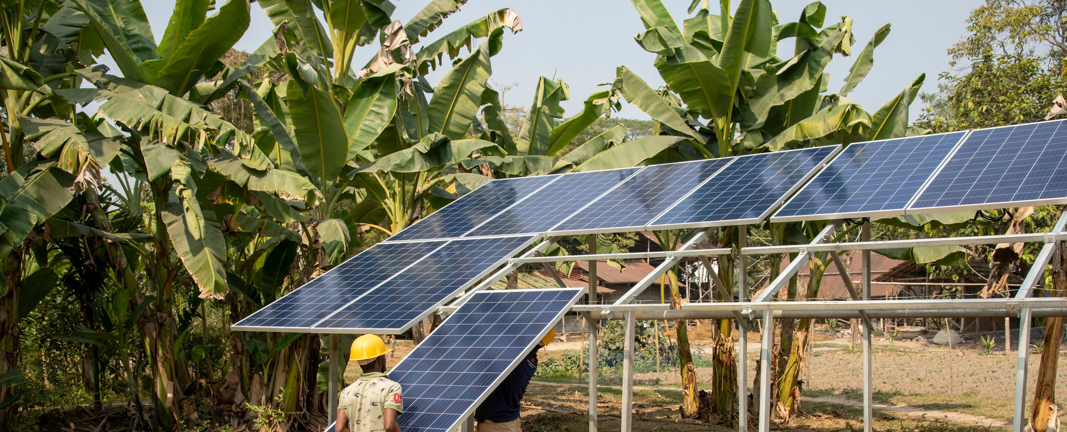
ASCENT is organized around three pillars of work
1
2
3
Regional and National Platforms to Accelerate Energy Access
Expanding Grid Electrification
Scaling Distributed Renewables and Clean Cooking
Regional implementation alignment and support for enabling economies of scale
Harmonization of policy and regulatory frameworks by adopting best practices
Digitalization of planning, processes and MRV and mobilizing financing at regional scale
Grid densification and expansion, grid strengthening and VRE integration investments
Cross-border electrification in remote, border areas
Utility strengthening, including digitization and improved climate resilience
Expand energy access with DREs and clean cooking technologies, including health care facilities and schools (DRE least cost technology for 50% of households)
Developing financing solutions for scale and to support home-grown innovation and mobilize private capital
Implementation via country programs + regional platforms, reinforcing each other

Slide 7


ASCENT Carbon
Achieving Results Faster, Together

Slide 8


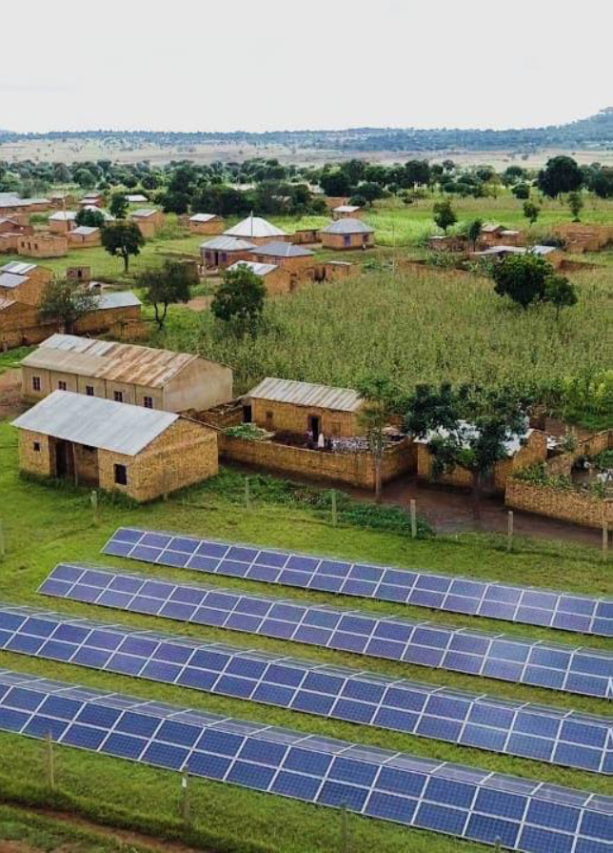
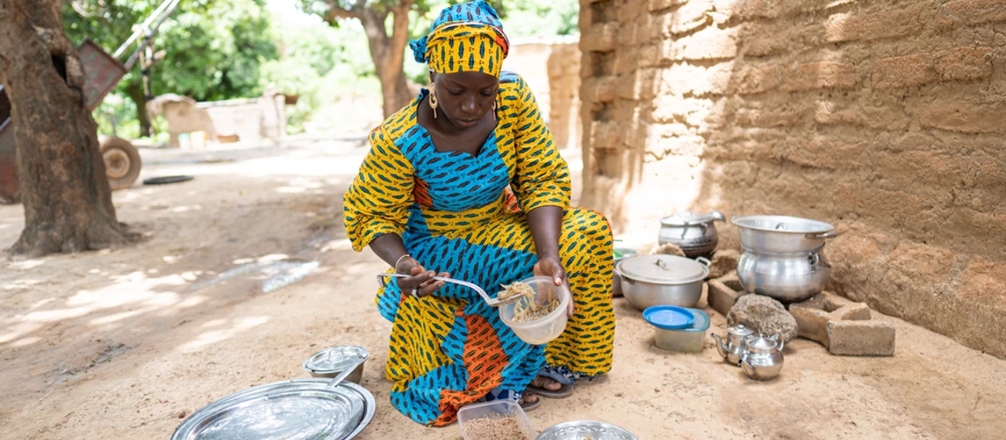
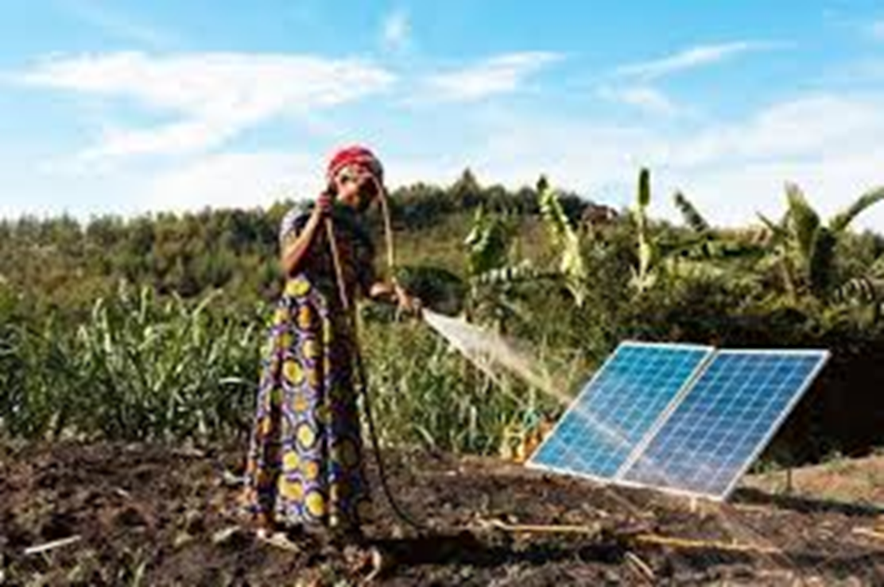
ASCENT Carbon Program
OBJECTIVE: Leveraging Carbon Finance for Energy Access
Achieving Results Faster, Together

Slide 9







Understanding the avenues to enable carbon finance in ASCENT countries
Key Challenges
Potential solution
Insufficient volume/scale
Aggregation
High transaction costs associated with measuring emission reductions and rigorous carbon validation & verification
Digitalization of carbon market ecosystem and capacity building
Conservative baselines, rigorous methodologies and robust MRV
Complexity of carbon generation and carbon market participation: Process and Monetization uncertainty→ price, quantities & timing
Transparency
High perceived risks from potential buyers (including linked to integrity and financial management). Reputational risks.
Procurement and financial management good practices
Lack of technical capacity and experience (as Africa generally overlooked in 1st phase of carbon markets under CDM)
Environmental and social safeguards
Regulatory uncertainty
Country carbon market strategy, policy framework, and technical assistance
Achieving Results Faster, Together

Slide 10




ASCENT CARBON opportunity: generating high-quality carbon credits for carbon finance mobilization
Benefits from digitalization, aggregation, standardization and capacity building
Features
Opportunities
Target to provide access to electricity to 100 million people and clean cooking to 20 million people
Development benefits → can fetch premium
E.g., Market putting higher value on carbon assets consisting of clean cookstoves and household devices
Leveraging emerging innovations & technological know how for energy access digital platform; data, tools, smart digital devices
Integrity, Transparency and Credibility are key → Opportunity to leverage ASCENT Digital MRV system
Opportunity to lower carbon market-related transaction costs
Regional approach
Regional platforms key to harmonization, aggregation of assets and capacity development efforts
Critical to enable smaller countries, smaller projects and small volumes access carbon monetization options
Subject to WB due diligence, operational policies, procedures and supervision
World Bank “label” considered valuable → Opportunity to engage actors seeking high integrity carbon credits
Market values WB due diligence; Env. & social framework; procurement; financial management

Slide 11
ESTIMATES; FINAL FIGURES MAY VARY
ASCENT Carbon: From Energy Access Targets to estimates of indicative Emission Reduction Credits (ERCs) and indicative carbon revenue potential for energy access
Targets
Indicative Emission Reduction Credits*
The overall ASCENT program has set targets for the various energy access technologies…
Most emission reduction credits are expected to be generated by On-Grid, followed by Clean Cooking and Off-Grid. ERC Delivery ramps up over time, following deployment and use of clean energy access technologies
Energy Access Technology | Number of Unique Connections
Mini-Grid | 1.600.000
Solar home systems (SHS) | 4.000.000
Pico Solar | 2.400.000
On-Grid (grid extensions) | 12.000.000
Cookstoves | 4.000.000
On-Grid:
40 Million ERC
47%
Off-Grid:
14 Million ERC
17%
~85 Million ERC (over crediting period)
Clean Cooking:
31 Million ERC
36%
Indicative Carbon Revenue Potential:
~$1.7 – $2.5 bn IF all indicative ASCENT Carbon ERCs volume sold @ $20-$30/tCO2
* As of September 1st, 2025 - Estimates are subject to ongoing revisions to account for any methodological updates, adjustments to crediting periods, evolving country-level assumptions and progress in the implementation of the underlying energy access projects
Notes:
Overall – for the group of ASCENT countries, over the entire crediting period, we estimate that ERCS in the order of 85 MtCO2 will be generated.
Calculation of estimated ERCs: key input data comes from the operations team: the type and volume of energy access connections and cook stoves covered. Then the emission reductions are calculated “centrally” within our ASCENT Carbon team using approved methodologies in alignment with guidance on Article 6 to ensure a consistent approach. We believe we have used a conservative approach (the innovation of the Carbon Standard for Energy Access is not in the calculation of tonnes). Based on the operational details we have at this stage – which may change – we believe we can be confident with the aggregate estimate.
Times series is based on estimated annual ASCENT energy connection targets. In aggregate, we are confident with numbers, but there may be uncertainties in timing of generation of ERCS in the first years– as some programs are yet to be approved and may affect timing. Better to look at country-level data for approved ASCENT country programs.
Some may recall that a couple of months ago, we had slides with a higher estimate. As we went through the data, we found an error in how the cookstoves target was reported (by person instead of by household). So that is the reason for the change. It has nothing to do with the methodology or expected operational performance. We caught the error. We do not expect any more changes of that magnitude.

Slide 12
ASCENT Carbon: Technical assistance, capacity building and sharing knowledge & good practices
1. Carbon Standard for Energy Access
2. Cabon Market infrastructure (carbon digital MRV)
3. Carbon Market policy/regulatory readiness – enabling environment
4. Country-level carbon asset generation & implementation support
5. Strategy & enabling for carbon monetization
A World Bank Group program working closely with COMESA (through Regional ASCENT Energy Access Acceleration Facility)
Delivering with partners (Global Carbon Council (GCC), Access to Energy (A2EI) and Carbon Clear)
Achieving Results Faster, Together

Slide 13
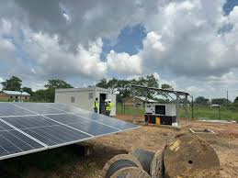
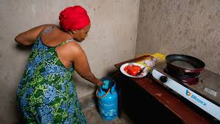
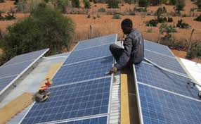
ASCENT CARBON DAYS: Key objectives
Development of a common and updated understanding of ASCENT Carbon
  What it takes to generate high quality emission reductions from ASCENT project to mobilize carbon finance that can help bridge part of each country’ energy access financing gap
Gain knowledge and share experience
Identify gaps and areas of needed support
Elaboration of Roadmap/Action plan by each ASCENT country
Leveraging Carbon Markets for Energy Access

Slide 14
The Starting Point: Your ASCENT/Energy Access Projects
Achieving Results Faster, Together

Slide 15
ASCENT is organized around three pillars of work
1
2
3
Regional and National Platforms to Accelerate Energy Access
Expanding Grid Electrification
Scaling Distributed Renewables and Clean Cooking
Regional implementation alignment and support for enabling economies of scale
Harmonization of policy and regulatory frameworks by adopting best practices
Digitalization of planning, processes and MRV and mobilizing financing at regional scale
Grid densification and expansion, grid strengthening and VRE integration investments
Cross-border electrification in remote, border areas
Utility strengthening, including digitization and improved climate resilience
Expand energy access with DREs and clean cooking technologies, including health care facilities and schools (DRE least cost technology for 50% of households)
Developing financing solutions for scale and to support home-grown innovation and mobilize private capital
Implementation via country programs + regional platforms, reinforcing each other

Slide 16

ASCENT Rwanda Components and Results
Approved
Pillars and Components
Outputs
Pillar 1:
Platform to Accelerate Energy Access
Component 4:
Technical Assistance, Institutional Capacity Building and Implementation Support
At least 1,880,000 people provided with electricity
Pillar 2:
Expanding Grid Electrification
Component 1:
Increasing Access to Grid Electricity
Component 2:
Enhancing the Reliability of Electricity Service
Pillar 3:
Scaling Distributed Renewables and Clean Cooking
Component 3:
Increasing Access to Off-Grid Electricity, Clean Cooking Solutions and Productive Uses of Energy (PUE)

Slide 17

ASCENT Tanzania Components and Results
Approved
Pillars and Components
Outputs
Pillar 1:
Platform to Accelerate Energy Access
Component 3:
National Access Acceleration Platform
4,000,000 people provided with electricity
Pillar 2:
Expanding Grid Electrification
Component 1:
Expanding On-Grid Access to Electricity, including densification and last-mile connections
Pillar 3:
Scaling Distributed Renewables and Clean Cooking
Component 2:
Increasing Supply of Distributed Renewable Electricity in Rural Areas

Slide 18

ASCENT Malawi Components and Results
Approved
Pillars and Components
Outputs
Pillar 1:
Platform to Accelerate Energy Access
Component 5:
Technical Assistance and Capacity Building
4,400,000 people provided with electricity
Pillar 2:
Expanding Grid Electrification
Component 1:
Last Mile Grid Connection
Pillar 3:
Scaling Distributed Renewables and Clean Cooking
Component 2:
Off-Grid Connection through Solar Home Systems
Component 3:
Energy Access for Schools and Health Facilities
Component 4:
Clean cooking solutions

Slide 19

ASCENT Zambia Components and Results
Approved
Pillars and Components
Outputs
Pillar 1:
Platform to Accelerate Energy Access
Component 3:
Strengthening National Platform for Energy Access
1,642,000 people provided with electricity
Pillar 2:
Expanding Grid Electrification
Component 2:
Expanding On-Grid Access to Electricity
Pillar 3:
Scaling Distributed Renewables and Clean Cooking
Component 1:
Increasing Supply of Distributed Renewable Energy

Slide 20

ASCENT Burundi Components and Results
Approved
Pillars and Components
Outputs
Pillar 1:
Platform to Accelerate Energy Access
Component 4 ASCENT Burundi:
Power sector sustainability
900,000 people provided with electricity
Pillar 2:
Expanding Grid Electrification
Component 1 ASCENT Burundi:
Network reinforcement outside of Bujumbura
Component 2 ASCENT Burundi:
Rehabilitation, densification, modernization, and extension of distribution network in Bujumbura and surrounding areas
Component 3 ASCENT Burundi:
Private sector distribution project
Pillar 3:
Scaling Distributed Renewables and Clean Cooking

Slide 21

ASCENT Ethiopia Components and Results
Approved
Pillars and Components
Outputs
Pillar 1:
Platform to Accelerate Energy Access
Component 3:
Strengthen sector capacity and institutional reform
5,000,000 people provided with electricity
Pillar 2:
Expanding Grid Electrification
Component 1:
Increase on-grid access to electricity
Pillar 3:
Scaling Distributed Renewables and Clean Cooking
Component 2:
Increasing off-grid access to electricity

Slide 22
Access to Distributed Electricity and Lighting in Ethiopia (ADELE) Components and Results
Approved
Pillars and Components
Outputs
Pillar 1:
Platform to Accelerate Energy Access
Component 5:
Capacity building, technical assistance, and implementation support
4,950,000 people provided with electricity
Pillar 2:
Expanding Grid Electrification
Component 1:
Network strengthening for improved reliability of supply in urban areas
Pillar 3:
Scaling Distributed Renewables and Clean Cooking
Component 2:
Solar-hybrid mini grids for rural economic development
Component 3:
Solar home systems for households (HHs), small-holder farmers and small businesses
Component 4:
Standalone solar systems for health and education facilities

Slide 23

ASCENT Madagascar Components and Results
In preparation
Pillars and Components
Outputs
Pillar 1:
Platform to Accelerate Energy Access
Component 3:
Optimization of Operational costs
Component 4:
Payment of JIRAMA’s arrears and debts
Component 5:
Improvement of JIRAMA’s Governance and Management
TBC
Pillar 2:
Expanding Grid Electrification
Component 1:
Development of Generation and Network infrastructure at Competitive costs
Component 2:
Increase of electricity Access to through JIRAMA grid
Pillar 3:
Scaling Distributed Renewables and Clean Cooking
Component 6:
Expansion off grid access through Decentralized Renewable Energy (DRE) & increase access to Clean Cooking

Slide 24
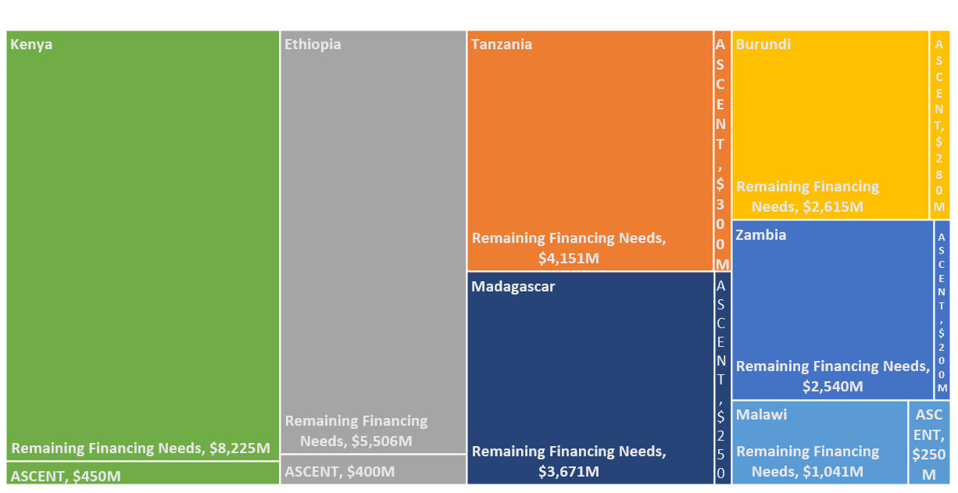
National Compact Financing Needs for Electricity and Clean Cooking Access (USD million)
Achieving Results Faster, Together

Slide 25

Thank you!
Achieving Results Faster, Together

Slide 26
Achieving Results Faster, Together

