Slide 1





Day 2
Session E.4
Authorization
Achieving Results Faster, Together

Slide 2



Session Outline
What’s authorization?
Why a country may want to issue authorization?
How to decide on authorization?
How to process authorization?
Achieving Results Faster, Together

Slide 3
Authorization
Corresponding Adjustment
Internationally Transferred Mitigation Outcomes
Nationally Determined Contribution
Achieving Results Faster, Together

Slide 4

An Analogy
NDC
Inventory
Authorization
Achieving Results Faster, Together

Slide 5
What is Authorization?
A host Party's formal decision
to allow mitigation outcomes to be transferred internationally
and used for achieving another Party's NDC
or other int’l mitigation purposes.
Achieving Results Faster, Together
Source: UNDP HICM Toolkit

Slide 6




Carbon credits can be authorized
Demand source determines whether authorization is needed
Not ITMOs
Not governed by Article 6.2 rules
Carbon credit mechanisms
ITMOs
Must comply with rules of Article 6.2
Approved, but not authorized
Approved and Article 6.2 authorized
Results-based climate finance
Mitigation contributions
Voluntary market: net zero commitments
Paris Agreement Crediting Mechanism (A6.4)
Compliance Market: Buyer NDC, CORSIA
Voluntary market: net zero commitments
National/Bilateral Crediting Mechanisms
Japan Joint Crediting Mechanism (JCM), Standardized Crediting Framework
Independent crediting mechanisms

Slide 7
Why authorize?
Higher Price
Achieving Results Faster, Together

Slide 8



Implications of Authorization
2
These ITMOs are purchased by Country B
3
Actual GHG emissions (150k)
ITMO transfer (50k)
Acquiring Party subtracts
the 50,000tCO₂e from its national inventory
Emissions balance
for NDC (100k)
ITMO
COUNTRY B
$
50,000tCO₂e
4
ITMO transfer (50k)
Emissions balance
for NDC (120k)
1
Country A authorizes these 50,000tCO₂e as ITMOs.
Courtny A adds 50,000tCO₂e
back to its inventory
Actual GHG emissions (70k)
Country A
Achieving Results Faster, Together
Adapted from: GGGI, 2023: Implementing Article 6 of the Paris Agreement: Options for governance frameworks for host countries

Slide 9


Should I authorize?
  Greater potential demand (given diversity of uses such as CORSIA and NDC compliance) and higher prices
Lower risk of NDC attainment and reputational risks

Slide 10




Which activities / sectors should I authorize?
Whether it is inside / outside NDC as well as conditional and unconditional NDC
Cost of mitigation
Underlying technology
Potential sustainable development benefits
Marginal abatement cost curves, technology needs assessments, sectoral development plans and Long-term emissions development strategies are some tools to help refine the scope of activities that can be considered for authorization.

Slide 11
How should I manage overselling risk?
Positive List
Intervention Basis (Qualitative)
Negative List
Cap on Transfers
Transfer Volume Basis (Quantitative)
Limited Crediting Period
Portion of MOs as Buffer
Pricing Options
Corresponding Adjustment Fee

Slide 12
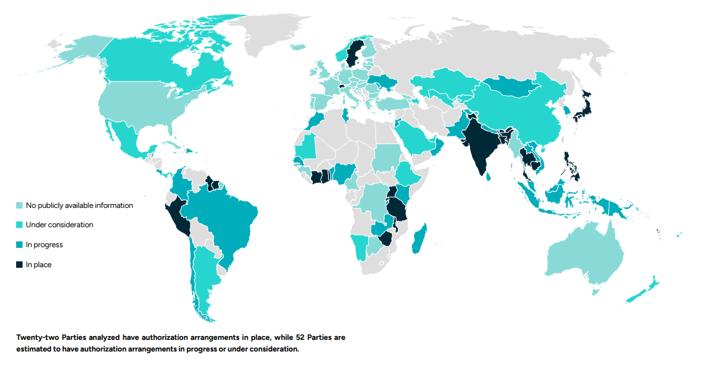
Countries are are putting authorization arrangements in place
Source: Article 6 Implementation Status Report 2025

Slide 13
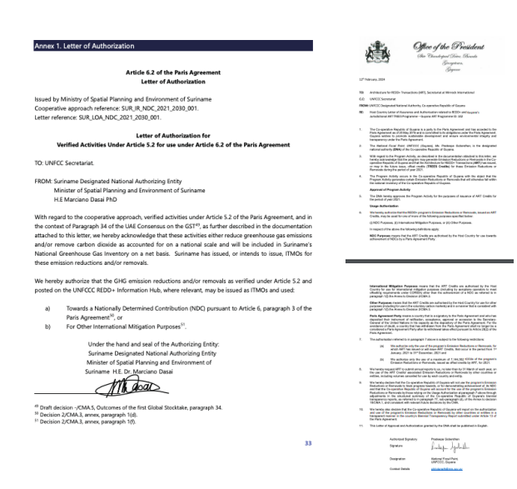
Authorization Templates
Parties can use either the UNFCCC template or their own as long as the letter contains the mandatory information stipulated

Slide 14
Interactive Discussion
Achieving Results Faster, Together

Slide 15
Authorization readiness
Has your country published a template and have a process for the issuance of letter of approval (yes, no, don’t know)?
In your country, which Ministries/entities will be involved in process and decision to authorize energy access programs such as the ASCENT Carbon Program?
In your country, do you have a registry to accommodate the authorization?
Achieving Results Faster, Together

Slide 16
Authorization readiness
How would you rate the probability of your country being able to authorize the ASCENT Carbon Program?
(High-Medium-Low- don’t know)
What are expected to be the key challenges in securing approval and authorization for ASCENT Carbon project?
What could we help address the challenges?
Achieving Results Faster, Together

Slide 17

Thank you!
Achieving Results Faster, Together

